Slide 1
CEEDAR Center Cross-State Convening
June 27, 2017
Michigan Department of Education
Office of Special Education

Slide 2
Engaging Questions
Turn to the person next to you and answer the following question:
  Does your state currently have an aligned statewide system?

Slide 3
Session Goal
Inform participates of the process Michigan is using to create a cohesive State Education Agency while supporting an aligned system at all levels.

Slide 4
Michigan’s Education Structure
USED
56 Intermediate School Districts
900+ Local Education Agencies
MDE
ISD
LEA
Classrooms/ Kids

Slide 5
Context Questions
What are the essential steps in creating an aligned statewide system?
What are the barriers and opportunities for sustainability of a new system?

Slide 6
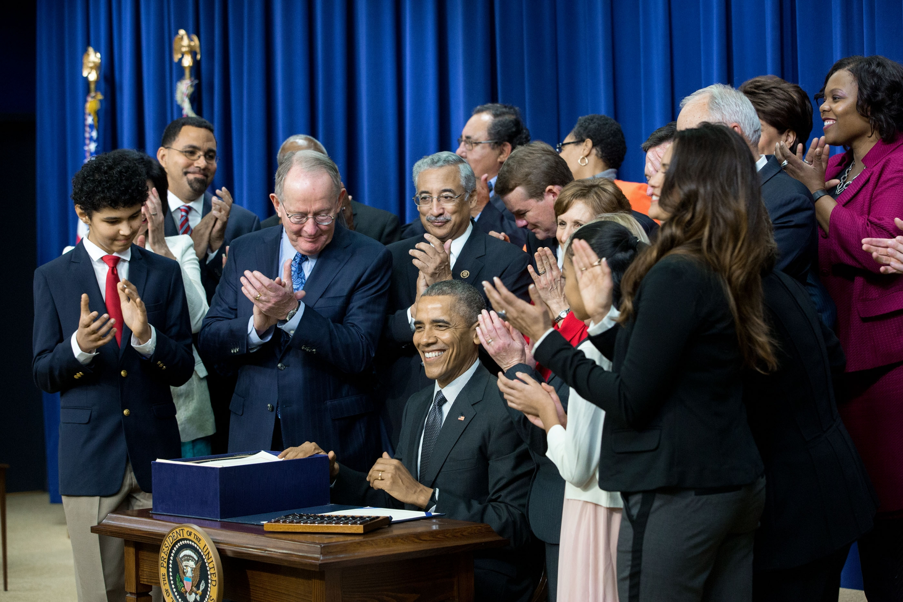
THE EVERY STUDENT SUCCEEDS ACT
ESSA, signed on December 15, 2015, builds on our progress and solidifies many of the reforms the Department has championed for the last 7 years.

Slide 7



Michigan’s Approach to ESSA

Slide 8
ESSA Plan Development Process

Slide 9
Working Toward Convergence:
ESSA, SSIP, SISEP, CEEDAR Center and the Top 10 in 10
Building a System to Improve
Learner Outcomes

Slide 10



Conceptual Framework for Improving Results for Children
Building Capacity
Coherent Infrastructure
Quality
Data
Improved
Learner Outcomes
Supporting Improvement
Effective Practices

Slide 11




State Systemic Improvement Plan
Data & Infrastructure Analysis
that
guided selection of coherent improvement strategies
to
increase the State’s capacity to lead meaningful change with Local Educational Agencies (LEAs)
to
improve results for ALL children.

Slide 12
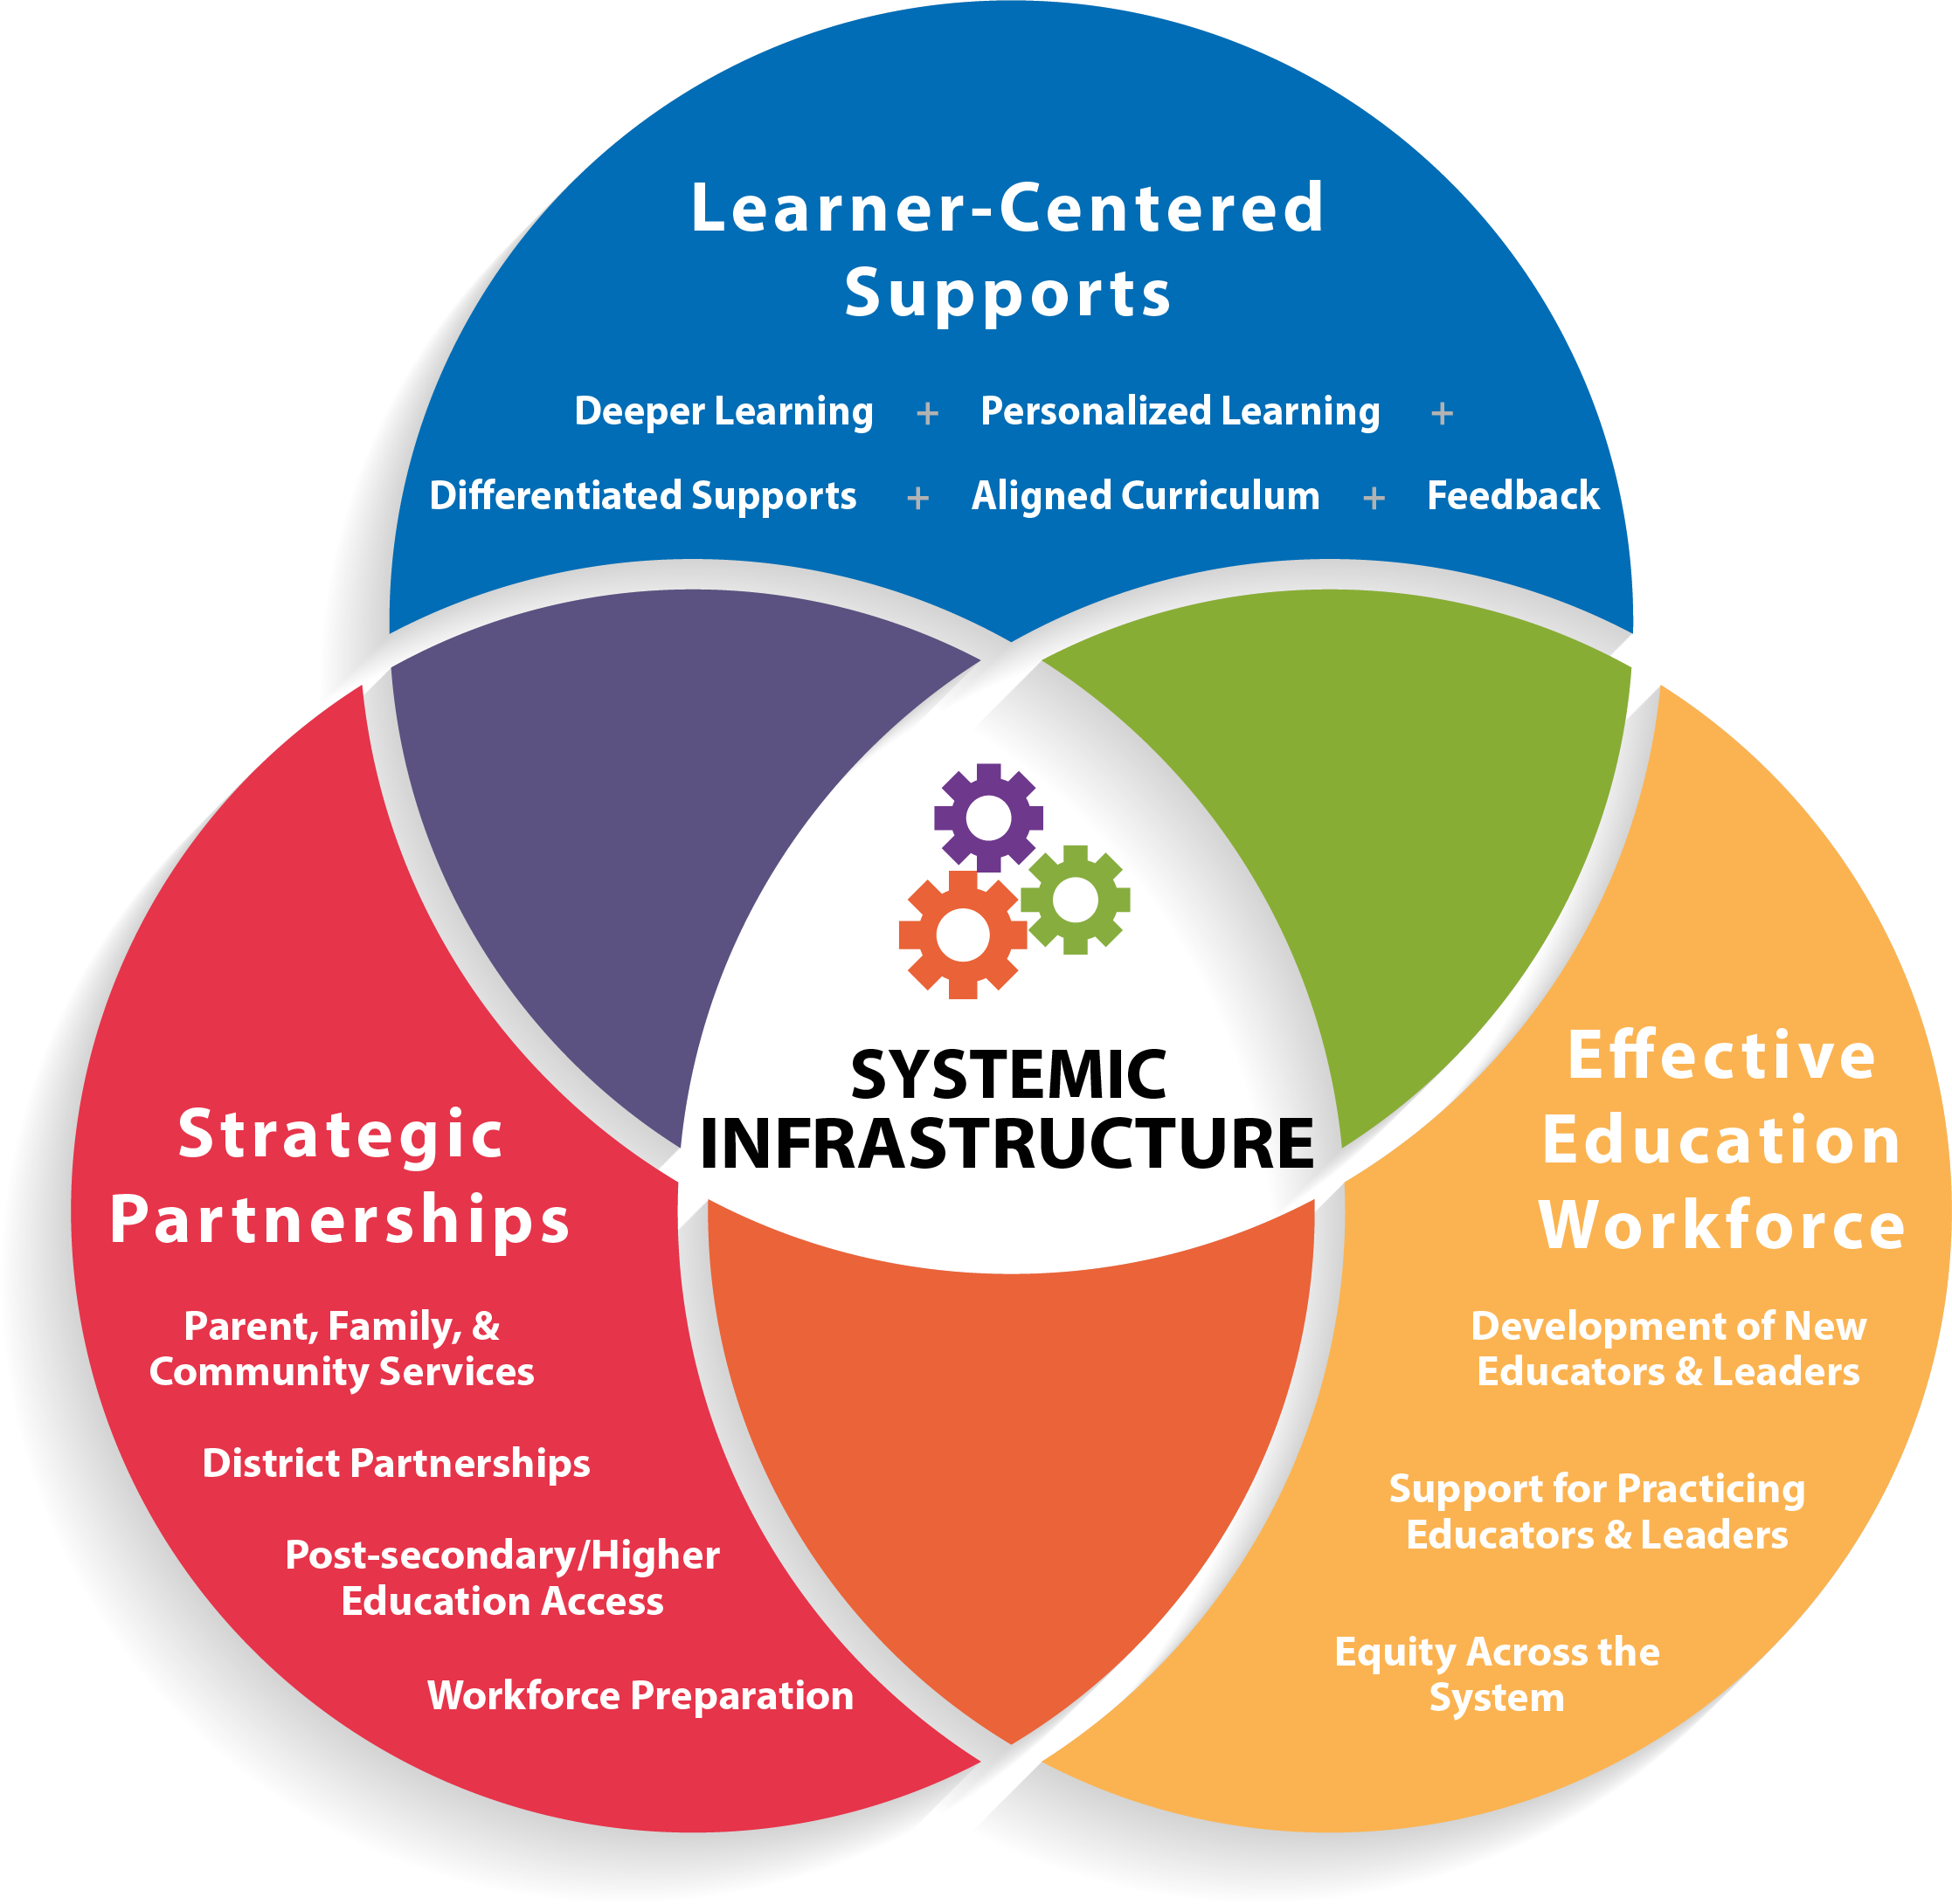

Focus Areas
Components
Notes:
1. Talk about the past, present and future of the 10 &10 plan.
a. Explain how the 10 & 10 came about, who was involved and how it was disseminated to the state.
b. Discuss the roadblocks and how long it took the state to complete the 10&10 vision.
2. Provide ample time for the group to ask for clarification and share ideas. This conversation will be continued during the facilitated discussion.

Slide 13
Formula for Success
State Implementation & Scaling-up of Evidence-based Practices (SISEP)
Effective
Innovation
Effective
Implementation
Methods
Enabling
Contexts
X
X
Educationally
Significant
Outcomes
=
Notes:
Too often, effective programs are not implemented as intended, not sustained, or not used on a sufficient scale to impact all learners. This is known as the implementation gap.
In order for all learners to benefit, we must support both WHAT innovations have been selected and the implementation strategies that ensure HOW to do it. Students cannot benefit from innovations they do not experience. Not only do we need effective programs, we need effective implementation strategies to make sure WHAT we are trying to do is actually put into practice and used as intended.

Slide 14
Michigan’s Blueprint

Slide 15
Michigan’s Blueprint
Goal 1:
Disseminate the state vision, findings and recommendations about literacy instruction, and the state’s goals and objectives to address the identified needs of struggling learners.
Goal 2:
Define evidence-based practices in literacy instruction for struggling learners K-3 within an MTSS model and link educators’ access to the resources.

Slide 16
Michigan’s Blueprint
Goal 3:
Review the certification structure and standards for teachers and school leaders (general and special education) and make recommendations for future revisions.
Goal 4:
Review the educator program approval process to ensure alignment with the State Board of Education Standards and ongoing program approval process. Align ongoing program approval with CAEP standards and processes.

Slide 17

MDE Collaboration with Four State universities:
Western Michigan University
Northern Michigan University
Grand Valley State University
Siena Heights University

Slide 18
Additional Collaboratives:
Office of Special Education
Office of Professional Preparation
Office of Great Start
Michigan’s Integrated Behavior and Learning Support Initiative (MIBLSI)
Governor’s 3rd Grade Literacy Commission

Slide 19
Facilitated Discussion
Discussion Activity:
  Each participant has approximately five minutes to jot down pros on one color sticky notes and cons on another color sticky regarding implementing a statewide initiative.
  On chart paper, organize the sticky notes into pros and cons
  Brainstorm together how to address the cons/issues.

Slide 20
Facilitated Discussion
Break into two small groups,
  Those who have statewide initiatives
  Those who have NO statewide initiatives
    Each group discusses next steps

Slide 21
Co-constructing improved outcomes for KIDS!
The bigger the challenge, the bigger the opportunity.

Slide 22
Closing Connections
Take a few minutes:
  Write down, what is important to share with your team that helps your context, lessons learned or things to avoid
  Think about networking. Who should you connect with later/ when and what should you follow up?

Slide 23
Overall Outcome
Thoughtful and intentional design for:
Scale-Up
Sustainability
  To reduce gaps and overlaps across and throughout the department in a coordinated and aligned approach to support improved district and student level outcomes

Slide 24
Contact Us!
Michigan Department of Education
Office of Special Education
Teri L. Chapman, Director
chapmant2@michigan.gov
517-335-0455
wecksteinj@michigan.gov
517-241-4521
Joanne Winkelman, Supervisor
winkelmanj@michigan.gov
517-335-0457
Janis Weckstein, Assistant Director

