Slide 1
Strategies for Going BIGGER

Slide 2
Georgia CEEDAR
Dr. Gregory Blalock
Columbus State University
Dr. Sheryl Cowart Moss
Georgia State University
Dr. Karen J. Wyler
Georgia Department of Education

Slide 3
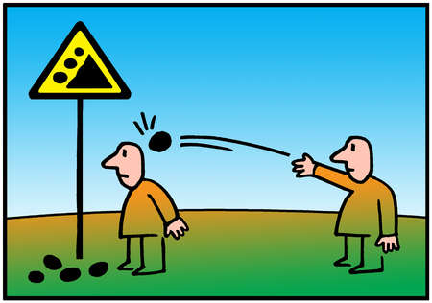
Are we shooting arrows?
Or, are we throwing rocks?
Notes:
Power of alignment….aligning the Georgia Ceedar Work to Georgia’s Major Initiatives: NTEP, Equity, ESSA, SSIP

Slide 4
Policy Lever Areas
NEXT STEPS:
Teacher and Leader Preparation
Licensure Certification
Preparation Program Evaluation/Program Approval
Notes:
Share briefly accomplishments

Slide 5
Georgia Accomplishments
Induction Plan
Syllabi Review by EPPs
Program Revisions
Alignment and Communication of the Work
Technical Assistance Modules to Support GaPSC EPPs in Data Usage

Slide 6
Table Talk - Accomplishments
Share briefly at your table your state’s accomplishments.
Be prepared to report out whole group.

Slide 7
Communicating → Interest
Focus on you current landscape…
Georgia Professional Standards Commission
Georgia Department of Education
University System Board of Regents
University System Dean’s Conference
Georgia Induction Summit
Professional Organizations
P-20 Collaboratives
Various Stakeholder Conferences
Web Presence

Slide 8
Table Talk
What are the groups, agencies, organizations exist in your state?
How can you leverage these groups to move your work forward?

Slide 9
Georgia’s Vision
Teacher/Leader Preparation
Certification/Licensure
Program Evaluation
Notes:
Read or paraphrase mission statement.

Slide 10
How do we approach teacher and leader program reform?
Evidence based practices
Review/revision of our programs
Scale up for Collaboration
Talk to our stakeholders
Review our syllabi
Revise our programs
Share the work
Mentor others
Continue the work
CEEDAR resources
Review our data
Talk to our own experts
CEEDAR support for review, revisions, and results

Slide 11
Who will carry out the work?
CEEDAR Representatives
State Leadership Team
Associate Dean
Assessment and Accreditation Committee
Content
Who are the players in your state?

Slide 12
What needs do we have based on:
Data
Our Mission
State and National Accreditation
Our political climate

Slide 13
How can existing college/university structures (e.g. Assessment & Accreditation Committee) begin the conversation ?
Identification of
KEY AREAS of Interest
Subtitle
Alignment to Modules
Classroom Management & Community Building
Culturally Responsive Pedagogy
Technology
Assessment
Reading/Academic Language
Universal Design for Learning
Align KEY AREAS of interest with CEEDAR modules
Access resources

Slide 14
SUPPORT – FOLLOW UP YEAR
After you have defined your process, plan for targeted follow-up in the next year.
Continue to tie the work to what your data is telling you and to what you already have in place
Look for venues to share your accomplishments
Communicate your mission consistently, concisely and in context for the targeted audience

Slide 15
Where are we headed in Georgia?
Documenting changes
Sharing our work with others (Cohort II)
Maintaining Momentum while scaling up
Developing a formalized mentoring program for our state
Targeted training for policy makers, part-time instructors, P-20 partners
Branding and empowering the state leadership team

Slide 16
Table Talk
What are your goals for sustainability?
Who are the players you need at your institution? On your leadership team?
What data do you have that can guide your process?
How can you engage the key players?

Slide 17
Dr. Karen Wyler
KWyler@doe.k12.ga.us
Dr. Sheryl Cowart Moss
Smoss13@gsu.edu

