Slide 1





Developing Quality Fieldwork Experiences for Teacher Candidates:
A Planning Guide for Educator Preparation Programs and District Partners
Council for Exceptional Children (CEC) Conference
April 21, 2017
H325A120003

Slide 2
Presenters
Suzanne Robinson
University of Kansas, CEEDAR Facilitator smrobins@ku.edu
Georgette Nemr
Connecticut State Department of Education georgette.nemr@ct.gov
Joan Nicoll-Senft
Central Connecticut State University joan.nicoll-senft@ccsu.edu
Louise Spear-Swerling
Southern Connecticut State University spearswerll1@southernct.edu
H325A120003
Notes:
In light of many of these difficulties, CEEDAR was developed as a response.

Slide 3
Disclaimer
This content was produced under U.S. Department of Education, Office of Special Education Programs, Award No. H325A120003. Bonnie Jones and David Guardino serve as the project officers. The views expressed herein do not necessarily represent the positions or polices of the U.S. Department of Education. No official endorsement by the U.S. Department of Education of any product, commodity, service, or enterprise mentioned in this website is intended or should be inferred.

Slide 4
Our Journey
The CSDE together with Central and Southern Connecticut State Universities embarked on the CEEDAR journey in 2014, initially to look at curricular reform focused on EBPs.
On that journey, we identified another need – to focus on clinical experiences. Faculty team leaders together with a few key district partners began to the quality of clinical experiences discuss relative to teaching standards/outcomes.
However, as this conversation developed, we all realized that there was a need for articulating the “what” and the “how” that EPPs and candidates SHOULD be doing in their clinical experiences to ensure that we prepare “learner ready day one” teachers.
Notes:
Georgette

Slide 5
Our Journey Part 2
The district partners raised serious concerns about not knowing:
what the learning outcome of the experience is
where it falls within the program
whether the candidate can answer the “why” question about that experience
why candidates were contacting district representatives directly at the school or district level to arrange for their own clinical experiences for “their course,” rather than the school of education contacting the designated district level administrator
Bottom Line: District partners were not included in the EPP design and communication of clinical experiences from beginning to end of the program.
Notes:
Georgette

Slide 6
Principles For Guiding Design of Clinical Experiences
Teacher preparation is a shared responsibility
Collaboration among professionals in the field improves preparation experiences and benefits teacher candidates
Practice-based preparation improves teacher candidates’ readiness
Practice experiences should occur throughout a preparation program, from beginning coursework to culminating student teaching.
Practice experiences are scaffolded carefully and thoughtfully to facilitate the development of confidence and success of teacher candidates in addressing varied student needs.
Practice experiences are designed based on research
Experiences are intended to be responsive to community and cultural contexts
EPP improvement is iterative and ongoing
Reference: page 7-8 of the Guide.
Notes:
Suzanne
We developed principles to guide our conceptualization of partnership for Educator Preparation
The first two principles focus on the importance of collaboration
Acknowledges the important role of preparation providers AND local school district personnel in preparing an effective workforce.
And that true partnership will improve the experiences for teacher candidates in substantive ways. (Examples: technology found in school to support student learning, teaching within curricula or programs that schools have adopted, use of progress monitoring systems, etc.)
The next four principles focus on the important role of practice in preparation and how important it is to thoughtfully plan practice – fieldwork experiences - that is sequenced and of sufficient challenge at particular moments in time – the literature talks very specifically about this concept of deliberate practice.
3-5
Then 7 focuses on the importance of community and context in planning practice experiences
Finally, improvement in iterative and ongoing. Needs change, relationships with districts change, new partners come into the educator preparation sphere.

Slide 7
Practice
… Is essential to demonstrating, improving and mastering specific techniques for all performance-based professions (medicine, plumbing, cosmetology, the law).
Based on research from psychology, neuroscience, sports, and other disciplines … deliberate practice is defined as carefully sequenced and calibrated practice that builds on one’s current knowledge and skill in conjunction with performance feedback.
(Ericsson, 2014, Ericsson, Krampe, & Tesch-Romer, 1993)
Notes:
Suzanne
SO this guidance document is explicit in defining the practice activities that make a different
On this slide we emphasize our understanding of practice and how we think about it within the context of developing fieldwork experiences.

Slide 8
Where We Started
Scaffolding evidence/practice based strategies for beginning, middle and end of program
Articulating roles and responsibilities for EPP and LEA
Identifying effective examples of those strategies used by our programs in clinical experiences
Notes:
Georgette

Slide 9
Why a guidance document?
Improve how fieldwork is conceptualized and implemented (Problem of practice: too much observing, not linked to courses, not scaffolded, etc.)
Design coherent program-wide clinical experience (rather than course-based disconnected experiences)
Ensure transparency of field experiences learning and practice outcomes responsibilities of LEAs.
Articulate for LEAs cost/benefits of partnership in fieldwork at every stage (beginning experiences through student teaching).
Use of intentional strategies and tools by all role-players engaging in practice-based experiences leading candidates to learn how to analyze and implement teaching and learning.
Notes:
Georgette

Slide 10
CEEDAR Documents Informing our Work
Note. See the CEEDAR and GTL practice guides:
Learning to Teach: Practice-Based Preparation in Teacher Education (Benedict, Holdheide, Brownell, & Foley, 2016) and
Learning to Teach: A Framework for Crafting High-Quality, Practice Based Preparation (Benedict, Foley, Holdheide, Brownell, & Kamman, 2016) for more information on evidence-based practice strategies and the research supporting their inclusion in this table.
Notes:
Suzanne
Concurrent with our work, other CEEDAR folks were working on documents specifying effective evidence-based practice approaches that we used in our work.
The first document describes a range of practice approaches.
The second document in a rubric for examining the practice opportunities provided in a program.

Slide 11
Organization of Evidence-Based Practice Strategies
Evidence-Based Strategies | Course work | Field work | Student Teaching
Case-study instruction | X
Microteaching | X
Virtual simulations | X
Video analysis |  | X
Tutoring |  | X
Lesson study |  | X
Coaching |  | X | X
Action/practitioner research |  | X | X
Practice in complex classroom contexts |  |  | X
Notes:
Suzanne, Georgette to add
One lens we used was to determine which practice activities were most effective within coursework, or within fieldwork, or within student teaching because these are the learning structures we find in most educator preparation programs.
Discuss each briefly.

Slide 12
Beginning Experiences: Ensure appropriate scaffolding of the practice-based opportunities and field experience strategies across semesters or courses to ensure both knowledge and skill development as candidates begin their preparation experience.
Notes:
Suzanne,
Another lens we used was how the learner (teacher candidate) lives and experiences their developing proficiency as a teacher. So it is organize temporally and makes recommendations about the potential roles and responsibilities of the EPP and school-based educators at each stage of the teacher candidate’s development from novice to proficiency, to the Day 1 educators schools need.
These are screen shots from our guidance document; it is not intended that you are able to read all of the text. You can go to our guidance document for that. Important are the headings (Beginning, Middle, and End)
Slides 13-15 Beginning, Middle, and End of program experiences helps faculty think about the candidate experiences the program. Are the experiences coherent in content and pedagogy. Don’t want the faculty to lose sight of the “lived experience” of the candidate.
Focus on the strategies best utilized at 3 points within/across the program.
Consider whether clinical experiences should be course-based versus semester/program based (shared by multiple courses/faculty).
Consider the roles and responsibilities by strategy of EPP faculty and school-based educator
Georgette Guided Observation strategy and the workgroup discussions about this.

Slide 13
Mid-Program Experiences: Plan knowledge development and field experiences to build on prior knowledge developed earlier in the program and increase complexity in experiences.
Notes:
Suzanne,
Charts in Slides 13-15 are screen shots from the Clinical Experience Document and just want to give participants today a visual.

Slide 14
End of Program Experiences: Plan field experiences, practica, and student teaching that allow candidates to experience the full complexity of teaching diverse students representing varied communities and needs.
Notes:
Suzanne

Slide 15
Planning Template
Two university examples of how this template can be used are contained in Appendix H & I
Notes:
Suzanne to introduce, Georgette to weigh in
We created a planning template for the EPP planning teams to use so that they could map fieldwork experiences across semesters, particular courses or multiple courses, with signature assessments, tools, and responsibilities identified.

Slide 16
Practice Based Strategies: Tools Highlighted
Sample Grade 3–5 English Language Arts Observation Guide
Sample Video Analysis Assessment Guide
Sample Tutoring Guide
Lesson Study Protocols
Observation/Coaching Guide for School-Based Practitioners
Notes:
Georgette

Slide 17
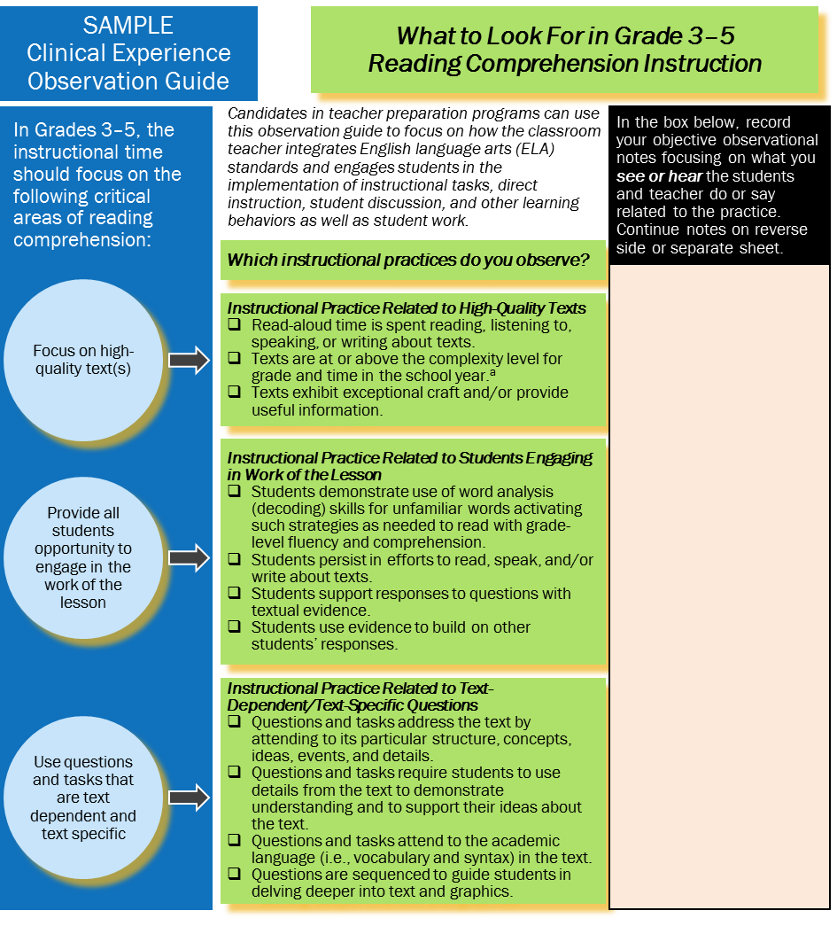
Notes:
Georgette

Slide 18
Tutoring Guide
Notes:
Georgette

Slide 19
Tutoring
Examples from undergraduate special education program
Two parallel courses with embedded supervised tutoring
  SED 365 Math and 435 Reading
Course content knowledge addressed first 7-8 weeks, tutoring follows in next 7-8 weeks
Formative assessments
In-class practice with a peer

Slide 20
Tutoring: High Leverage Practices Used
Explaining/modeling important content and skills
Diagnosing common student errors
Adjusting instruction during lessons
Designing sequences of lessons
Providing effective oral feedback
Analyzing instruction for the purpose of improving it

Slide 21
Tutoring: Practice Based Preparation Strategies Used
Spaced learning
Explicit coaching and feedback (course instructor to candidates)
Modeling (course instructor to candidates)
Scaffolding candidate responsibilities over time
Analyzing and reflecting on lessons

Slide 22
Tutoring: Benefits
Ensures high coherence between course content learning and clinical experience
Makes content learning more meaningful for candidates
Improves candidate ability to use high-leverage teaching practices such as modeling, providing students effective feedback, etc.

Slide 23
Video Analysis:
Overview
Scaffolded analysis of teaching
Aligned with edTPA and CT’s Common Core of Teaching (CCT)
Completed semester prior to student teaching
Video segments shared during seminar class, assessed by instructor, student, and peer(s)

Slide 24
Video Analysis:
Components
Lesson plan
Two video segments:
  10-minute video segment in which TC is instructing a literacy or language objective in their discipline
  5-minute video segment in which students in the field placement classroom are using literacy and language to support content learning
Written reflection on the teaching and viewing experience (what, so what, now what)
Rubric scored (reflection only)

Slide 25
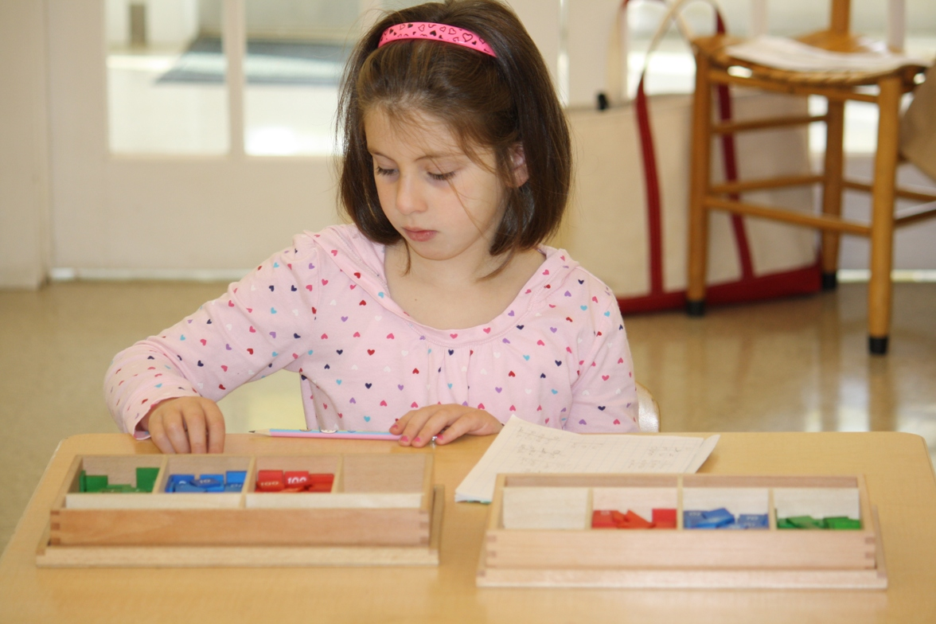


Video Analysis:
Three Lenses
Lens 1: The Students
  What opportunities were created for students to make sense of the new learning?
  How did students show what they learned?
  What are students’ specific learning needs?
Lens 2: The Teacher Candidate
  How did the candidate share responsibility with students for learning?
  How did questions lead students to learn?
  What supports were provided to deepen learning or scaffold students who were struggling?
Lens 3: The Learning Environment
  Preparing the learning environment to support learning?
  Creating an environment of mutual respect and rapport with the students?
  Communicating standards of behavior?

Slide 26
Video Analysis:
Lessons learned
Little/no need for borrowed equipment
Importance of scaffolding
Alignment to edTPA & SEED
Currently expanding on assignment to assess lesson planning and implementation

Slide 27
Considerations for Designing and Implementing Field Experiences
We propose five critical components of designing and implementing field experiences, including roles and responsibilities, between the EPP and LEA:
Design of field experiences across planned programs
Development of specific field experiences
Coordination of shared responsibility
Communication
Professional learning and calibration of faculty and school-based educators.
See Table 3 in the Guide
Notes:
Georgette

Slide 28
Developing Shared Partnerships
Win-win for both sides to collaborate in order to secure the teacher pipeline as well as ensure learner ready day one teachers. Must address the cost/benefit to all parties most importantly the investment of TIME.
Quality indicators for consideration in partnership development (King, 2014) can be grouped within the following categories:
Partnership vision
Institutional leadership
Communication and collaboration
Joint ownership and accountability for results
System alignment, integration, and sustainability
Response to local context
Notes:
Suzanne
We believe that shared and informed planning and decision making among preparation faculty and supervisors from EPPs and school-based educators about teacher preparation experiences will benefit teacher candidates. The Council for Accreditation of Educator Preparation (CAEP) Standard 2 (2015, para. 7) states the following expectations for EPP and LEA partnerships on clinical experiences:
2.3 The provider [Educator Preparation Program] works with [School-Based] partners to design clinical experiences of sufficient depth, breadth, diversity, coherence, and duration to ensure that candidates demonstrate their developing effectiveness and positive impact on all students’ learning and development. Clinical experiences, including technology-enhanced learning opportunities, are structured to have multiple performance-based assessments at key points within the program to demonstrate candidates’ development of the knowledge, skills, and professional dispositions, as delineated in Standard 1, that are associated with a positive impact on the learning and development of all P–12 students.

Slide 29
In Closing
Establish a representative workgroup of faculty and district partners
Review sequence, coherence, course vs. semester based clinical experiences and substantive engagement in the work of the classroom
Identify shared goals and accountability measures between EPP and LEA to ensure quality and communication, without overburdening the parties
Consider program evaluation measures of impact on candidate performance
Notes:
Georgette

Slide 30
Q & A
Notes:
Suzanne

Slide 31

Thank You

