Slide 1
Essential Components of Reading Instruction K–5
Part 3.2: Phonological and
Phonemic Awareness
Notes:
Part 2: Phonological and Phonemic Awareness
Materials Needed for Part 2:
1. Handouts:
3.2A Say it and Move it Activity
3.2B Curriculum Map: Kdg. Phonemic Awareness
https://dibels.uoregon.edu/assessment/dibels/cmaps/
3.2C Grab a Group Activity
3.2D Features of Effective Instruction: Guide to Video
3.2E Phonological Awareness Assessments
3.2F Phonological Awareness Quiz
3.2G: Phonemic Awareness Activity Cards
1. Costume rabbit ears
2. Four tokens or coins per participant
3. Two videos:
1. Phonological Awareness and Word Play (Duration: 4:00)
http://buildingrti.utexas.org/videos/phonological-awareness-word-play
2. 3-tier Reading Model Reading Intervention: Tier II (First 11 minutes)
http://resources.buildingrti.utexas.org/CAP/Tier_II_Reading/multiscreen.html

Slide 2
Phonemic Awareness
The ability to hear, identify, and manipulate individual sounds—phonemes—in spoken words.
Part of the phonological awareness umbrella.
Al Otaiba, Kosanovich, & Torgesen,2012;Ehri, 2001; Torgesen & Mathes, 2000; Uhry, 2011
Notes:
Instructor: Put on rabbit ears! Phonological awareness, which includes phonemic awareness, involves listening (note the big ears). Phonological awareness is not associated with printed language. Most children intuitively understand phonological awareness by age 3 or 4. Phonological awareness consists of several skills.
Everyone, hold up your hand. Bend it at the wrist. You are making an umbrella with your hand. Each finger represents a stay in that umbrella. The back of your hand is phonological awareness, the all-encompassing concept. Each stay of the umbrella (or finger on your hand) represents one aspect of phonological awareness. Your thumb is the easiest concept for children to learn: rhyming and alliteration. Next is sentence segmentation, then syllable segmentation, onset-rime blending and segmentation, and finally, phonemic blending, segmenting, and manipulation.
Raise your hand if you speak a foreign language. Anyone speak a language other than Spanish? I want to provide you an example of these skills in a language you do not know well. Ask a participant to think of a few phrases to say quickly in another language. You will ask him/her to say the sentences, quickly, in a few minutes.
Phonological processing is the all-encompassing term that includes phonological awareness and phonemic awareness. Phonological processing also includes other areas such as verbal short-term memory, rapid serial naming, and articulation speed. If students have difficulty learning phonemic awareness, it could be because of difficulty in these other areas. The general education reading teacher may need support from a reading or speech and language specialist to address difficulties in these discrete skills.

Slide 3
PA begins with listening
©2009 University of Texas System/Texas Education Agency
Notes:
Phonological awareness is developed by listening; no print is involved. This does not mean you do not read to your students and show them print. But when you teach phonemic awareness, students must concentrate on what they are hearing, not on the print. After children understand the concept of phonemic awareness and can blend and segment three to four phoneme words, they can begin to learn to match the sounds to the printed letters.

Slide 4
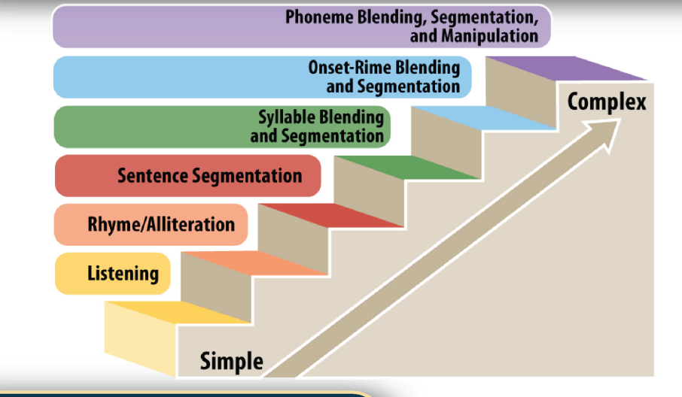
Phonological Awareness Continuum
©2009 University of Texas System/Texas Education Agency
Notes:
Let’s review the phonological awareness continuum. Note that there are multiple levels of phonological awareness, starting with basic listening skills and being able to distinguish between a dog barking and a door slamming. The next concept most children learn is rhyme/alliteration, usually by age 3. That is your thumb as it is the biggest and easiest to learn skill. Next is sentence segmentation—knowing where one word ends and another begins in a sentence. Children should be able to clap for each word in a sentence, for example.
Call on the participant who agreed to say a few sentences in another language. Thank you for demonstrating this for us. Please go ahead and say your sentences, quickly, as you would in typical speech. Everyone else, count the number of words she says. Participant says sentences. Most others will not be able to count the words. Just as we had trouble knowing where one word stopped and another started, that is how some children feel when they hear English, even when it is their first language.
The skill is followed by syllable blending and segmentation (cow+boy = cowboy; homework without work is home).
Onset-rime is taught with one syllable words. The initial consonant is the onset and the vowel and rest of the word is the rime. For example, in the word cat, the onset is /c/ and the rime is at. Onset-Rime: Say the word shake. What is the beginning sound? Yes, /sh/ (a diagraph). What is the rime? Yes /ake/, the vowel and consonant following the onset.
Examples of blending and segmenting: Everyone, listen to the sounds I say. /sh/ /a/ /k/, What word? Yes, shake. Say the word shake. What sounds do you hear? (using your left hand, hold up a finger for each sound). /sh/ /a/ /k/. Three sounds. What word? Yes, shake!
The most difficult concept to learn, and the one most necessary to become an efficient reader, is phonemic awareness. This is the ability to differentiate a sequence of sounds into individual phonemes. There are three phonemes in cat are /c/ /a/ /t/; four in fix /f/ /i/ /ek/ /s/ and three in ball /b/ /a/ /l/. For some children, developing phonological awareness is a challenge. Because it is a precursor to efficient reading, teachers need to know how to assess and teach phonological awareness, and especially phonemic awareness.

Slide 5
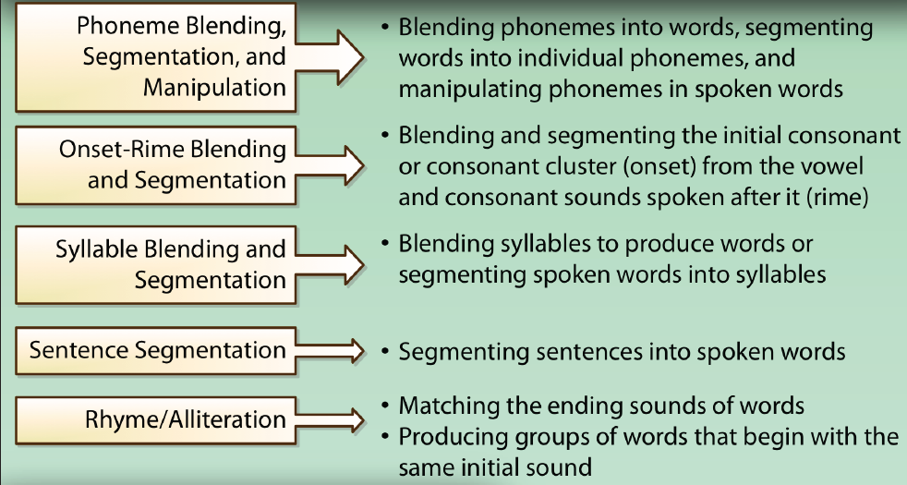
Another View of the Phonological Awareness Continuum
©2009 University of Texas System/Texas Education Agency
Notes:
Partners, take turns whisper reading each of these definitions. Together, think of at least two examples of each.

Slide 6
Phonological Awareness Continuum
As you watch, note:
Activities for each level.
Phonological awareness in Spanish.
The connection of sounds to letters.
Notes:
Video: Phonological Awareness and Word Play
http://buildingrti.utexas.org/videos/phonological-awareness-word-play (duration 4:48) Used by permission of Meadows Center for Preventing Education Risk (2002).
Let’s watch a video of teachers providing phonological instruction.
After the video, provide time for a discussion of each item on the slide.
Turn to your partner: Discuss what Dr. Chard meant by the “quick integration of letters and sounds.” What does this mean for teachers?
Ask participants to retrieve Handout 3.2 B: Curriculum Map: Phonemic Awareness Continuum. Give the participants a few moments to review it.

Slide 7
PA Continuum
Student has difficulty . . .
Blending phonemes into a whole word.
Telling which word is different.
Identifying medial sound.
Substituting individual sounds.
Notes:
The slide indicates the area of difficulty four students are experiencing. With your partner, determine what skills each student needs to be taught. Provide 5 minutes for the partners to discuss. Sample answers are below.
#1: Student has trouble blending phonemes. Start with blending two separate phonemes. If that is too difficult, practice blending onset rimes.
#2. Telling which word is different in a group of three or more words. Be sure the student understands the concepts of same and different. Begin with discriminating different sounds such as a door opening and water running.
#3: Identifying medial sound. Be sure the student knows what medial means. Start with identifying the initial sound, then the final sound, and finally the middle sound.
#4. Substituting individual sounds: Start with deleting sounds—always say the sounds, not the letter names, and have students repeat the word. (Note: the student responses are in quotes.) The word is fat. What word? “fat” fat without the /f/ is:”at” Yes, at. Next word: nope.
What word? “nope” Nope without the /p/ is: “no” Yes, no. Then try: the word is fat. What word? “fat” Yes, fat. Take away the /f/ and put /s/. What word? “sat” Yes! Sat!

Slide 8
English Phonemes
26 letters.
44 phonemes.
98 phoneme-grapheme associations.
Vaughn & Linan-Thompson, 2004
Notes:
English has 26 letters, 44 phonemes (sounds), and 98 frequently recurring phoneme-grapheme associations or ways those 44 sounds are written. Some sounds have more than one spelling. For example, there are eight ways to spell the sound /a/ (long). Turn to your partner and see how many spellings for the long a sound you can think of.
As you obtain responses, write them on a board or chart paper in one column, labeled /a/. There are eight spellings: a as in baby; vowel=consonent=e as in bake; aigh as in straight; eigh as in eight; ay as in pay; ei as in veil; ai as in pail; and ea, which appears in only three English words: great, break, steak.

Slide 9
Phonemes
©2009 University of Texas System/Texas Education Agency
Notes:
Partner A: explain this slide to your partner.
Point out to the group that some phonemes are represented by two letters such as /sh/, which is represented by s and h in print. Other phonemes may be represented by one letter, such as /ks/, which is represented by x in print. Therefore, it is important that students learn to listen to the sounds in spoken words and not rely on counting letters in printed words to determine the number of phonemes.
Also, remind the group not to add a schwa sound when pronouncing the phonemes. It is /k/, not /kuh/ for the initial sound of cat. I do not have a black /kuh/ /a/ /tuh/. I have a black /k/ /a/ /t/. Cut or clip the sounds!

Slide 10
Important Points About Phonological Awareness
Ability to blend and segment phonemes predicts reading skills.
Phonological awareness can be taught.
Phonological awareness helps with spelling.
Direct, explicit instruction is essential for students.
Brady, 2011; Foorman & Torgesen, 2001
Notes:
Of all the concepts encompassed by the phonological awareness umbrella, the most important for students to master is to blend and segment phonemes. Typically, children master the concepts in the order we discussed, but sometimes students will not master rhyming until they begin to read. Students do not have to master all of the subsequent skills before you move to the higher level skills. You have to watch the children carefully and judge what to teach next. There is no need to spend all of kindergarten only on rhyming, for example, and never teaching the other skills. Teach them all, providing multiple opportunities to practice.
Phonemic awareness can be taught. Now, it is included in most reading series. Some students may need additional help in small groups or with a reading specialist.
Phonemic awareness helps with spelling. You can evaluate a student’s spelling and know if he/she has mastered this concept or not. Analyzing a student’s spelling is an excellent way to monitor their progress in phonemic awareness.
Direct, explicit instruction is essential for most children. There is no room to guess while learning the concept of phonemic awareness.

Slide 11
More Points About Phonological Awareness
instruction should be paired with letters as soon as students and segment and blend three phoneme words.
15-20 minutes of phonological awareness instruction a day is sufficient for most K-1 students.
Ehri et al., 2001; Ehri & Roberts, 2006; Foorman & Torgesen, 2001
Notes:
Most students master phonemic awareness by the end of kindergarten or the beginning of first grade. Note it does not take much instructional time, and the time can be distributed throughout the school day. Teaching PA in small groups is recommended so that you can hear each child’s response. Once the students master this concept, direct instruction is no longer required. You can review the concept when teaching spelling and other skills.

Slide 12
Mouth Pictures
Letters plus mouth pictures illustrating articulation improved learning.
Mouth with closed lips: /b/ /p/ /m/
Teeth touching lower lip: /f/ /v/
Mouth open & lips rounded: /o/
Ehri, 2014
Notes:
Research indicates that articulation training with mouth pictures improved children’s access to the motoric gestures configuring the phonemic representations of words in memory. (Ehri, 2014).
Therefore, be sure to demonstrate what your mouth is doing when you teach children the letter sounds. Provide them with mirrors (the safety type with a plastic edging) to watch their own mouths when making the discrete sounds.

Slide 13
Phonological, Phonemic, Phonics
Partner A: phonological awareness and phonics?
Partner B: phonemic awareness and phonological awareness?
Create “elevator” explanation of phonemic awareness.
Notes:
Monitor the answers discussed. Make sure the participants can articulate that phonemic awareness is one of the phonological awareness skills.
Partner A, explain to your partner the difference between phonological awareness and phonics.
Partner B, explain to A the difference between phonemic awareness and phonological awareness.
Together, form your elevator explanation about the importance of phonemic awareness
Phonological awareness is an awareness of units of speech such as words, syllables, and phonemes. It is important for the later development of the alphabetic principle.
Phonemic awareness is the awareness of the sequence of sounds in words. Phonemic awareness is necessary, but not sufficient, to learn to read and is the area in which most students with reading difficulties experience the most challenges.
Phonics is an instructional method that teaches the relationship of phonemes, sounds, to graphemes, letters. When students understand the concept of phonemic awareness, they will be better able to learn phonics and to decode words with automaticity.

Slide 14
Common Core State Standards Foundational Skills–Kdg
2. Demonstrate understanding of spoken words, syllables, and sounds (phonemes).
a. Recognize and produce rhyming words.
b. Count, pronounce, blend, and segment syllables in spoken words.
c. Blend and segment onsets and rimes of single-syllable spoken words.
d. Isolate and pronounce the initial, medial vowel, and final sounds (phonemes) in three-phoneme (consonant-vowel-consonant, or CVC) words.* (This does not include CVCs ending with /l/, /r/, or /x/.)
e. Add or substitute individual sounds (phonemes) in simple, one-syllable words to make new words.
Notes:
Read these standards with your partner. Jot down two or three concepts on which you have questions or would like more information. If you do not write anything down, I will assume you feel confident to define and teach these concepts (and I may ask you to do so).
Ask for partners to share one concept about which they are unsure. Discuss two to three of them and refer back to the presentation where the concepts were discussed.

Slide 15
Common Core State Standards Foundational Skills–Grade 1
2. Demonstrate understanding of spoken words, syllables, and sounds (phonemes).
a. Distinguish long from short vowel sounds in spoken single-syllable words.
b. Orally produce single-syllable words by blending sounds (phonemes), including consonant blends.
c. Isolate and pronounce initial, medial vowel, and final sounds (phonemes) in spoken single-syllable words.
d. Segment spoken single-syllable words into their complete sequence of individual sounds (phonemes).
Notes:
How do the first grade Common Core State Standards differ from kindergarten?

Slide 16
Practice and Application
Instructional Sequence
I Do (teacher models)
We Do (teacher and students)
You Do (students)
Notes:
We are going to practice several activities you can use with young students to teach and reinforce phonemic awareness.
It is best to do most of these activities in small groups of four to five students so that you are able to listen to each student’s response. While working with your small group, use an assessment measure to keep track of which tasks the students have mastered. There are several available and your core textbook may also have some. See examples of assessments in Handout 3.2E.
As we practice these activities, we will use the instructional sequence of “I do, We do, You do.” You will model the task, the students will practice it with your guidance, and the students will complete the task independently. Sometimes, the sequence is “I do, we do, we do, we do, we do, you do” to provide sufficient guided practice.
Please listen and do what I ask. Remember, phonemic awareness with young children initially does not involve print.

Slide 17
Say It and Move It
Say It and Move It
Blachman et al., 2000
Notes:
This activity is a version of the Elkonin boxes created to help students become aware of the phonemes in words. Daniil El’konin, a Russian psychologist, developed a strategy to teach young children the concept of phonemes. Children are presented with a picture of an object, or a spoken word, and asked to say the word and to represent each phoneme with a small tile that is moved into a square below the picture as each phoneme is pronounced. Others have incorporated pictures such as “Mrs. Magic Mouth” (Uhry & Goodman, 2009) in which tiles are pulled out of the mouth of a drawing of a face.
Blachman and colleagues (2000) created a “say it and move it” task that we will practice now.
Handout 3.2A has specific directions, but let’s try it now. Everyone should have three tokens or coins. Put them on the solid line on top. When I say a word, segment the word into phonemes and move one coin down for each phoneme. We will use the “I do it, We do it, You do it” instructional sequence.
First, I do it. The word is at. What word? Yes, at. /a/ /t/. So I am going to move one token to the line with the arrow as I say the sound /aaaaaaa/. What sound? Yes, /a/. What word? At. The last sound is /t/. Watch as I say /t/ and move a second token down. What are the sounds? /a/ /t/. Say it fast (swipe your finger under the sounds and say the word fast). What word? Yes, at.
Now, let’s do a word together. The word is pie. What word? Yes, “pie.” What are the phonemes? Yes, /p/ /i/. Move the tokens while you say the sounds. (Observe them doing the task). What word? Yes, pie!
You try one on your own. The word is pig. Watch as the participants say the word, then the sounds, then say the sounds as they move the tokens, then say the word fast.
Partner B, teach Partner A this activity. Use the words cow and pig. Check that they use only two sounds for cow: /k/ /ow/ and three for pig: /p/ /i/ /g/.

Slide 18
Manipulating Phonemes
Elision & Substitution
Notes:
Please stand. Everyone say the word cat. “cat” Yes, cat. Let’s say the sounds. When you say the first sound, put your hands on your head. Do it now. /k/ (model with your hands on your head). Say the word cat again. What is the middle sound in the word cat? /a/ Yes, /ă/ (elongate the sound). Say /ă/ while you put your hand on your stomach. /a/ (model hand on stomach) Let’s put the first two sounds together. /k/ (hands on head),/ă/ (hands on stomach). Let’s the word again, cat. Yes, cat. What is the last sound you hear? /t/. Yes, /t/. When you say the last sound, put your hands on your knees. Model /t/ (hands on knees). Now let’s put it all together.
Model: /k/ (hands on head); /ă/ (hands on stomach); /t/ (hands on knees). What word? Yes, cat. Now you try it. What word? Yes, cat. What sounds? /k/ /ă/ /t/. (be sure students are using the motions). What word? Yes, cat!
Now let’s make this harder! Say the word cat, with the motions. Now take away the /k/. What word? Yes, at! (Students may put their hands to their heads, silently, and swipe away the sound, then proceed to touch their stomachs and say /a/ and their knees and say /t/. What word? at
When students master this skill, move on to deleting the medial sounds. Say the word slip. What word? Yes, slip. Now say slip without the /s/. Yes, lip! Say slip again. Now say slip without the /l/. Yes! Sip!
For advanced practice, try this: Everyone, say the word man. Class repeats the word man. Take away the /m/ (always say the sound, not the letter name) and replace it with /p/. What word? Yes, pan. Take a way the /m/ and replace it with /t/. What word? Yes, pat. Take
away the /ă/ and replace it with /ĭ/. What word? Yes, pit.
Say the word statistics. Take away the /c/. It is hard and probably many of you are cheating and spelling the word in your mind, but the youngest students couldn’t spell that word. The new word, statistis, is not a real word, but I wanted you to experience how difficult it can be to delete and substitute sounds.

Slide 19
Grab a Group
A fun way to practice identifying phonemes after students understand the concept.
Remember, this is a listening activity.
Always have students repeat the words and orally segment the words.
Notes:
See Handout 3.2C for directions.
When I say a word, repeat the word, count the phonemes on your fingers, then form a group that corresponds to the number of phonemes in the word. Let’s try one together. Select three participants to model with you.
The word is slip. What word? Yes, slip. Count the number of phonemes. Put up one finger for each phoneme. Use your left hand, palm facing the class, so your fingers are raised from the left to the right from the perspective of the class, the same way we read words. /s/ /l/ /i/ /p/. Yes 4. Find a group of four.
Practice words: mat (3), cash (3), ship(3), spell (4), strike (5), rug (3), fox (4), scratch (5).

Slide 20
Phonological Awareness Activity Cards
What concept is addressed?
On the continuum, what concepts should precede the one on the card?
©2002 University of Texas System/Texas Education Agency
Notes:
Turn to Handout 3.2G: Phonological Awareness Activity Cards and Handout 3.2B: Curriculum Map: Kdg. Phonemic Awareness
https://dibels.uoregon.edu/assessment/dibels/cmaps/
This activity helps you apply the principles of phonological awareness we discussed. Each of the cards explains an activity teachers can use to reinforce concepts of phonological awareness. With your partner, read each card and decide what phonological skill it addresses. You have 3 minutes.
Now go back to the cards and decide what concept you should teach if a student struggled with the activity on the card. In other words, identify concepts that are easier to understand than the one on the card. What concepts typically develop before the one on the card? You have 3 minutes.
The Phonological Awareness Activity cards are used with permission from: Meadows Center for Preventing Education Risk, ©2002 University of Texas System/Texas Education Agency.

Slide 21
Phoneme Mapping
f | a | s | t
c | r | a | sh
m | e | t
t | r | u | ck
Adapted from the work of Berninger et al., 1998; Ehri, 1998; Moats, 2004
Notes:
When students have learned to identify and write some letters, they can begin to learn phoneme-grapheme correspondence. Phoneme mapping is an activity that transitions students from phonemic awareness to an understanding of phoneme (sound) to grapheme (letter) correspondence. As words are said, students write the graphemes in the boxes. You can start with them reading words they have been taught and copying the graphemes in the boxes. Later, this chart can be used to help students spell. This activity leads to an awareness of the alphabetic principle.
One sound is written in each box. Words: fast, crash, met, truck (Note, examine the word crash. The cr combination stands for two phonemes. Sh, a diagraph, represents one phoneme.)
Phoneme mapping practice helps students improve reading and spelling skills (Berninger et al., 1998; Ehri, 1998; Moats,2004).
Ask the participants to review the teaching materials provided by the Florida Center for Reading Research. The Kindergarten and first Grade Student Center Activities contain numerous evidence-based instructional activities to develop Phonological Awareness and Phonics.
http://www.fcrr.org/curriculum/PDF/GK-1/Archive/K1BookOneIntro.pdf

Slide 22
Challenges
With your partner, discuss the challenges you anticipate some students may have with phonemic awareness.
For each challenge, list ways you could scaffold instruction.
You have 5 minutes.
Notes:
With your partner, think about students who may have difficulty learning the concept of phonemic awareness. The students may have physical disabilities, behavior problems, or other challenges. How could you plan to address their challenges and ensure they learn this skill?
Spend 5 minutes with your partner planning instruction and activities that could help these students.
Instructor: Assign different sets of partners to address one of the areas above. After 5 minutes, discuss the ideas the participants suggest. Ideas should include small group or one-on-one instruction, use of technology, peer assistance, etc.

Slide 23
More Indicators of Risk
Difficulty with inventive or emergent spelling.
Difficulty following finger-point reading.
Notes:
An indicator that a student may be at risk for reading difficulties is his or her inability to invent spellings for words during kindergarten and first grade. Invented spellings reflect a student’s level of phonemic awareness (see Birsh, 2011, p. 126). As students learn to read and write, they should be able to represent the beginning and ending consonants. If most students do and a few do not, be sure to work closely with those students. Use the Curriculum Map to guide your instruction, starting with what the student knows and progressing from easier to more difficult skills. https://dibels.uoregon.edu/assessment/dibels/cmaps/
Another indicator of inadequate phoneme awareness is difficulty with finger-point reading (Ehri & Sweet, 1991). Using a familiar text, most students will be able to identify the initial phonemes in the text and match the spoken text with the initial consonant as they follow the teacher’s pointing from word to word (Morris et al., 2003). However, those students with difficulty in phonemic awareness will also have difficulty following along in text.
It is important to identify students who are struggling with these initial concepts in kindergarten and first grade (Connor et al., 2014). Early reading intervention can reduce the development of significant problems in reading (Connor et al., 2014).

Slide 24
In Action
Partner A: Note what facets of phonological awareness are taught.
Partner B: Note how the teacher reinforces the learning.
All: Note how the teacher differentiates the instruction.
Notes:
Prepare the video 3-tier Reading Model Reading Intervention: Tier II (Show minutes 0-11:00)
Distribute Handout 3.2D: Features of Effective Instruction Video Guide.
We are going to watch a teacher working with a small group of first grade students who were having difficulty with phonemic awareness.
Partner A, note what facets of phonological awareness she addresses.
Partner B, note how she reinforces the learning through physical activities and feedback.
Show the first 11 minutes of the video, stopping after the phonemic awareness activities (approximately minutes 0-10:49)
After the video, discuss the responses. Using Handout 3.2D, discuss specific teaching behaviors such as systematic instruction with scaffolding, explicit instruction with modeling, and immediate and corrective feedback. Note the teacher’s thorough preparation, planning, and pacing of the lesson.
Participants will have the opportunity to watch this entire video after the section on phonics. The video is used by permission of Meadows Center for Preventing Educational Risk (MCPER). MCPER. (2005). 3-tier Reading Model Reading Intervention: Tier II. Retrieved from http://resources.buildingrti.utexas.org/CAP/Tier_II_Reading/multiscreen.html

Slide 25
Application Assignment
Review the materials at: www.fcrr.org
Grades K & 1: Phonemic Awareness
Teach the activity to a young student
Reflect: What worked? What will I do differently next time? How can I differentiate the instruction?
Notes:
It is necessary to practice teaching and assessing phonemic awareness.
Spend a few minutes reviewing the activities available on the Florida Center for Reading Research website. Choose a phonemic awareness activity for grades K or 1. Teach it to your partner.
Before the next session, teach that activity to a young student. Come to the next session prepared to discuss: What worked? How did the student do? Did he or she learn the skill you were teaching? How do you know? What will you do differently the next time you teach this skill? What are three ways you may adapt this lesson for students who are having difficulty learning this concept?

Slide 26
Assessment
Complete the quiz independently.
In a small group, discuss your answers and reach a consensus.
Submit one quiz with the names of group members.
Notes:
Instructor: You may choose to use Handout 3.2F: Phonological Awareness Quiz for an assessment. Ask participants to work in groups of 3 or 4. Note the importance of class discussion around the concepts and the requirement that the small group (three to four participants) reach a consensus on each answer. You may or may not want to grade the quizzes.

