Slide 1

The Network for Transforming Educator Preparation’s Sustainable Funding Webinar
August 25, 2016
2:00 – 3:30 p.m.

Slide 2


Welcome and Introductions
Karen DeMoss
Program Director,
Sustainable Funding Project
Gale “Hap” Hairston
Director, Educator Preparation

Slide 3
Agenda
Overview of Possibilities: Karen DeMoss
Q & A with Karen DeMoss
Lived Realities of Missouri: Gale “Hap” Hairston
Q & A with Gale “Hap” Hairston
Discussion
Next Steps and Closing

Slide 4
Introduction to the Sustainable Funding Project
A Presentation for NTEP
August 25, 2016

Slide 5
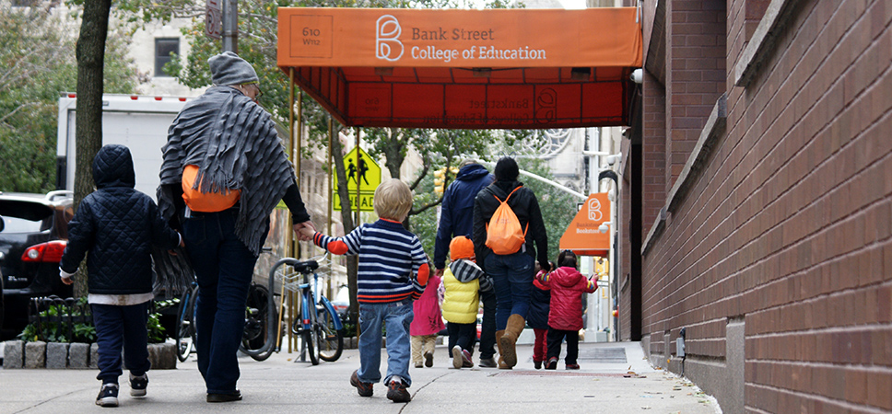
Who We Are
The Sustainable Funding Project (SFP) was launched by Bank Street’s Division of Innovation, Policy and Research to help districts, states, and teacher preparation providers find ways to develop sustainable streams of public funding to support high-quality teacher preparation.
Bank Street College has deep experience in teacher preparation, professional development, and school reform, making us well-positioned to develop a new funding framework in alliance with colleagues across the nation.
SFP is grant funded. We do not have a business model to build our organization. We are not trying to sell a service. We exist to support you.

Slide 6
Some Definitions
  Sustainable Funding for High Quality Teacher Preparation
Non-political
Money streams that will withstand leadership changes
Public
Not reliant on philanthropy
or individual funding
Adequate
Provides supports for candidates to fully engage their learning experiences
Principle # 1
Preparation providers ensure teacher candidates are diverse, committed, and effective
Principle #2
Preparation providers ensure teacher candidates are experts in human development, content, and pedagogy
Principle #3*
Clinical practice offers year-long pre-service co-teaching (“residencies”) in an effective environment
Principle # 4
Districts and providers have deep partnerships that meet candidates’ and students’ needs
* Our focus in this presentation is on residencies--Year-long, co-teaching placements (undergraduate or graduate, traditional or alternative) in a supportive school context under the daily guidance of effective practitioners, with continued, aligned learning opportunities facilitated by the preparation provider. The blend of research, theory, reflection, feedback, and practice provides candidates the opportunities to apply their conceptual learning to practice. Since residencies require significant shifts for most programs and districts, funding models can help or hinder overall quality. This presentation offers some ways to think creatively about funding the clinical portion of quality teacher preparation.

Slide 7



Teacher Preparation Has a Range of Often Unmet Needs
Districts & schools need…
Providers need…
Aspiring teachers need…
Strong candidates for every position
Teachers who reflect and are integrated into the school’s community
Teachers who are ready
on day one
Ways to make tight budgets stretch
Less staff turnover so school cultures are stable
Student success,
particularly for those
historically underserved
Promising, diverse candidates serious about joining the teaching profession
High quality placement sites so candidates learn in positive environments from experts
Ability to use their expertise to improve the P-12 education system
Affordable preparation
for their chosen career
High-quality experiences to feel prepared on day one
Deep preparation to
carry them through
their professional lives
Capacity to meet daily living needs without having
to take on extra jobs or debt

Slide 8
Paid Residencies Address These Needs and Transform Schools by…
Attracting
Building
Retaining
Improving
diverse, promising candidates into the profession
the skills aspiring teachers need to promote student growth and learning
effective teachers, especially in schools serving low-income and diverse families
the broader educational system
Stipends for aspiring teachers attract a diverse, promising teacher pool and reduce barriers to entry, especially for career changers
Alignment with districts’ needs facilitate targeted recruitment efforts
Residencies foster strong professional ties and knowledge of district contexts, making graduates excellent recruits
Residency-trained teachers are more effective promoting student growth and learning
They are skilled at working with adults and promote positive school cultures
Students taught by effective teachers are more likely to do well, reducing the need for remediation (summer school, retention, tutoring)
Residents who work alongside expert teachers in high-functioning schools remain in teaching, even when ultimately hired in less functional schools
Cost-savings could be great: Attrition costs ~ $2.2 billion annually. “Finder’s fees” alone are $1 million for every 200 recruits
Other recurring costs associated with rapid teacher turnover, such as personnel processing and certification tracking, would be reduced over time
Residency systems need good mentors, creating a teacher development continuum that offers meaningful leadership and learning opportunities for all teachers
Mentor teachers develop adult leadership and collaborative skills and are better able to build professional learning communities in the schools, enhancing professional culture among teachers and promoting school improvement efforts
Quality education is associated with less social services dependence and increased standards of living, bringing long-term taxpayer savings and increased quality of life for communities
Notes:
Attracting strong, diverse candidates into the profession
Ensuring all teachers have the skills they need to promote student growth and learning
Having a strong pool of qualified candidates for high-needs positions
Retaining teachers, especially in schools serving low-income and diverse families
Even with these clear district benefits, tight education budgets might make it challenging to invest in residencies—but they are more an investment than a cost. They offer district leadership a clear path towards viable system improvements that can prove economical in the long run. Among the more costly issues residencies could address are these:
High attrition rates, which are associated with quick entry programs, are a significant cost driver in education, estimated at $2.2 billion annually across the United States.
“Finder fees” for quick entry candidates are estimated at more than $1 million for every 200 recruits.
Other recurring costs associated with rapid teacher turnover, such as personnel processing and certification tracking, would be reduced over time.
Students taught by effective teachers are more likely to stay on grade level, potentially reducing costs associated with summer school, grade retention, tutoring, and other supplemental interventions.
The better prepared teachers are, the better schools can become. Strong schools help students develop in ways that ensure their future success. Quality education is associated with reduced dropouts, better health, less dependence on social services—all of which reduce taxpayer costs in the long run.

Slide 9

Teaching is a Public Service for the Public Good
  Today, education is recognized as a key responsiblity of every government in the world; it is a public sector that grows a nation’s economy and well-being.
  We could show our commitment to ensuring every child has access to good schools in the same way we have offered governmental support for medical preparation. Because having well-prepared physicians is in the public interest, the federal government guarantees funds to support every doctor we prepare, providing stipends for individuals and subsidies for medical teaching hospitals. States also support these medical education efforts.
  Each new doctor benefits from half a million dollars in public investment in her training.
  We could make a similar investment in teacher resdiencies, helping us achieve our national goal of providing a quality education for every child and youth.
The National Hourly Average for Apprenticeship Salaries

Slide 10
Our Mission
  To support states, districts, and teacher preparation programs in the development and adoption of sustainable funding streams for high quality teacher preparation so that every teacher enters the profession ready for the demands of 21st century classrooms
Notes:
To supports districts, states, teacher preparation providers, and others in the education sector to make it possible for more

Slide 11
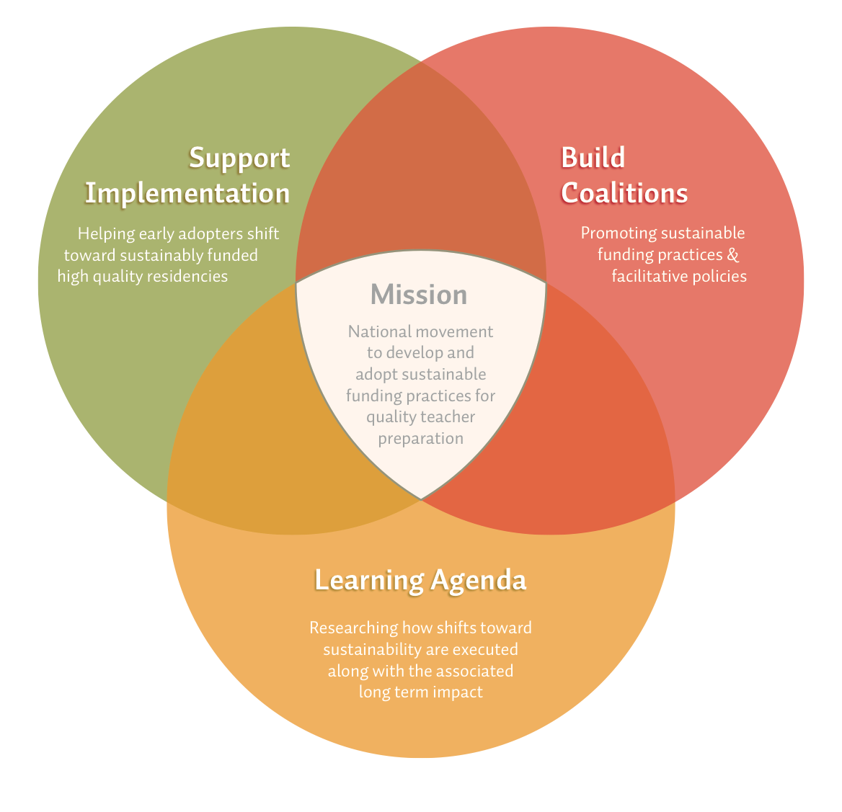
Our Strategy

Slide 12
Opportunities
Reallocation Models
ESSA
Identifying areas of existing district budget lines that could be reallocated to support residencies within schools, better supporting districts’ instructional goals
Supporting the development of ESSA applications that provide districts the flexibility to direct Title I and Title II funds towards residency programs that support school improvement and teacher quality goals

Slide 13
Reallocation Models
Notes:
Local documenting the kinds of resources that go in to models
States: RFP as an example of state level work…

Slide 14
Reallocation Opportunities
Resource Reallocation Model
Quick-Entry Reallocation Model
Reallocating resources and redesigning staffing structures to free up dollars to dedicate to residencies
Gradually rolling students out of quick-entry programs into paid residency programs by strategically supplementing quick-entry budgets

Slide 15
Resource Reallocation
Assumptions
Approaches
There are existing budget line functions and instructional needs that residents can meet while pursuing their studies
We don’t assume resource reallocation will be able to pay for every residency needed in the nation
Available resources for reallocation will vary by locality
Only 3% of the nation’s teaching force are new graduates, newly hired. Supporting these aspiring teachers would account for a very small portion of staffing budgets.
Full cohorts save staffing money for academic providers
Stipends
  The federal government pays roughly 12% of state and local education costs. Dollars from these funding sources (Individuals with Disabilities Education Act, Every Students Succeeds Act) are eligible for resident stipends and other costs
  As full time students, residents can be paid through internship stipends, which usually do not include Social Security, Medicare, or benefits
  Residency stipends range from $0 to $30K/year (assistant teachers simultaneously serving as residents make as much as $45K)

Slide 16
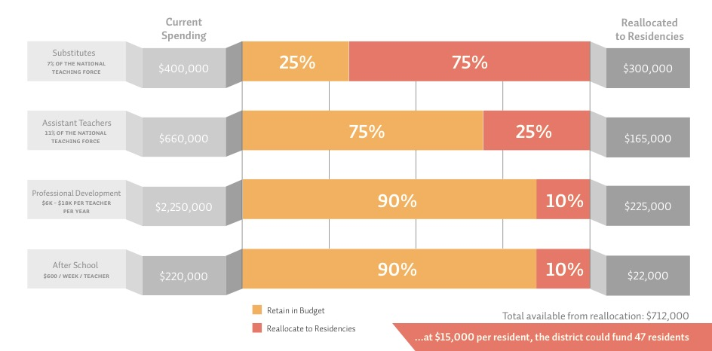
Resource Reallocation Example
If an average-size district (about 190 teachers) reallocated small portions of current funding streams to residency programs…

Slide 17
Quick-Entry Reallocation Model
Assumptions
Explanation
Districts that have quick-entry programs spend between 15-25K per year in recurring costs.
External funding for additional residents could enable the district to transition its public funds to residency funding without impacting the annual number of teachers needed.
Beginning in year 2, residents who were prepared using external funds would be ready for classroom teaching, freeing up current funds to sustainably support residents.
How many residents were trained each year using external funding would determine how long the roll-out would take.
If a district currently trains and hires 100 quick- entry teachers, supplemental funding for a cohort of 25 people each year would reduce the need for quick-entry teachers by 25 teachers the following year, since those residents would be ready for their own classroom the following year. Within 5 years, the dollars that had been used for the quick-entry program would be available for 100 year long residency stipends, bringing future savings and benefits to the district through increased retention and improved teacher effectiveness.

Slide 18

Quick-Entry Reallocation Model Example
Currently:
100 Quick-Entry Teachers are available to fill vacancies
During transition, need to keep 100 teachers available in the classroom
Goal:
By 2021, 100 teachers prepared in a high quality year long co-teaching residency
25 Well-Prepared
25
Quick- Entry
teaching
75
Quick- Entry
50 Well-Prepared
50
Quick- Entry
100 Quick- Entry
75 Well-Prepared
100 Well-Prepared
preparing
funding
25 person cohort in residencies covered with gap funding
25 person cohort in residencies with funding rolled-over from quick-entry dollars

Slide 19
ESSA Opportunities
Notes:
Local documenting the kinds of resources that go in to models
States: RFP as an example of state level work…

Slide 20
ESSA Opportunities
There is currently a unique opportunity for states to use the flexibility within ESSA to promote pre-service residencies to improve teaching and learning for all students.
Without strategic conversations at the State level to include language in State applications, it will be more difficult for local partnerships to access ESSA funding for residencies.
In addition to supporting the use of local funds for residencies, States may also direct their own state-level ESSA allocations towards the further support of residencies as their preferred method of teacher preparation.
States apply to the U.S. DOE outlining acceptable uses of State ESSA funds, aligned with State priorities and ESSA guidance
Districts apply to the State with their plans for using ESSA funds, aligned with the U.S. DOE-approved plan

Slide 21
Page 115 (5) A-C Defines a Teacher Residency Program as:
A school-based teacher preparation program in which a prospective teacher:
For not less than 1 academic year, teaches alongside an effective teacher, who is the teacher of record for the classroom
Receives concurrent instruction during the year (through courses about the content areas in wich the teacher will become certified)
Acquires effective teaching skills, as demonstrated through the compeletion of a residency program (or another measure determined by the State)

Slide 22
Residency Opportunities within Title I and Title IIA
Title I – Improving Basic Programs | Title II, Part A – Supporting Effective Instruction
Pre-service residents can become an essential part of school improvement processes, supporting improvement plans and providing services aligned with school-wide and targeted assistance programs. Residency programs can: Support comprehensive and targeted plans for Title I schools (Section 1003) Provide services aligned to schoolwide and targeted assistance programs (Sections 1008 & 1009) Benefit teachers by providing PD activities in mentoring, adult leadership, & reflective practice (Sections 1008 & 1009) Support strategies to recruit & retain effective teachers, including in high need subjects and schools (Sections 1008 & 1009) | Well-designed residencies can help accomplish all stated purposes of ESSA’s Title II – increasing student achievement, improving teacher effectiveness and increasing the number of effective teachers; providing low-income and minority students with greater access to effective teachers. Residencies can also be designed to: Promote reforms in teacher preparation systems (Section 2101(c)(4)(B)(xi)) Reduce class size (Section 2103(b)(3)(D)) Draw on provider expertise for school wide professional development (Section 2103(b)(3)(E)) Create and support teacher career ladders and differential pay (Sections 2101(c)(4)(B)(vii) & 2103(b)(3)(B)) Support recruitment & retention efforts, including of diverse teachers and for high-need subjects and schools (Sections 2101(c)(4)(B)(iii) & 2103(b)(3)(B))

Slide 23
Sample Language for ESSA Application
While states that want to promote residencies as the preferred means of teacher preparation should develop a comprehensive strategy to do so as part of their ESSA applications, all states can facilitate the development of strong residency programs in their districts by including language such as the following:
Teacher residencies help states and LEAs meet the goals of ESSA in a variety of ways. Individual residents enhance direct instructional services by reducing class sizes and providing personalized supplemental instruction. Well-designed programs also offer systemic effects: attracting and retaining strong, diverse candidates in hard-to-staff schools; promoting teacher leadership; supporting school improvement; and building productive partnerships between teacher preparation providers and districts.
For these reasons, the state encourages districts to consider entering into partnerships with providers to implement clinically-rich preparation programs.

Slide 24
Questions? Comments?
Karen DeMoss, kdemoss@bankstreet.edu
Sign up for project reports and updates at www.bankstreet.edu/sfp.
Email us at sfp@bankstreet.edu

Slide 25

Creating A New
Vision for Teacher Preparation
Four Conversations
Missouri Department of Elementary
and Secondary Education
August 25, 2016

Slide 26
A Special Thank You
Preparation Programs
  Kansas City Teacher Residency
  Missouri State University
  University of Central Missouri
  University of Missouri
PK-12 Schools
  Blue Springs
  Clinton
  Holden
  Lee’s Summit
  Logan-Rogersville
  Nixa
  Pleasant Hill
  Republic
  Springfield
  Warrensburg

Slide 27
39 Participants Representing
PK-12 Schools
  Classroom Teachers
  Directors and/or Instructional Support
  Building Principals
  Superintendents
Educator Preparation Programs
  Faculty
  Directors
  Financial Aid Officers
  Deans/Unit Leaders

Slide 28




Why?

Slide 29
Certification Programs
Missouri State University – August 12
  Elementary Education
Kansas City Teacher Residency -- August 22
  Early Childhood & Elementary Education
  Middle School – Language Arts, Mathematics, & Science
University of Central Missouri – August 23
  Early Childhood & Elementary Education
University of Missouri Columbia – August 23
  Early Childhood, Elementary, & Special Education

Slide 30
Learner-Ready Teachers
Results – 2016 First Year Teacher Surveys
Quality – Field & Clinical Experiences
  Working with Great Master Teachers
  More Time in the Classroom
  Differentiation to Meet Needs of the Learners
  English Language Learners
  Classroom Management

Slide 31
Current Status
Missouri Educator Preparation
  Standards & Quality Indicators
  Educator Evaluation System
  Redesign of Educator Preparation
    Program Standards
    Annual Performance Report
    New Series of Assessments
    Field & Clinical Experiences
  New Certification Requirements
Current Initiatives – NTEP & CEEDAR

Slide 32
Our Conversations
Improving Clinical Experiences
  Opportunities
    Every Student Succeeds Act (ESSA)
    Quality Teacher Preparation
    Explore The Concept of Residencies
  Gather Ideas
    PK-12 Students, Candidates, Mentor Teachers, PK-12 Schools/EPPs
    Benefits & Challenges

Slide 33
Conversation Agenda
Review Bank Street College Presentation
Discuss Three Opportunities
  Title I
  Title II A
  Title II B
Combine Discussions from All Meetings
DESE-OEQ Webinar – August 24 @ 3:00 PM
CCSSO Webinar – August 25 @ 1:00 PM
Developing ESSA Plan – Due January 2017

Slide 34
Three Opportunities
Improving Clinical Experiences
  Opportunities
    Every Student Succeeds Act (ESSA)
    Quality Teacher Preparation
    Explore The Concept of Residencies
  Gather Ideas – Benefits & Challenges
    PK-12 Students, Master Teachers, and PK-12 Schools/Districts
    Candidates & EPPs

Slide 35
Opportunity #1 – Title I
Residents can:
Support comprehensive
and targeted plans for
Title I schools
(Section 1003)
Provide personalized
learning opportunities
(Section 1004)
Provide services aligned to schoolwide and targeted
assistance programs
(Sections 1008 & 1009)
Title I – Improving
Basic Programs
PK-12 Students
Candidates
Mentor Teachers
Buildings/EPPs
Ideas & Benefits
Ideas & Challenges

Slide 36
Opportunity #2 – Title II A
Title II, Part A
Where residences meet the definition of Teacher Residency Program in Section 2002(5),
they are an allowable use of funds for all Part A activities.
Residencies can also be designed to:
Promote reforms in
teacher preparation systems
(Section 2103(b)(2)(B))
Reduce class size
(Section 2103(b)(2)(D))
Draw on provider
expertise for school wide
professional development
(Section 2103(b)(2)(E))
(
Title II – Part A
PK-12 Students
Candidates
Mentor Teachers
Buildings/EPPs
Ideas & Benefits
Ideas & Challenges

Slide 37
Opportunity #3 – Title II B
Title II – Part B
Allows co-teaching, recruitment, and salary
Differentials including for mentor roles
Subpart 1: Teacher and School Leader Incentive Program
Residencies can be designed as LEA activities to meet Subpart goals in collaboration with a preparation provider
(Subparts 2-4)
Title II – Part B
PK-12 Students
Candidates
Mentor Teachers
Buildings/EPPs
Ideas & Benefits
Ideas & Challenges

Slide 38
Ideas & Benefits – PK-12 Students
Increase student achievement by implementing differentiated learning practices supported by master teachers
Learn how to approach students from where they are instructionally
Individualize learning strategies/practices
Build positive relationships with students and other teachers/staff
Appeal to students with different personalities

Slide 39
Ideas & Benefits – PK-12 Students
Reduction in class size
Reorganize and utilize instructional space
Develop student-centered programs
Train for and use co-teaching strategies to benefit ALL students
Provides consistent instruction and understanding by a candidate who is recognized as a member of the faculty and/or staff.

Slide 40
Ideas & Benefits – Candidates
Increase confidence of confidence
Develop the Concept of “Professional Self”
Complete a full year of teaching with support from a preparation program
Participate in the induction & professional development activities – start to finish
Receive individual learning/coaching within an authentic learning environment
Substituting builds “On the Fly” awareness

Slide 41
Ideas & Benefits – Candidates
Receive on the job-training with targeted professional development offered by building and/or district
Immersed in the community culture and the vision of the school and district
Increase employment & potential advancement opportunities
Embedded authentic projects & courses
Develop alternate pathways for non-traditional candidates

Slide 42
Ideas & Benefits – Master Teachers
Learn & grow through sharing experiences
Decrease “Burn-Out” & “Stress” through sharing the responsibility of instruction while meeting the needs of students
Foster opportunities for teacher leadership
Work with EPPs to provide and share in professional development
Merge theory & practice

Slide 43
Ideas & Benefits – Buildings & EPPS
Form and/or strengthen existing partnerships
Provide feedback for program enhancement
Attract & retain quality teachers in Title I and urban and/or rural schools
Opportunity to restructure educator preparation programs
Opportunity to observe Master Teachers with an eye to develop new instructional leaders

Slide 44
Ideas & Challenges – Candidates
Assessing the candidate “readiness” for the internship and/or residency experiences
Identifying sustainable funding sources
Establish “loan forgiveness” opportunities for candidates willing to work in hard to staff positions and/or locations
Study various options regarding stipends, salaries, benefits, insurance, tax status, implications on existing financial aid

Slide 45
Ideas & Challenges – Buildings & EPPS
Review the rules & regulations Every Student Succeeds Act (ESSA) to determine opportunity and/or impact upon the district, educator preparation programs, and the state.
Study the definition of a “residency” program and determine the opportunity to develop individual and/or state model.
Determine monies available for reallocation by districts and the state

Slide 46
Ideas & Challenges – Buildings & EPPS
Identify settings where sustainable funding could be used
  Regular school day
  Before and/or after school programming
  Instructional aide or paraprofessional positions
  Summer school (Address certification issues)
Establish policies that provide equitable access for PK-12 students & interns
Develop policies to address all aspects of internships and/or residencies

Slide 47
Ideas & Challenges – Buildings & EPPS
Establish a selection process for Master Teachers
Build annual training processes including taking steps to ensure the best match for candidates, master teachers, building, and community

Slide 48
Continue Moving Forward
Review the ESSA Rules & Regulations
Revisit the early conversations
Identify possible roadblocks and/or policies that must be reconsidered
Develop & communicate – Missouri’s Plan
Working with stakeholders to develop and support plans for Sustainable Funding
  Internships/Apprentice/Residents
  Involvement of MoTEP & CEEDAR
  Buildings/Districts & EPPs

Slide 49
Thank
You!

Slide 50
Contact Us – 573-751-2931
Paul Katnik – Assistant Commissioner
Paul.Katnik@dese.mo.gov
Gale “Hap” Hairston – Director, Educator Preparation
Gale.Hairston@dese.mo.gov
Notes:
Type comments here.

Slide 51
Questions?

Slide 52
Webinar Coming Soon!
Preparing Teachers for Diverse Learners Through the
The Science of Learning and Personalized Learning
Featuring Johns Hopkins’ Science of Learning Institute, Turnaround for Children, and CCSSO’s Innovation Lab Network
September 30th, 2016 12:00 – 1:30 E.T.
Invitation Coming Soon!

Slide 53
Thank You!
Contacts
Karen DeMoss kdemoss@bankstreet.edu
Gale “Hap” Hairston gale.Hairston@dese.mo.gov
Paul Katnik pauk.Katnik@dese.mo.gov
Jasmine Highsmith jasmine.Highsmith@ccsso.org
Saroja Warner Saroja.warner@ccsso.org

