Slide 1
Collaboration for Effective Educator Development, Accountability, and Reform
Evidence-Based Transition Planning and Services: Part 4
H325A120003
Notes:
This PowerPoint presentation is part of the Implementing Transition Planning and Services Content Enhancement Module (CEM). This presentation, used in conjunction with the other supporting materials, is intended for use by university and college faculty and other appropriate educator preparation program (EPP) staff to develop and enhance their teacher and leadership education courses as well as their professional development (PD) programs for practitioners.
The CEM is aligned with the innovation configuration (IC) on this topic: Teacher Preparation to Deliver Evidence-Based Transition Planning and Services for Youth with Disabilities. The focus of the CEM is to first provide understanding of transition planning and the IDEA regulations. The remaining topics addressed in this CEM target the critical characteristics of schools that prepare and support youth with disabilities to successfully transition from school to postsecondary education, integrated employment, and community living and participation.
The topics associated with this CEM include:
Introduction to transition planning and IDEA.
Overview of evidence-based predictors and practices associated with transition.
Strategies to ensure transition planning and preparation is student focused.
Access to secondary academic general education curriculum.
Engagement and involvement of families during transition planning.
Strategies to ensure positive collaboration both within school systems and with the community.
This CEM is divided into six hours of content with each hour building on previous information and resources. However, the sessions can stand alone with content embedded into a class or PD session. These speaker notes are provided for most of the PowerPoint slides. The notes provide to supplement the material in the PowerPoint.
These speaker notes are provided for most of the presentation slides. The notes provide additional details about the information presented in the slide, including the context for the information being presented as well as further elaboration of key points. The notes also indicate when the speaker may want to use a handout that has been created to supplement the material in the PowerPoint.

Slide 2
CEM Overview
Part 1: Introduction to Transition Planning
Part 2: Designing Effective Transition Program Structures
Part 3: Student-Focused Planning
Part 4: Providing a Transition-Focused Education
Part 5: Transition and Family Engagement
Part 6: Interagency Collaboration
Notes:
The Transition CEM is divided into six sections. The sections were designed to be one hour in length. However, extension activities are included for those wishing to make these sessions longer.
This session will focus on Part 4: Providing a Transition-Focused Education

Slide 3
Part 4: Providing a Transition-Focused Education
Notes:
Students of transition age should be provided a transition-focused education.

Slide 4
Objectives
Explain the importance of providing transition-related activities within a general education setting.
Demonstrate how to embed transition-related activities within the general education curriculum and coursework.
Identify academic evidence-based practices (EBPs) to support students with disabilities.
Notes:
Read slide.

Slide 5
THINK-PAIR-SHARE
What are the essential skills that students need to have for a successful post-school transition?
What are some of the issues around effectively providing secondary transition services throughout the academic day and addressing the state academic standards?
Notes:
Lead participants through a discussion about the issues around effectively providing secondary transition services throughout the academic day and addressing the Common Core State Standards (CCSS). After asking the questions, provide participants 3 minutes to T-P and have participants share out responses. Then, provide them with the responses, which are on the next slide.

Slide 6
Taxonomy and Student Development

Slide 7
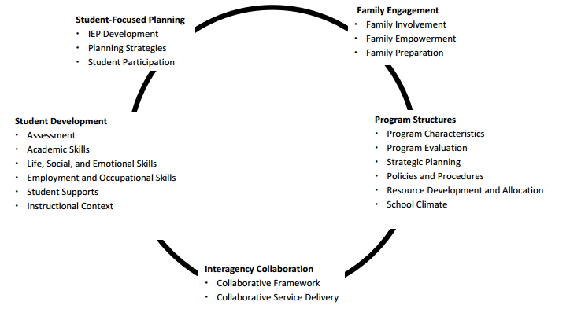
Taxonomy for Transition Programming 2.0
Available Handout
Kohler, Gothberg, Fowler, & Coyle, 2016, p. 3.
Notes:
The Taxonomy for Transition Programming 2.0 handout, available at http://transitionta.org/sites/default/files/Tax_Trans_Prog_0.pdf, is referenced in Parts 2-6. Refer participants to pages 2-3 to learn more about the purpose of the taxonomy. This slide and the following slides focus solely on the area of student development.
As you can see, the student development area of the Taxonomy provides guidance relative to the functional and academic skills students are required to attain to support a positive and successful transition into post-school life. Based on the research literature, student development can be viewed from its role in assessment, academic skills, life/social/emotional skills, employment and occupation skills, student supports, and instruction context. A well-written transition plan has no value if it does not lead to the development of essential student skills. Let’s look deeper into how educators can develop these skills.
Resource: Kohler, P. D., Gothberg, J. E., Fowler, C., & Coyle, J. (2016). Taxonomy for transition programming 2.0: A model for planning, organizing, and evaluating transition education, services, and programs. Western Michigan University. Available at http://www.transitionta.org.

Slide 8
Activity: Taxonomy and Student Development
Review Taxonomy for Transition Programming 2.0: Student Development.
In teams, identify three activities in each column that you should consider first when working to develop student skills.
Explain your selections to the group.
Notes:
This is an optional activity and can be adapted for in-service and pre-service settings.
Handout: Taxonomy for Transition Programming 2.0 (pp. 5-6).

Slide 9
Developing Student Skills Through Transition-Focused Education
Student development includes assessing and teaching functional, academic, social, and vocational skills to ensure that students are fully prepared for post-school life.
Kohler, 1996
Notes:
Read slide.
Resource: Kohler, P. D., Gothberg, J. E., Fowler, C., & Coyle, J. (2016). Taxonomy for transition programming 2.0: A model for planning, organizing, and evaluating transition education, services, and programs. Western Michigan University. Available at http://www.transitionta.org.

Slide 10
What We Know About Learning New Skills
Research and practice indicates that all students can succeed.
Evidence demonstrates that having high expectations for all students results in improved performance.
Using multiple means for accessing content in innovative ways impacts successful outcomes for students.
ESSA, 2015; Hattie, 2015; Morningstar & Mazzotti, 2014
Notes:
When considering access to the general curriculum, research indicates that all students can succeed if they are provided with the necessary supports to do so. When we have high expectations for students, we provide them support and confirmation that adds to their ability and self-determination to succeed through improved academic performance, etc. We can ensure that all students succeed by providing differentiated instruction throught the concept of Universal Design for Learning (UDL), which we will talk about later in this session.

Slide 11
What We Know About Transition-Focused Education
Guides development of students’ educational programs and is outcome oriented.
Not an “add-on” activity for students with disabilities.
Directed toward adult outcomes―expectation for all students to achieve a quality life (e.g., family, school, community).
Provides a variety of instructional pathways.
Promotes greater involvement and ownership in the decision-making process for students and families.
Morningstar & Mazzotti, 2014
Notes:
In general, the concept of transition-focused education represents the perspective that “transition planning” is the fundamental basis of education that guides development of students’ educational programs rather than an “add-on” activity for students with disabilities when they reach age 14 or 16. The impact of transition-focused education is greatly enhanced when service systems and programs connect with and support implementing and applying such learning.
Transition-focused education is directed toward adult outcomes and comprises academic, career, and extracurricular instruction and activities delivered through a variety of instructional and transition approaches and responsive to the local context and students’ learning and support needs. Quality of life outcomes include three general areas: independent living (home, family, community participation); employment; and participation in postsecondary education. To prepare students to achieve positive post-school outcomes, transition-focused education builds student competence through academic, occupational, and social development. Further, to ensure that all students develop and achieve at their greatest potential, transition-focused education provides a variety of instructional pathways that may range from few or no specialized supports to extensive applied experiences or supports.

Slide 12
Components of Developing Student Skills
Student Skill Development
Community Participation
Employment Skills
Work-Based Experiences
Academics
Independent Living
Self-Determination
Morningstar & Mazzotti, 2014, p. 21.
Notes:
Students in transition need to develop skills in multiple areas not limited to academics. In the previous section, we discussed the development of self-determination as an essential component of student-focused transition planning. We will discuss the remaining areas in this section.
Review slide.
The following essential components are outlined in the IC for Transition Planning and Services. Each of these essential components is discussed in more detail in the section.

Slide 13
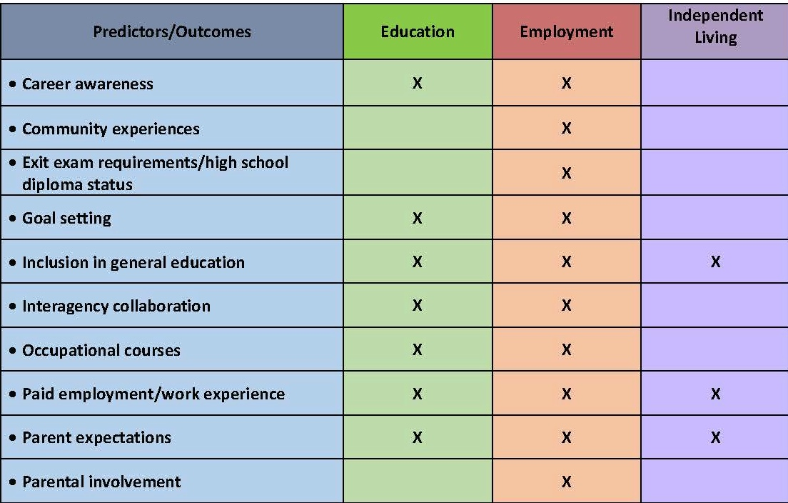
Predictors of Post-School Success
Handout
4.1
Mazzotti et al., 2015; Test et al., 2009.
Notes:
In previous sections of this module, you were introduced to the Predictors of Post-School Success and learned about some predictors: career awareness, community experiences, and inclusion in general education. Now that you have a better understanding of developing student skills, which of the predictors do you believe support the development of student skills in a transition-focused education?
Refer participants to Handout 4.1, Strategies for Developing Student Transition Skills. Some of the highlighted predictors are listed in Column 1. Inform participants that they will complete Column 2 (description) and Column 3 (related strategies/practices) as we move through the presentation.
In this section, we will focus on how some of these predictors can be implemented to support the development of student skills. In Handout 4.1, you will see that several of the presented predictors are listed. Others not listed overlap with other components outlined in the Taxonomy of Transition Programming 2.0 and are discussed in other parts of this module. As we go through this section, you will complete Columns 2 and 3.
Make connections between the Taxonomy of Transition Programming 2.0 skills development areas―independent living, community participation, employment, work-based experience, academics, and self-determination.

Slide 14
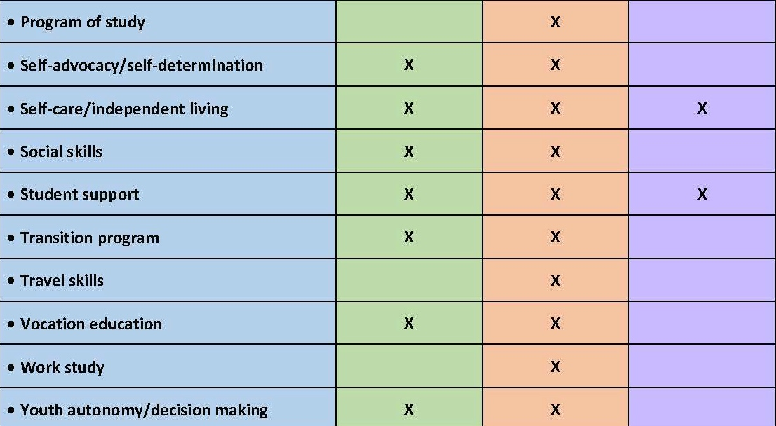
Predictors of Post-School Success
Handout
4.1
Mazzotti et al., 2015; Test et al., 2009.
Notes:
Briefly introduce the remaining related predictors and the activity in Handout 4.1.

Slide 15
Developing Independent Living Skills
Self-care/independent living skills.
Social skills.
Notes:
Refer participants to Handout 4.1 and remind them to complete the related columns.
In the CEEDAR IC for preparing educators in the area of transition, two predictors of post-school success are related to developing independent living skills. Educators must be able to embed independent living and social skills across academic content areas in the general educational context and community settings.
Read slide.

Slide 16
Self-Care/Independent Living Skills
Skills necessary for management of one’s personal self-care and daily independent living, including the personal management skills needed to interact with others, daily living skills, financial management skills, and self-management of healthcare/wellness needs.
Rowe, et al., 2013
Notes:
In Handout 4.1, you will notice that self-care independent living skills is listed as the first related predictor variable. In the next column, write a description of the predictor in your own words. Share your description with your neighbor.
Read slide.
Provide time for participants to write a BRIEF description in Column 2.

Slide 17
Social Skills
Behaviors and attitudes that facilitate communication and cooperation (e.g., social conventions, social problem solving while engaged in a social interaction, body language, speaking, listening, responding, verbal and written communication).
Rowe et al., 2013
Notes:
Another predictor of student skill development of independent living is social skills.
Read slide.
Examples include being able to interact in socially appropriate ways with people based upon one’s relation to them. For example, one would not interact with a family member in the same way that he or she would interact with an employer. Students need to learn discrimination skills for social skills. In the next row, write a brief description of this related predictor and share it with your neighbor.

Slide 18
Evidence-Based Practices (EBPs) for Independent Living Skills
Backward chaining
Constant time delay
Forward chaining
Progressive time delay
Self-monitoring instruction
Least-to-most prompts
Most-to-least prompts
Total task chaining
Community-based instruction
Simulations
Handout
4.2
DEMO: http://www.transitionta.org/transitionplanning
Notes:
Several EBPs exist for teaching independent living skills. Handout 4.2 features an extensive chart that contains all of the EBPs for transition. With your neighbor, review the available EBPs. Identify three or four and briefly describe in the final column.
Independent living skills training will vary based on the needs of individual students.
Demonstrate where participants can access lesson plans to implement these EBPs: http://www.transitionta.org/transitionplanning, under transition planning…independent living…student development. Have participants explore two or three and write a brief description of the strategy or practice in Column 3.

Slide 19
Developing Community Participation Skills
Community experiences include activities occurring outside of the school setting, supported by classroom instruction, in which students apply academic, social, and/or general work behaviors and skills.
Rowe et al., 2013
Notes:
One predictor of post-school success was identified by the CEEDAR Transition IC relative to teaching community participation skills (p. 14 of IC).
Read slide.
In some cases, schools can establish community-based instruction opportunities for students. However, budget constraints and program structures may prevent schools from providing sufficient opportunities. In any case, educators should collaborate with families to ensure that students engage in community experiences outside of school hours. The school transition program should support the student in being successful in these opportunities.
Take a minute to write a brief summary of this predictor variable in Column 2 of page 2.

Slide 20
Examples of Strategies and Practices for Community Participation Skills
Evidence-based practice (EBP):
Simulations―purchasing skills.
Research-based practices:
Community-based instruction― purchasing.
Community-based instruction― safety skills.
Handout
4.2
DEMO: http://www.transitionta.org/transitionplanning
Notes:
In the final column, work with your neighbor to identify two to four strategies for developing student community participation skills. Here are some examples.
Read slide.
To complete the activity, either use Handout 4.2, the NTACT website, or other resources like What Works Clearinghouse.
Provide participants several minutes to complete the activity. Demonstrate where participants can access lessons plans to implement these EBPs, http://www.transitionta.org/transitionplanning, under transition planning…independent living…student development. Have participants explore two to three and write a brief description of the strategy or practice in Column 3.

Slide 21
Developing Employment Skills
Career awareness.
Occupational courses.
Vocational education.
Notes:
Three key predictors related to developing employment skills were identified in the CEEDAR Transition IC. Career awareness was discussed in Part 2. We will focus on occupational courses and vocational education.
Read slide.

Slide 22
Occupational Courses
Individual courses that support career awareness, allow or enable students to explore various career pathways, develop occupation-specific skills through instruction, and provide experiences focused on students’ desired employment goals.
Rowe et al., 2013
Notes:
Read slide.
Take a minute to write a brief summary of this predictor variable in Column 2 of page 2.

Slide 23
Vocational Education
Vocational education is a sequence of courses that prepares students for a specific job or career at various levels from trade or craft positions to technical, business, or professional careers.
Rowe et al., 2013
Notes:
Read slide.
Take a minute to write a brief summary of this predictor variable in Column 2 of page two.

Slide 24
What Are Employability Skills?
When you hear the term employability skills, what are some of the terms, considerations, and contexts that come to mind?
Notes:
Ask participants the question on the slide and orally take responses.
Allow 2-3 minutes.

Slide 25
Employability Skills Definition
Employability skills are general skills that are necessary for success in the labor market at all employment levels and in all sectors.
Notes:
Read slide.

Slide 26
Importance of Employability Skills
Frequently cited as among the most important skills by employers (Hart Research Associates, 2015).
Lack of employability skills contributes to “talent shortage.”
Employers value workers who can do the following:
Think critically.
Work well with others.
Apply their knowledge.
Adapt to a changing workplace.
Notes:
Research has shown that employers often state that employability skills are the most important. Lack of employability skills among would-be employees may contribute to a workforce shortage. An individual may be very talented in an area, but if that person lacks the skills required to be employable, such as appropriate social skills, he or she does not benefit an employer.

Slide 27
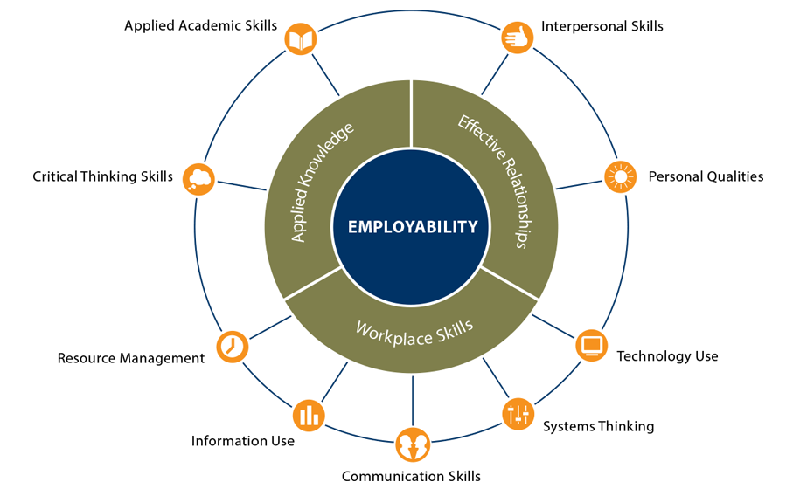
Explore the Employability Skills Framework
http://cte.ed.gov/employabilityskills/index.php/framework/index#
Notes:
Follow the link to access an interactive page of the Employability Framework, http://cte.ed.gov/employabilityskills/index.php/framework/index. Click on each section to learn more about the types of employability skills that should be included in students’ transition-based education programs.
How was the framework developed? The Employability Skills Framework was developed as part of the Support for States’ Employability Standards in CTE and Adult Education project, an initiative of the Office of Career, Technical, and Adult Education, U.S. Department of Education. Framework development was guided by a group of the career and technical education (CTE), adult education, workforce development, and business organization. See more at: http://cte.ed.gov/initiatives/employability-skills-framework

Slide 28
Optional Activity: Employability Skills Framework
Integrating Employability Skills: A Framework for All Educators.
Integrating Employability Skills With Classroom Instruction to Students With Disabilities.
Notes:
Optional Activity: The College and Career Readiness and Success Center (CCRS) provides educators Professional Learning Module, Integrating Employability Skills: A Framework for All Educators, that can be used to learn more about the employability skills framework, how it can be embedded in general and special education, and how educators can assess and monitor student proficiency in the employability skills. In addition to the overview module, CCRS offers additional modules targeting employability skills for students with disabilities and English Language Learners.
The Professional Learning Modules (e.g., presentation slides, facilitator guide, handouts, activities) can be accessed here: http://www.ccrscenter.org/implementation-tools/integrating-employability-skills

Slide 29
Examples of Strategies and Practices for Employment Skills
Research-based practices:
Counseling―competitive employment.
Response prompting―employment skills.
Self-management instruction―job skills.
Handout
4.2
DEMO: http://www.transitionta.org/transitionplanning
Notes:
With your neighbor, identify two to three practices that would address the predictor area.
Demonstrate where participants can access lessons plans for and descriptions of EBPs, http://www.transitionta.org/transitionplanning, under transition planning…employment…student development—employment skills. Have participants explore two to three practices and write a brief description of each strategy or practice in Column 3.

Slide 30
Developing Skills Through Work-Based Experiences
Work study.
Paid employment/work experience.
Notes:
The CEEDAR Transition IC identifies two predictors that target the development of skills through work-based experiences.
Read slide.

Slide 31
Work Study
A specified sequence of work-skills instruction and experiences designed to develop students’ work attitudes and general work behaviors by providing them with mutually supportive and integrated academic and vocational instruction.
Rowe et al., 2013
Notes:
Read slide.
In Column 2 on page 3 of Handout 4.1, write a brief description of the predictor and share it with your neighbor.

Slide 32
Work Experience
Work experience is any activity that places the student in an authentic workplace and could include work sampling, job shadowing, internships, apprenticeships, and paid employment.
Rowe et al., 2013
Notes:
Read slide.
In Column 2 on page 3 of Handout 4.1, write a brief description of the predictor and share it with your neighbor.

Slide 33
Paid Employment
Paid employment can include existing standard jobs in a company or organization or customized work assignments negotiated with the employer, but these activities always feature competitive pay (e.g., minimum wage) paid directly to the student by the employer.
Rowe et al., 2013
Notes:
Read slide.
In Column 2 on page 3 of Handout 4.1, write a brief description of the predictor and share it with your neighbor.

Slide 34
Examples of Strategies and Practices for Providing Work-Based Experiences
Research-based practices:
Supported employment―competitive employment.
Targeted group―competitive employment.
Handout
4.2
DEMO: http://www.transitionta.org/transitionplanning
Notes:
Using Handout 4.2 and other resources, identify two to three practices that could support implementation of these predictor variables.
Read slide.
Demonstrate where participants can access lessons plans to implement these practices, http://www.transitionta.org/transitionplanning, under transition planning…independent living…student development. Have participants explore two to three and write a brief description of the strategy or practice in Column 3.

Slide 35
Developing Academic Skills
Inclusion in general education.
Program of study.
Exit examination requirements/high school diploma status.
Notes:
The CEEDAR Transition IC identifies three predictors related to developing academic skills through a transition focused education.
You learned about inclusion in general education in Part 2: Program Structures;, although we will review it again in this section. We also discussed in Part 1 and Part 2 the importance of ensuring that students meet exit examination requirements and achieve high school diploma status. As a result, we will focus only on the first two elements in this section.

Slide 36
Inclusion in General Education
Requires students with disabilities to have access to general education curriculum and be engaged in regular education classes with peers without disabilities.
Rowe, et al., 2013
Notes:
Read slide.
In Column 2 on page 4 of Handout 4.1, write a brief description of the predictor and share it with your neighbor.

Slide 37
Program of Study
An individualized set of courses, experiences, and curriculum designed to develop students’ academic and functional achievement to support the attainment of their desired post-school goals.
Rowe et al., 2013
Notes:
Read slide.
In Column 2 on page 4 of Handout 4.1, write a brief description of the predictor and share it with your neighbor.

Slide 38
Requirements for Teachers to Implement Academics Into Transition
Use principles of Universal Design for Learning (UDL) to guide instruction
Differentiate instruction
Collaborate with a variety of school professionals
Provide learning strategies and meta-cognitive instruction
Ensure that appropriate accommodations and assistive technology are used
Be culturally responsive/sensitive
Notes:
Read slide.

Slide 39
Designing Academic Instruction
Make curricular content more meaningful and relevant | Address Non-Academic Skills
Embed
Real-Life Skill
(transition-related skill)
CCSS Standard
&
Academic Content
Align With CCSS
Standard
Real-Life Skill
(transition-related skill)
Notes:
Two ways are available for considering how to tie transition-related skills into the general curriculum and the CCSS.
Refer to first set of circles. The first is making curricular content more meaningful and relevant by embedding a real-life skill (e.g., self-determination, vocational skill) into academic instruction.
Refer to second set of circles. The second way is aligning a real-life skill with the CCSS (academic standards). Designing instruction is as individualized as an IEP; more than one way exists. You have to consider the needs of your students and the location in which services are provided. For example, if you are providing instruction to students with disabilities in an inclusive setting, you will need to consider how to embed transition-related skills into daily academic content. If you are providing instruction to students with disabilities in a resource room or self-contained setting, you will need to determine how you will align transition-related skill instruction with the academic standards (i.e., CCSS).
For examples of how CCSS aligns with skill development, read Partnership for 21st Century Skills. (2011). P21 Common core toolkit: A guide to aligning the Common Core State Standards with the Framework for 21st Century Skills. Available at http://www.p21.org/storage/documents/P21CommonCoreToolkit.pdf

Slide 40
Requirements of Teachers to Implement UDL
Differentiate instruction.
Meta-cognitive instruction.
Identify accommodations and assistive technology.
Notes:
All teachers, special and general education, are responsible for all these difference components of UDL. (This information is outlined on page 18 of the IC.)

Slide 41
Examples of EBPs That Promote Academic Learning
Peer-assisted instruction.
Using mnemonics.
Using visual displays such as graphic organizers.
Using assistive technology.
Using self-management strategies.
Notes:
Using EBPs, such as the ones listed, to promote academic learning helps students increase their academic potential. Increasing students’ academic potential helps prepare them for secondary transition to either a continuing education program, such as college, or a vocational training program.

Slide 42
Using Peer Assistance to Teach Academic Skills
Peer tutoring is the delivery of academic instruction by another student.
Cooperative learning is when groups of different students work together.
Peer instruction is when students assist other students in completing an activity or teaching a lesson.
Notes:
Using peer assistance strategies to support students during academic instruction is supported by a strong research base. The three specific peer assistance strategies are peer tutoring, cooperative learning, and peer instruction, which have been effective for supporting students during academic instruction (read slides to describe each).
Peer tutoring is the delivery of academic instruction by another student, either older or the same age as the tutee.
Cooperative learning is when groups of students of differing ability levels, genders, or ethnicities work together to achieve mutual goals.
Peer instruction is when students are given specific roles to assist other students in completing an activity or teaching a lesson.

Slide 43
Examples of Strategies and Practices for Developing Academic Skills
Evidenced-based practices (EBPs):
Graphic organizers to teach reading comprehension.
Strategy instruction to improve reading comprehension.
Research-based practices:
Anchored instruction to teach mathematics.
Graduated sequence of instruction to teach mathematics.
Handout
4.2
DEMO: http://www.transitionta.org/transitionplanning
Notes:
Read slide.
Using Handout 4.2 and other resources, identify two to three practices that could support implementation of these predictor variables.
Demonstrate where participants can access lessons plans to implement these practices, http://www.transitionta.org/transitionplanning, under transition planning…education…student development—academic skills. Have participants explore two or three practices and write a brief description of the strategy or practice in Column 3 of Handout 4.1.

Slide 44
Developing Self-Determination Skills
The ability to make choices, solve problems, set goals, evaluate options, take initiative to reach one’s goals, and accept consequences of one's actions.
Rowe et al., 2013
Notes:
One predictor of post-school success has been identified relative to the development of self-determination skills.
Read slide.

Slide 45
Examples of Strategies and Practices for Self-Determination Skills
Evidence-based practice (EBP):
Self-determined learning model of instruction―goal attainment.
Research-based practice:
Whose future is it?―self-determination.
Handout
4.2
DEMO: http://www.transitionta.org/transitionplanning
Notes:
Read slide.
Using Handout 4.2 and other available resources, identify two to three strategies with your neighbor and record them in the final column.
Demonstrate where participants can access lessons plans to implement these EBPs, http://www.transitionta.org/transitionplanning, under transition planning…independent living…student development—self-determination skills. Have participants explore the two practices and write a brief description for each strategy or practice in Column 3.

Slide 46
Closing

Slide 47
Review Activity
Student Skill Development
Community Participation
Employment Skills
Work-Based Experiences
Academics
Independent Living
Self-Determination
Morningstar & Mazzotti, 2014, p. 21.
Notes:
Throughout this module, you learned about the essential skills students need to develop through their transition programs. Find a new partner and share the strategies you recorded for implementing predictors of student skill development.
Provide participants 4-5 minutes to share their learning. Assist participants who have missing information.

Slide 48
Did We Meet Our Objectives?
Explain the importance of providing transition-related activities within a general education setting.
Demonstrate how to embed transition-related activities within the general education curriculum and coursework.
Identify academic EBPs to support students with disabilities.
Notes:
Review the objectives of this section. Have participants reflect on their learning.
Consider the following partner discussion prompts:
Why is providing transition-related activities within a general education setting important?
Provide two or three examples of how you could embed transition-related activities within the general education curriculum and coursework.
Identify two or three examples of academic EBPs to support students with disabilities.

Slide 49
Ticket Out the Door
Do you have follow-up questions related to today’s content?
What additional information would you like to have?
Notes:
Materials: Note card or sticky note for Ticket Out the Door
(provide students with note card). Take a moment to talk with a partner and identify follow-up questions you have about today’s objectives or content and anything additional you would like to know. Write your questions and responses on the notecard, which will serve as your Ticket Out the Door for today.

Slide 50
Collaboration for Effective Educator Development, Accountability and Reform (CEEDAR)
H325A120003

Slide 51
Disclaimer
This content was produced under U.S. Department of Education, Office of Special Education Programs, Award No. H325A120003. Bonnie Jones and David Guardino serve as the project officers. The views expressed herein do not necessarily represent the positions or polices of the U.S. Department of Education. No official endorsement by the U.S. Department of Education of any product, commodity, service, or enterprise mentioned in this website is intended or should be inferred.

