Slide 1
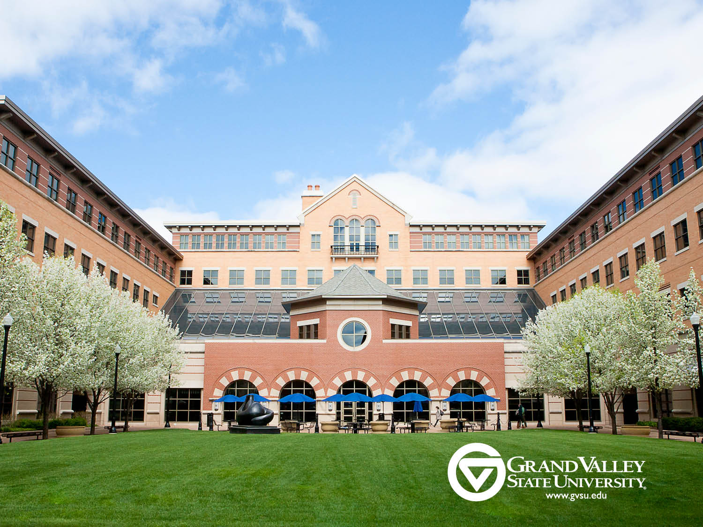
Scaling up EBPs and HLPs
Scaling Up Evidence Based and High-Leverage Practices
Paula Lancaster, PhD
Grand Valley State University

Slide 2
CEEDAR At GVSU
Faculty members from COE (Educational Leadership, Literacy Studies, & Special Education) and CLAS (English &Psychology) agreed to participate.
We have mapped our content across the units and gathered to review the maps for gaps and redundancies.
Student teachers completed a survey of their knowledge and skills.
Notes:
W

Slide 3
CEEDAR At GVSU Part 2
We have held two joint retreats to discuss, map, and revise our curriculum and program.
We are focused on evidenced-based &high-leverage content and practice and ensuring that our candidates are prepared to deliver comprehensive early literacy instruction for all children.

Slide 4
CEEDAR At GVSU Part 3
CEEDAR
Structure for starting the conversation
Opportunities for collaboration within and across institutions
Tools, materials, and support for the work
Consistent stream of feedback and ideas

Slide 5
TeachingWorks – University of Michigan
Dedicated to improving teachers’ preparation and to creating a professional threshold for entry to teaching
Have identified a set of instructional practices that are “high-leverage” for beginning and early-career teachers, such as leading a group discussion and eliciting and interpreting students’ thinking in specific subject areas.
http://www.teachingworks.org/

Slide 6
Michigan Program Network
Six IHEs and TeachingWorks
Convene monthly to:
Develop a common language and understanding of teaching practice,
Develop and try new approaches for preparing novice teachers, and
Ensure all students have skilled teachers.

Slide 7
Skillful Teaching is NOT As Easy as it Looks
Contrary to popular belief skillful teaching:
Does not come naturally.
Is not based on “gut” or uninformed intuition.
Is a combination of many things including good training, deliberate practice, thoughtful reflection …
Is less a question of style and more a question of technique and execution.
Is professional practice.

Slide 8
High-Leverage Practices
Leading a Group Discussion Explaining and modeling content, practice, and strategies Eliciting and interpreting individual students’ thinking Diagnosing particular common patterns of student thinking and development in a subject-matter domain Implementing norms and routines for classroom discourse and work Coordinating and adjusting instruction during a lesson Specifying and reinforcing productive student behavior Implementing organizational routines Setting up and managing small group work Building respectful relationships with students | Talking about a students with parents or other caregivers Learning about students’ cultural, religious, family, intellectual, and personal experiences and resources for use in instruction Setting long- and short-term learning goals for students Designing single lessons and sequences of lessons Checking student understanding during and at the conclusion of lessons Selecting and designing formal assessments of student learning Interpreting the results of work, including routine assignments, quizzes, projects, and standardized assessments Providing oral and written feedback to students Analyzing instruction for the purpose of improving it

Slide 9
HLP: Eliciting and Interpreting Student Thinking
Teachers pose questions or tasks that provoke or allow students to share their thinking about specific academic content in order to evaluate student understanding, guide instructional decisions, and surface ideas that will benefit other students. To do this effectively, a teacher draws out a student’s thinking through carefully-chosen questions and tasks and considers and checks alternative interpretations of the student’s ideas and methods.

Slide 10
Eliciting and Interpreting Student Thinking
Teaching Works Website
Notes:
What did you see

Slide 11
CEEDAR and HLP Work
Given us common language across department and programs for discussing early literacy content, EBP, and pedagogy
Extended this conversation to our local partners
Next steps

Slide 12
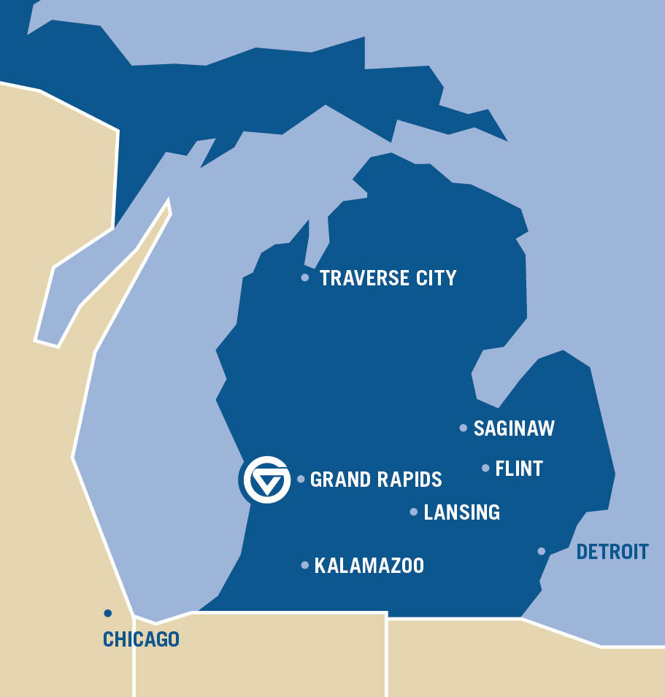
About Grand Valley
Nearly 25,000 students
Students from all Michigan counties, dozens of other states, and many foreign countries
81 undergraduate and 32 graduate degree programs
Campuses in Allendale, Grand Rapids, and Holland, and regional centers in Muskegon and Traverse City.
[other boilerplate copy options available at: http://www.gvsu.edu/identity]

