Slide 1
What Does It Take to Scale-up?
CEEDAR-IRIS Cross State Convening
Caryn S Ward, PhD
National Implementation Research Network
FPG Child Development Institute
University of North Carolina at Chapel Hill

Slide 2
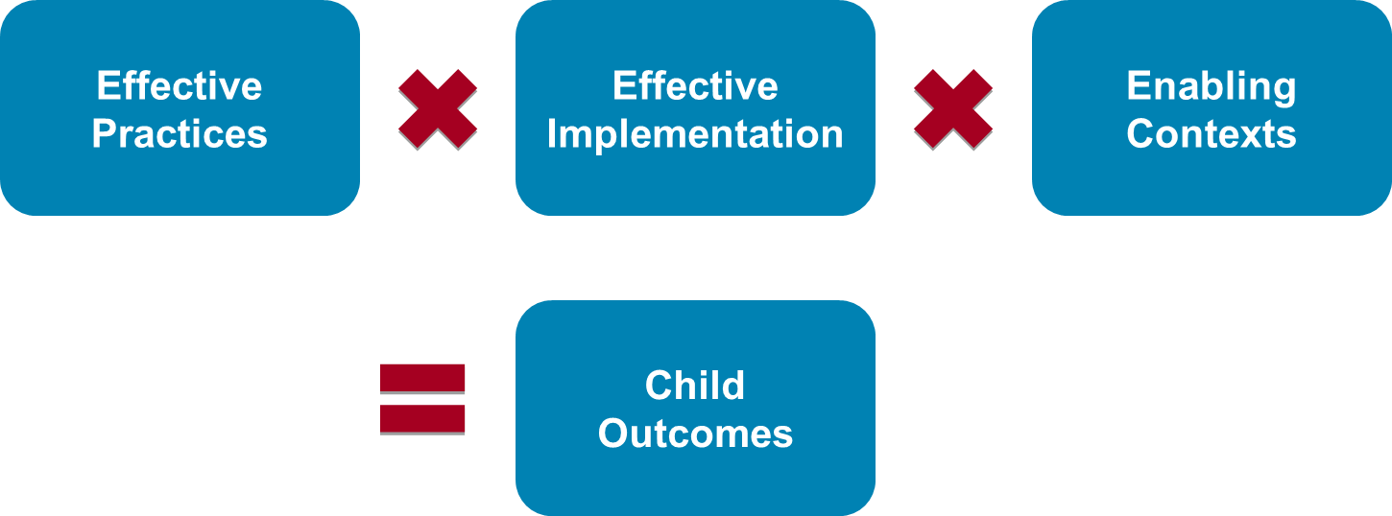
Active Implementation

Slide 3
What does it take?
Four key ingredients for Active Implementation
It Takes Time
It Takes Teams
It Takes Support
It Takes Learning
Notes:
There are four key ingredients or strategies that support active implementation that you can use in your work to support programs, and that programs can use to support implementation of teaching practices.

Slide 4
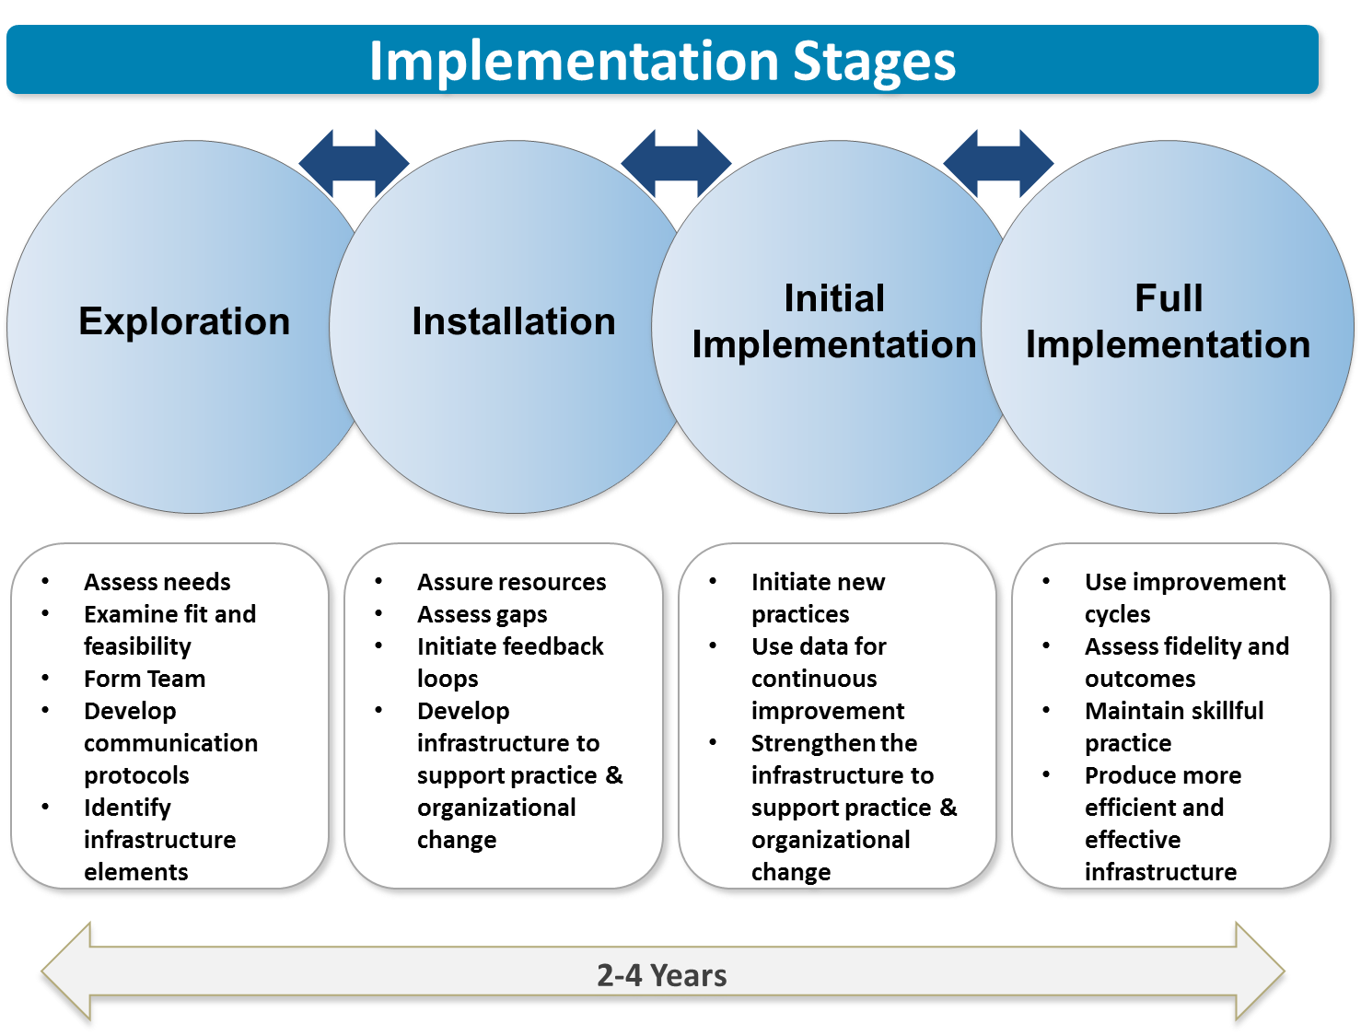
Implementation Stages
Drivers
Drivers
Drivers
Drivers

Slide 5
It takes learning: Improvement Cycles
Act
Plan
Act
Plan
Act
Plan
Study
Do
Study
Do
Study
Do
Data Driven Decision Making
Notes:
5

Slide 6
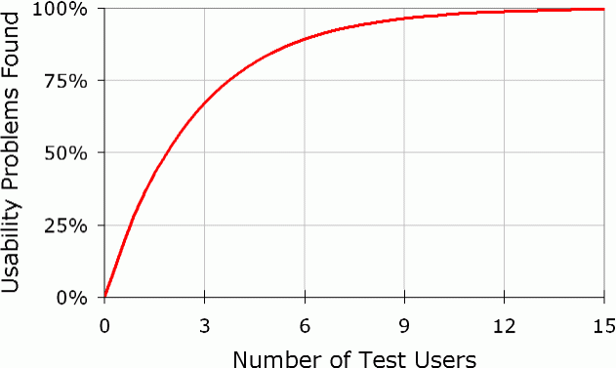
TESt Users Graph
Get Started, Get Better
Notes:
6
Nielsen, J. (2000). Why you only need to test with 5 users. Retrieved April 22, 2007, from http://www.useit.com/alertbox/20000319.html

Slide 7
Change is great…
…you go first!

Slide 8
Reflection Question
How might we support the use of stage based activities to support the scaling up of our effective practices?
What are the barriers and facilitators to supporting change over time?

Slide 9
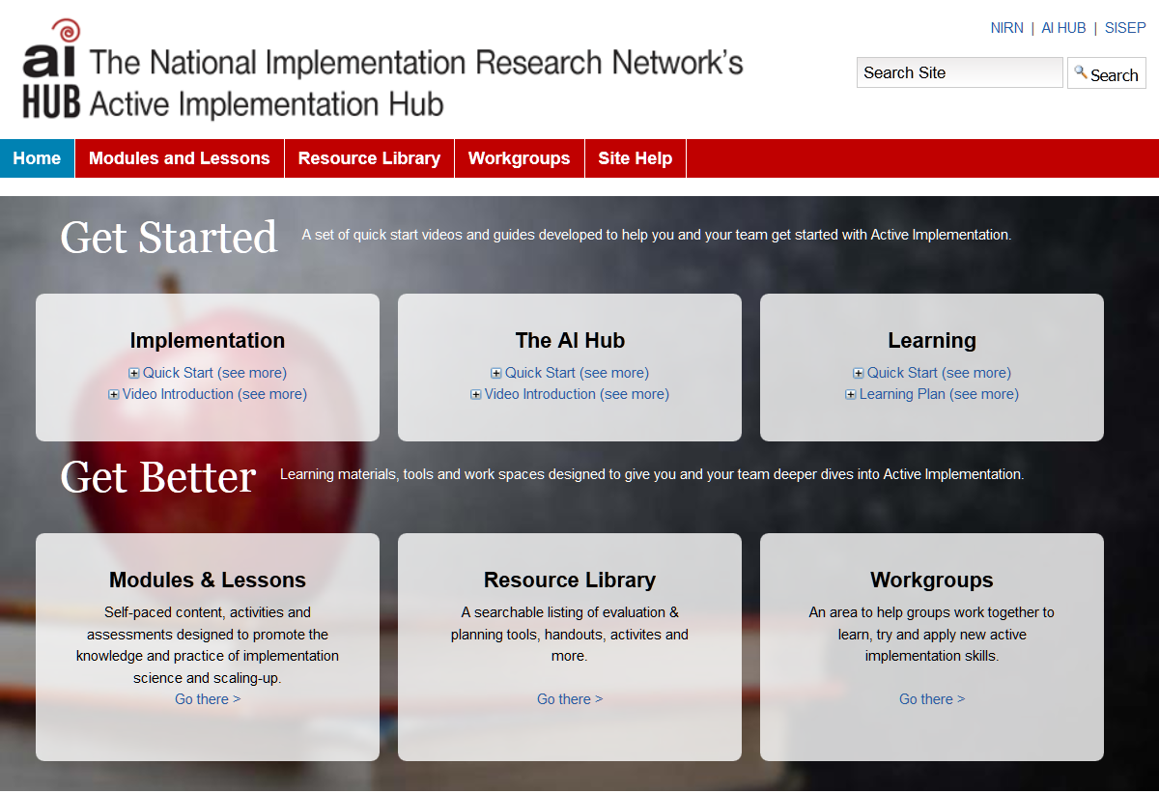
AI Hub
The Active Implementation Hub is a free, online learning environment for use by any stakeholder — practitioners, educators, coaches, trainers, purveyors — involved in active implementation and scaling up of programs and innovations.
Click here to visit the AI Hub Website

Slide 10
Citations
Citation and Copyright
This document is based on the work of the National Implementation Research Network (NIRN).
© 2013-2016 Allison Metz, Leah Bartley, Jonathan Green, Laura Louison, Sandy Naoom, Barbara Sims, and Caryn Ward
This content is licensed under Creative Commons license CC BY-NC-ND, Attribution-NonCommercial-NoDerivs . You are free to share, copy, distribute and transmit the work under the following conditions: Attribution — You must attribute the work in the manner specified by the author or licensor (but not in any way that suggests that they endorse you or your use of the work); Noncommercial — You may not use this work for commercial purposes; No Derivative Works — You may not alter, transform, or build upon this work. Any of the above conditions can be waived if you get permission from the copyright holder.
email: nirn@unc.edu
Website
The mission of the National Implementation Research Network (NIRN) is to contribute to the best practices and science of implementation, organization change, and system reinvention to improve outcomes across the spectrum of human services.

