Slide 1
CEEDAR-IRIS Cross-State Convening Panel Aligning efforts to improve capacity with strategies for scale up and documenting impact
Kristin Reedy, Co-Director
June 24, 2016
Notes:
Susan

Slide 2
Objectives
Provide background on NCSI
Build knowledge and understanding about RDA and the State Systemic Improvement Plan (SSIP)
Demonstrate connections between states’ SSIP continuous improvement work and state/local professional development and preservice teacher preparation efforts

Slide 3
The NCSI Charge
Provide states with technical assistance to support school districts and local early intervention programs to improve outcomes for children with disabilities by building capacity
Play a major role in helping states achieve a national vision of results-driven accountability for special education and early intervention programs

Slide 4
Improving Results
Improved state level capacity
Improved local level capacity
Improved student results

Slide 5
Over-arching NCSI Objective
Increase state capacity to development, implement, and evaluate State Systemic Improvement Plans (SSIPs) to improve results for children with disabilities and their families

Slide 6
State Systemic Improvement Plan
The State Systemic Improvement Plan (SSIP) is a comprehensive, multi-year plan that focuses on improving results for children with disabilities.
The SSIP is reported in the state’s SPP/APR (Indicator 11 for Part C and Indicator 17 for Part B).

Slide 7
FFY Years
Year 1 - FFY 2013 Delivered by April 1 2015 | Year 2 - FFY 2014 Delivered by April 2016 | Years 3-6 FFY 2015-18 Feb 2017- Feb 2020
Phase I Analysis | Phase II Planning | Phase III Implementation
Data Analysis Identification of State-identified Measurable Result (SIMR) Infrastructure to Support Improvement and Build Capacity Coherent Improvement Strategies Theory of Action | Infrastructure Development Support for EIS Program/LEA in Implementing Evidence-Based Practices Evaluation Plan | Results of Ongoing Evaluation Extent of Progress Revisions to the SPP

Slide 8
SIMR

Slide 9
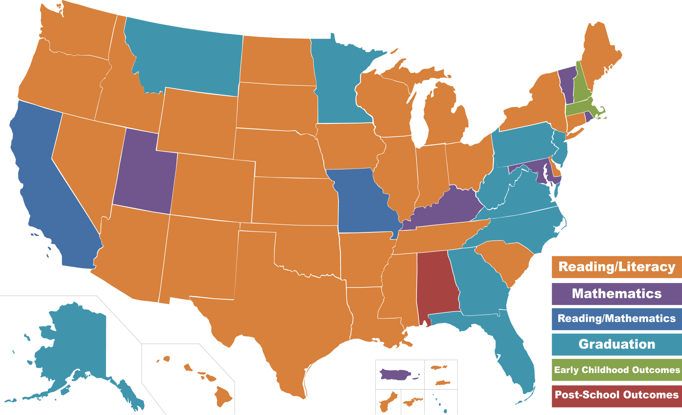
SIMR Map

Slide 10
Supporting Systemic Thinking to Build Capacity to Achieve Desired Results

Slide 11
Knowledge
Workforce Focus
How do state organizations engage, manage, and develop staff to utilize full potential -- in alignment with mission, strategy, and action plans?
How do states assess workforce capability and capacity needs to build an environment conducive to high performance?
How do states ensure individuals have the content knowledge and skills to do what is being asked of them?

Slide 12
Workforce Focus
Systems in Action: Phase I SSIPs
All states analyzed PD and TA systems
A third identified PD offerings to LEAs as a strength
A third saw this as an area for improvement
All 60 states are focused on building LEA capacity, including district and school-level staff
Coaching was a strength for 20% but an area for improvement in 15%
Use of technology, and professional learning communities were cited as strengths, as was certification of LEA staff, teaching and principal standards were a strength
Only one state addressed pre-service/institutions of higher education in its improvement strategies

Slide 13
Improvement Strategies

Slide 14
Focus Areas

Slide 15
Infrastructure Analysis

Slide 16
Given that…
Most states are focused on an “academic” SIMR (reading, math, or combo);
The most frequently mentioned improvement strategy in Phase I SSIPs was increasing access to the general education curriculum for SWD;
All states analyzed PD and TA systems and a third saw this as a critical area in need of improvement;
All 60 states are focused on building LEA capacity, including district and school-level staff;
but
Only one state addressed pre-service/institutions of higher education in its improvement strategies… and
Only 3% of states noted the State Equity Plans as an area for alignment with their improvement work…

Slide 17
It might make sense to…
Bring IHE Teacher Preparation programs into the discussion of improvement strategies to improve results for SWD
Use available state policy levers and initiatives to help influence preservice and inservice teacher preparation and professional development
Align strategies for State Equity Plans and the SSIP in selected/targeted districts

Slide 18
So that…
…the teachers working with SWD are effectively implementing the evidence-based practices (EBPs) that research and experience show are effective in improving outcomes for SWD and all students.

Slide 19
Questions to consider…
How might your state’s IHE Teacher Prep Programs/Preservice Programs become more involved in or aligned with your state’s improvement work related to improving results for SWD…specifically in the implementation of the SSIP?
How can we build a coherent system of educator development?

Slide 20
Where to find state SSIPs
State Profiles Part B
SPP/APR Report 2015 Part B

Slide 21
Connections to NCSI
NCSI Website: State Snapshot
NCSI TA Facilitators for each state
Part B and Part C
Collaboratives the state has joined
SIMR Focus Area

Slide 22
Resources
NCSI Website

Slide 23
Thank You!
http://ncsi.wested.org
@TheNCSI

