Slide 2
My Story: How Evidence Based Practices Shaped My Life
Colin Smith

Slide 3
Little Colin
Notes:
In Chronological Order:
Joke regarding my military phase and how my parents did not want me to join because I was an only child.
Then phase into discussion about my acumen for math and vocabulary. Accompany this then through first grade, but include that I was struggling to read and spell.

Slide 4
My First Dilemma/Success
Notes:
Digital image courtesy of the Getty's Open Content Program. The Getty does not endorse any content.
Talk about how I received an evidence based remediation that was not tailored to my individuals needs. Explain how I was left bored and lethargic. Transition into how later, with private tutoring, I became proficient. Ms…. Individually evaluated me, she compiled my strengths and weaknesses, talked with my parents, set goals, measured progressed, and succeeded. This is according to my Mother. When I was done, I was able to read. Will say how it made me feel I school.
Lead into your 3rd grade experience; Everyday Mathematics led to my marginalization. Talk more about this. According to my mother, I later learned, specific research showed that the curriculum harmed students like myself. This leads into my adult life.
Transition into how you felt about being at a charter school who was thought to be outstanding, but wasn't using the research to help me. Explain all the time I remembered sitting in a ineffective program of remediation. Tell them about how the school was using a well supported research based program on other students while leaving me out.
Conclude by saying that the holes in my school experience still haunt me today.

Slide 5
10th Grade Was a Different Year
Notes:
Talk about Ms. Smith Mention how she was explicit, provided feedback, encouraged students, gave them leeway- but still held students accountable, and showed the pathway to success to each and every student.

Slide 6
10th Grade
Notes:
Digital image courtesy of the Getty's Open Content Program. The Getty does not endorse any content.
I began to flourish because of Ms. Smith.

Slide 7
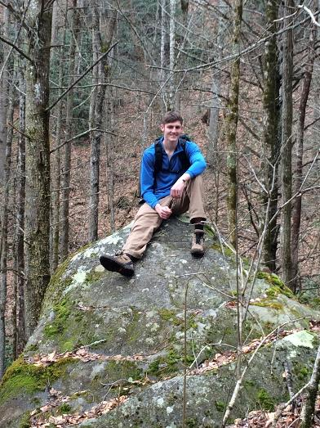
I’ve Begun to Find Myself

Slide 8
What Happens When You Don’t Use Evidence Based Practice
Notes:
This image is from: (https://www.linkedin.com/pulse/20140501184146-40474570-first-know-the-wall-then-be-the-spaghetti)
Not using evidence base practices is like throwing spaghetti against the wall.
Conclude by saying that the holes in my school experience still haunt me today.

Slide 9
Think Of Kids Like Me
Notes:
End on the notion that we have dream too.

