Slide 1
Anchor Presentation:
Inclusive Education for ALL Students
Hour 5
Access to Core/General Education Curriculum and Settings (Part 2)
Project #H325A120003
Notes:
This section of the module, Part 2 of Access to Core/General Education Curriculum and Settings, features the specific roles and responsibilities of team members related to supporting students’ meaningful access to and participation with curriculum; the principle of partial participation; curricular, instructional and ecological adaptations to support access and participation; and finally, embedded instruction as an evidence-based practice (EBP) to deliver high-quality, specialized instruction in inclusive settings.
We begin this section with a discussion of the roles, responsibilities, and strategies employed by an effective inclusion facilitator to implement high-quality, effective inclusive services for students with the most intensive and complex support needs. We define inclusion facilitators as credentialed teachers who develop and implement inclusive education. Inclusion facilitators are often special education teachers by trade but can also be general education teachers or other school team members.

Slide 2
Roles in Inclusive Settings
General education teacher(s).
Special education teacher(s).
Inclusion specialist.
Paraeducators.
Related services providers:
Occupational therapist.
Physical therapist.
Speech language therapist.
Adapted physical education teacher.
Orientation & mobility teacher.
Assistive technology specialist.
Sign language interpreter.
Behaviorist.
Notes:
This slide shows a list of some of the people who may be responsible for implementing inclusive services. We have included an inclusion specialist among the possible roles. Note that a general or special education teacher may act as an inclusion specialist; in some districts, an inclusion specialist is hired as a unique role while, in other districts, existing educators take on this role.
This list, although long, is certainly not exhaustive. Some students may require different types of support, based on their individual needs. In addition to variation in the size and composition of an educational team, the individual members will likely vary in their familiarity with inclusive practices and their comfort and skill in implementing inclusive services.
Recall that the importance of collaborative teaming and the roles of key team members in inclusive schools were previously discussed in the section Inclusive Service Delivery (Hour 3) of the module.

Slide 3
Inclusive Roles & Responsibilities
Class | Roles of Team Members
Period 3: English 11 | *English teacher will provide book list, materials, and tests in advance to SPED teacher. *SPED teacher will download digital books to iPad. *Vision specialist will provide enlarged text materials. *Speech therapists will provide assistance in writing speeches, comprehension of novels, and improving oral responses in class. *Paraeducator will set up laptop at start of class, scribe written responses, type homework in e-planner, and set up iPad with headphones.
Kurth & Gross, 2014
Notes:
It is, therefore, critical that every team member is familiar with the call to develop inclusive services and team members understand how to implement their responsibilities in an inclusive setting. The example on this slide demonstrates how teams examine a class activity or, in this case, class period and designate specific roles and responsibilities for each team member. In this instance, the student being planned for is a high school junior who experiences multiple disabilities, including physical and intellectual disabilities. A variety of team members collaborate to meet her unique needs. The team has documented how the student’s needs in English will be addressed; a similar plan would be made for all other class activities. The plan for these roles would be developed collaboratively, ideally before the beginning of the school year, and all team members would agree to their responsibilities. This planning may be completed in person or using online technologies; after it is developed and agreed upon, each team member would receive a copy for his/her permanent records. Periodically, the team may reconvene to troubleshoot and evaluate the effectiveness of the plan.

Slide 4
Communicating About Curriculum
What subjects or skills are you teaching next week/next unit?
Books used (include chapters and/or page numbers).
Materials/labs.
What tests will be given and when?
Topics/chapters/pages tested.
What long-term reports or projects will be part of this week/unit?
What project?
When was it assigned? When is it due?
Is it an individual or group project?
Are there any schedule changes ?
Field trips.
Assemblies.
Notes:
Inclusive educators need to be knowledgeable about the classroom routines, activities, and content to provide the best support to students and teachers. General education teachers and special education teachers need to communicate on a regular basis about the curriculum and instruction in a classroom to plan ahead for student needs. To fully prepare for the meaningful participation of students with disabilities, special educators may use these questions to guide their conversations with general education teachers to better plan for the upcoming week or unit. Specifically, understanding what skills or subjects will be taught, which tests will be given, if there are any long-term reports or projects, and schedule changes can all assist a special educator (or inclusion specialist) in knowing what types of support a student will need. This knowledge will further enable an inclusion specialist to gather or develop any needed adaptations to the curriculum, materials, and tests for the student ahead of time. Inclusion facilitators and teachers may meet face to face to communicate, by emailing these questions, or placing these as worksheets in teacher mailboxes to gain the needed information.

Slide 5
Readiness = Rejection
Some students may simply never be able to perform at the same skill levels as their typical peers.
And, skill levels cannot determine whether a student has access to general education.
And, we aim to provide an appropriate education.
Notes:
While considering the curricular needs of students with disabilities, we must be willing to confront the assumption of readiness skills. Many believe that there are a host of skills students must demonstrate to be ready to participate in general education; for example, a student may be expected to demonstrate appropriate behavior, reading skills, or the ability to care for her physical needs. The problem is that many students with disabilities will not ever pass a readiness test, making them at great risk of being excluded from standards-based, grade-appropriate, high-quality instruction. For example, a student who reads at a primer level is most likely excluded from 10th-grade English, yet may learn an enormous amount from listening to novels and participating in class lectures about perspective. Similarly, a student who demonstrates off-task or disruptive behavior in a special education classroom may learn self-regulation strategies by learning with same aged peers who do not experience disability in inclusive settings. In both of these situations, rejecting a student from a setting is making a dangerous assumption and also preventing a student from benefitting from high-quality instruction.

Slide 6
The Student Should Be Allowed to Participate in the Activity Even When:
the student does not exhibit all the necessary prerequisite skills,
the student will not be able to acquire all components of the skill, and
the student may not complete the entire activity or skill independently.
Notes:
Rather than making these dangerous assumptions and excluding children from learning, we propose allowing a student to participate in general education activities even if the student does not exhibit all of the necessary prerequisite skills. It is possible that a student has splinter skills, meaning that the student will be able to learn skills that are considered well above their current functioning level. We would further allow a student to participate in a skill even if she cannot acquire all components of the skill or cannot complete the skill independently.
6

Slide 7
Principle of Partial Participation
All students
can participate in whatever parts of a task or activity that they can, and in doing so
“can acquire many skills that will allow them to function, at least in part in a wide variety of least restrictive school and nonschool environments and activities” (Baumgart et al., 1982, p. 19).
Notes:
We operate on the principle of partial participation, meaning that students will likely benefit from completing some part of a task or activity, with or without assistance. In fact as Baumgart et al. (1982) shared more than 30 years ago, through partial participation, students “can acquire many skills that will allow them to function, at least in part in a wide variety of least restrictive school and nonschool environments and activities” (p. 19).
7

Slide 8
Remember!
Providing access to the general education curriculum does not mean the student must be able to access the curriculum in the same way as other students!
The level or severity of disability cannot be a reason for segregating students with disabilities!
Notes:
Together, the principle of partial participation and the focus on participation reminds us that it is not possible for us to predict what a person will be capable of learning or how a student will benefit from our instruction. Because none of us can predict what another person will learn, know, or do, we must provide all students with opportunities and support to learn.

Slide 9
So, How Do We Provide Meaningful Access and Participation?
Notes:
9

Slide 10
Notes:
As discussed in Part 1 of Access to Core/General Education Curriculum/Settings (Hour 4), Universal Design for Learning (UDL) and differentiated instruction (DI) are frameworks and approaches to create and provide meaningful access and participation. Both approaches utilize adaptations to curriculum, instruction, and the learning environment.
This section will further discuss adaptations, changes to curricular, instruction, and/or the environment to support student’s learning and engagement with the core curriculum.
Curricular adaptations make adjustments to what is taught; instructional adaptations adjust how teaching is delivered and learning is demonstrated. Last, ecological adaptations adapt the setting by removing physical barriers and adding needed personnel or material supports.

Slide 11
Types of Curricular Adaptations
Giangreco 2007
Notes:
Dr. Giangreco at the University of Vermont has identified four main types of curricular adaptations. Curricular adaptations allow a diverse group of same-aged students to learn together at different ability levels (such as advanced students and students with disabilities). In providing these adaptations, students share an activity or experience, and each learner has an individual learning outcome at an appropriate level of difficulty. Multi-level curriculum refers to changes in the curriculum in which students are responsible for more or fewer outcomes at different levels of complexity. Curriculum overlapping occurs when learning outcomes come from two or more curriculum areas such as from both reading and communication skills. Students are responsible for more or fewer outcomes at different levels of complexity. Implementing either multi-level or overlapping curriculum requires time, collaboration, and creativity—but by teaching in these ways, we provide opportunities for all students in a classroom to be successful and learn at a level that is appropriate for them.
11

Slide 12
General & Specific Adaptations
Helpful for everyone
Unique to a student
Graphic organizers.
Writing responses (e.g., type, draw, write).
Peer tutors.
Books at different levels, topics.
Colored overlays.
Visuals/pictures.
Manipulatives.
Embedded examples.
Resource guide/tool kit.
Word banks.
Planners/agendas.
Assignment checklist.
Consider students’ needs
Physical.
Sensory.
Cognitive.
Communication.
Attention.
Notes:
Janney and Snell (2000) further identified that adaptations can be general and specific. General adaptations are those supports educators put in place that provide support to all learners at different times. For example, having examples of a completed multi-step algebraic equation on the top of a worksheet will help all learners receive reminders of how to solve these equations. Although general adaptations are useful for all learners, specific adaptations are unique to the individual needs of a specific student. These take into account the specific physical, sensory, cognitive, communication, and attention needs of a specific student. For example, a student with a sensory loss such as deafness will need a sign-language interpreter (a specific adaptation) but will also benefit from visual cues during lectures and discussions (a general adaptation that would help other learners as well).

Slide 13
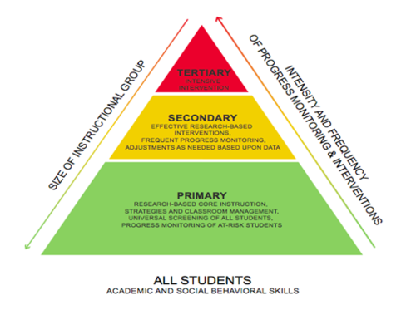
Instructional Adaptations
Providing general adaptations decreases the need for special adaptations (e.g., Tier 2 vs. Tier 3)
Notes:
The UDL framework, initially shared in Part 1 of Access to Core/General Education Curriculum/Settings (Hour 4) of this module, provides further guidance in making adaptations for students. Recall that UDL is premised on the idea that students benefit from having:
Different ways to represent knowledge (how content and directions are presented to students).
Different ways to express knowledge (how students show us what they know).
Different ways to engage (stay motivated in learning and activities).
UDL and a multi-tiered system of supports (MTSS) framework [MTSS was initially shared in Inclusive Service Delivery (Hour 3) of this module] give guidance about developing specific and general adaptation. We can think of general adaptations as Tier 1 (or primary) supports. By providing these, most learners (about 80%) will have their individual learning needs accounted for. There are a group of students who need more intensive general supports, more concrete representations provided, more high-interest books at different reading levels, and so on. These more frequent and intensive general supports account for Tier 2 interventions and will help an additional 15% of students be successful. Last, there is a group of students, those about whom we are talking in this module, with complex disabilities who will need specific adaptations that account for their unique physical, sensory, cognitive (e.g., memory), communication, and/or attention needs.
It is important to remember that these MTSS models and UDL reduce the number of students who require specific supports, and those supports will be more natural and easier to provide because the learning environment is already rich with general supports.

Slide 14
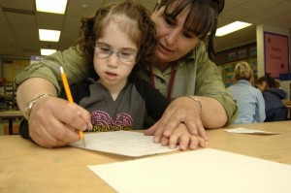
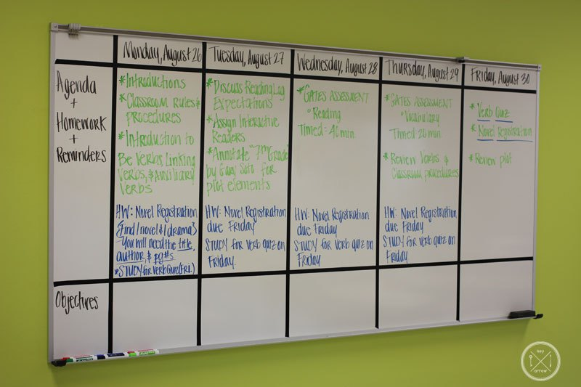
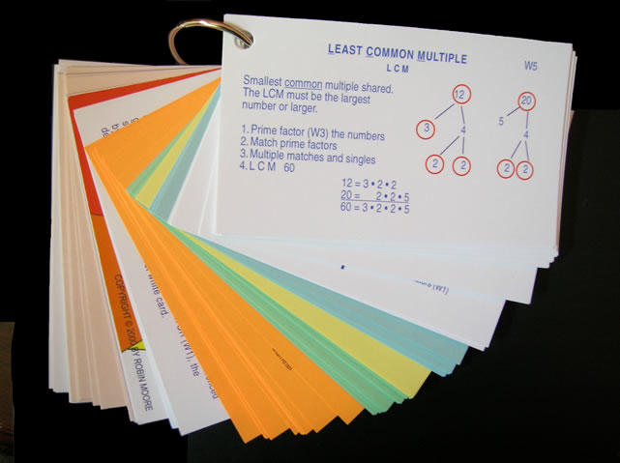
Ecological Adaptations
Notes:
Ecological adaptations are those made to remove barriers and provide supports within a setting. This slide shows a few examples of ecological supports, ranging from (clockwise from top left) wheelchair accessible desks, speech-to-text software, personnel supports, a token economy system, providing examples for completing multi-step math problems, and visual schedules (bottom right). Of course, the needs of the individual student will dictate what ecological adaptations will be needed, as will the demands of the activity.

Slide 15
In-Advance Adaptations
Predict what teachers and classes are doing ahead of time:
What text books?
What curricular materials?
What novels?
What exams?
What field trips?
Where will instruction occur?
Who will be present?
Notes:
To the extent possible, it is ideal to develop curricular, instructional, and ecological adaptations in advance of the lesson. To plan for these adaptations, educators must be able to predict what teachers and classes will be doing ahead of time. Knowing the books, materials, and other expectations of the lesson will be critical. Further, knowing where instruction will occur (e.g., in a science lab, art classroom), along with the people who will be present, will enable inclusion facilitators to make any needed ecological adaptations.

Slide 16
How Do We Make These Predictions?
Curricular maps.
Ask the teacher.
Get teacher editions of all text books, novels, curricular materials (e.g., school library, principal, grade level team).
Notes:
Making predictions about what will be taught is possible using some simple strategies. First, many schools require teachers to develop curricular maps at the beginning of the school year. An inclusion specialist can review these maps and get a general sense of what topics will be covered and what materials will be used. Second, inclusion specialists can follow up with individual teachers to inquire about what will be taught in the upcoming week or lesson unit. Last, it is helpful for inclusion specialists to have teacher editions of all text books, novels, and other materials. These are usually available in the school library or can be obtained by asking a building principal or grade-level team for them.

Slide 17
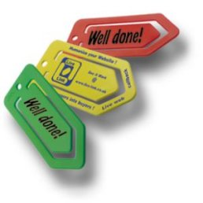
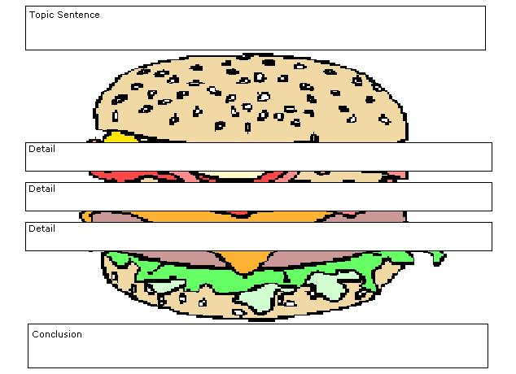
On-the-Spot Adaptations
Magazine pictures to use for reading comprehension and writing assignments.
Blank graphic organizers.
List of sponge activities.
Story starters.
An adaptations materials/supplies box.
Notes:
Despite this background preparation, the best laid plans of mice and men often go awry. Having a substitute teacher, an assembly, a student illness, or for pedagogical reasons, the pacing and sequence of instruction may be altered, making pre-made adaptations less than useful. Thus, making on-the-spot adaptations will be necessary. Inclusion specialists can best prepare for these situations by having a bag of tricks ready to make on-the-spot adaptations. Having items like white out, label makers, highlighters, and graphic organizers readily on hand are very useful for making on-the-spot adaptations to worksheets, lectures, and other assignments.
17

Slide 18
What Is a Good Adaptation?
Does it facilitate social and instructional participation?
Is it “only as special as necessary?”
Does it promote independence?
Does it build on strengths and preferences?
Is it age and culturally respectful?
Did the student make learning progress with it?
Notes:
Simply making in-advance or on-the-spot adaptations can be instrumental in helping students gain access to the core general education curriculum. However, understanding how effective those adaptations are is critical.
Janney and Snell (2006a) and Kurth and Keegan (2014) have identified a few questions that can be useful in determining how effective an adaptation is. First, does the adaptation facilitate social and instructional participation? In other words, was the student better equipped to participate with peers and access the important pieces of instruction by using this adaptation? Second, was the adaptation only as special as necessary? It is rather easy to create adaptations that stigmatize and alienate students. It is important to create an adaptation that assists the student in participating using as many of the same materials, supports, and locations as other peers. Third, does the adaptation promote independence? All instruction will require some adult input and facilitation; however, the adaptation should allow the student to work as independently as possible, with peers, and not requiring extensive one-to-one prompting and support from adults. Fourth, does the adaptation build on strengths and preferences? Paula Kluth and Patrick Schwarz (2008) reminded us in their book Just Give Him the Whale that honoring student preferences facilitates learning. If a student learns best visually, providing visual supports is beneficial. If a student prefers to learn about dinosaurs, incorporating dinosaurs into reading, writing, math, and other activities can provide a useful hook for student learning. Fifth, is the adaptation age and culturally respectful? That is, it would be inappropriate to give an adaptation with cartoon characters on it to an older student. It is important to ask, “Would I feel comfortable giving this adaptation to a similar student without a disability?” If the answer to that question is “yes,” then it is more likely to pass this test. Last, collecting data and engaging in progress monitoring will be necessary to determine if the student made learning progress using the adaptation. It would be disrespectful to the student and her instructional time to continue using adaptations that are not effective. Taking progress-monitoring data can help us avoid using adaptations that are not facilitating learning.

Slide 19
Embedded Instruction
Notes:
Teaming and providing adaptations are necessary first steps in delivering effective inclusive instruction. However, these are inadequate to provide truly inclusive instruction, particularly for teaching skills to students that require specialized instruction and are typically taught in self-contained special education classes. Embedded instruction is emerging as an EBP to deliver high-quality, specialized instruction, in inclusive settings.

Slide 20
Teaching Trials
How many trials does the student need to learn the skill?
The student’s current functioning level.
The complexity of the skill being taught.
The structure of the activities and routines of the class.
Notes:
To begin the process of embedded instruction, and truly any special education, it is critical that the instructor knows how many trials a student requires to learn a skill. We want to be certain to provide students adequate opportunities to learn. Because students with significant intellectual disabilities require more support to learn skills than other students, this is particularly important. For example, if a student is learning to read the sight word the, we want to know approximately how many times we need to teach the word the before the student is likely to learn it. This may require 256 presentations; however, if we stopped our instruction after 200 trials, the student would not learn a skill he/she is capable of learning. How does one know how many learning trials a student will need? It depends on a number of factors, including the student’s learning rate, or current functioning level, and the structure of the activity.
The student’s functioning level tells us approximately the student’s learning rate. For example, if we graphed a student’s sight-word reading and found they were learning five words per month, his/her learning rate would be about one new word per week. We would want to further collect data to determine how many presentations of this word the student needed. Having an estimate of approximately how many times a student needed to see the sight word before it was learned would also be helpful. Factors such as attention, memory, and other cognitive processes will help us approximate a student’s current functioning level.
The overall complexity of the skill to be learned can also help us determine how many trials a student is likely to need. A number of factors contribute to task complexity, including the type of thinking required (e.g., higher order reasoning, abstract concepts); the demands for memory and attention to complete the task; and the underlying skills required to complete the learning task (such as fine motor skills, social skills, and behavior regulation skills). Generally speaking, more complex skills will require more learning trials to reach mastery.
Last, the structure of the activities and routines will help determine how many teaching trials a student will need. Activities and routines that have more structure, such as checklists or visual reminders, will often be learned more rapidly than skills for which there is little context or for abstract reasoning skills.
In general, viewing previous data to learn about the student’s learning history in previous, similar situations, will be key.

Slide 21
Massed Trials
What do we mean?
1-2PM: T₁ T₂ T₃ T₄ T₅ T₆ T₇ T₈ T₉ T₁₀ T₁₁ T₁₂ T₁₃ T₁₄ T₁₅
Video example:
Massed Trials Teaching Example
Pros:
Opportunity, direct instruction.
Cons:
Generalization; authentic/spontaneous use.
Student frustration/boredom/behavior.
Forces segregation.
Notes:
While designing instruction, then, we aim to provide students with enough instructional trials so the student can learn the skill. Typically, special educators use massed trials to deliver this instruction. Let’s imagine that we have a student who needs 150 trials to learn a skill. In this case, let’s say the skill he needs to learn is how to tie his shoes. As depicted in the slide, the team can provide 15 trials of shoe tying between 1:00 and 2:00 in the afternoon. If we do this every day for 2 weeks (15x5x2), we will have provided the needed 150 trials.
Instructor note: Consider playing one or both video examples of discrete trial teaching, which illustrate massed trials. (2:05 minutes; URL http://www.teachertube.com/video/discrete-trial-training-210480)
The advantages of massed trials is that we can use this technique to provide adequate opportunity for students to learn skills and provide direct instruction in teaching the skill.
The disadvantage of massed trials is that the skills taught in these situations rarely generalize to other settings because they are context free. Instead, students learn to perform a skill in a rote manner but do not know how to authentically or spontaneously use the skill when it is needed. Another major disadvantage is that massed-session trials are context free and, thus, are often not intrinsically rewarding to perform. This makes students likely to become prompt dependent and dependent on artificial reinforcement but can also lead to boredom, frustration, and even behavior problems. Last, massed trials are usually completed in segregated settings, as you saw in the video. This is not only a problem with creating segregation, but it is also unlikely to be the authentic space where the skill will be needed. To illustrate, imagine teaching a child to tie and untie his/her shoes 15 times in an hour, every day, for 2 weeks. Common sense tells us that this is just not a very logical approach.

Slide 22
Distributed Trials
Practice goals across a typical school day.
Distributed trials:
8-9 AM: T₁ T₂
9-10 AM: T₃ T₄
10-11 AM: T₅ T₆
11AM-12PM: T₇ T₈
12-1 PM: T₉ T₁₀
1-2 PM: T₁₁ T₁₂
2-3 PM: T₁₃ T₁₄ T₁₅
3PM: Advantages to generalization, maintenance, acquisition.
Notes:
In contrast to massed trials, embedded instruction distributes those learning trials across a day. This is one of the two key characteristics of embedded instruction. The 15 instructional trials were taught in 1 hour with massed trials but are taught across the school day, once or twice per hour. The advantages to distributed trials are promotion of skill generalization, maintenance, acquisition, and decreased student frustration.

Slide 23
Specific & General Goals
“Read five sight words taken from the core vocabulary.”
“Respond to name when called.”
“Identify coins by name and value.”
“Write name correctly.”
Notes:
Embedded instruction using distributed trials can be used to teach specific and general individualized education program (IEP) goals. Each of the goals listed here can be distributed across a school day; some of the more general goals (e.g., correctly write name, respond to name when called) are readily embedded in a typical school day. There are plenty of natural opportunities in a general education setting to address these goals.

Slide 24
Natural Teaching Opportunities
Math is a natural time to work on math goals.
Recess and lunch are natural times to work on social and communication goals.
Reading is a natural time to work on reading and writing goals.
PE is a natural time to work on gross motor skills.
Art is a natural time to work on fine motor skills.
Notes:
Natural opportunities are just like they sound; they are naturally occurring times when a skill could be practice. The natural time to teach math skills is during math class. The natural time to work on social communication goals is during lunch or recess. In other words, schools are already created with times set aside for specific types of instruction and activities.

Slide 25
Example
Third-grade math class; graphing lesson.
Students are naming favorite ice cream flavors and using this data to create bar graphs.
Student with ID has goal to count to 10 with one-to-one correspondence.
How can student work on this goal?
Notes:
Let’s look at this example. We have a third-grade math class learning to graph. Students are naming their favorite ice cream flavors, tallying, and graphing them. A student with intellectual disability in the class has an IEP goal to count to 10 with one-to-one correspondence. How can the student work on this goal in this natural setting?
Count how many students have their hands raised for each flavor.
Count number of flavors.
Count number of tally marks.
Count lines on graph paper.
As illustrated in this example, this simple and fun activity provides a great natural opportunity to work on an IEP goal, even an IEP goal that, as in this case, is below-grad-level standard. In other words, we can assume that the other third-graders have mastered counting to 10, and this student with intellectual disability can still practice the skill of counting as a fully participating member of this general education class.

Slide 26
Natural Opportunities & IEP Matrix
Notes:
The IEP goal matrix is a useful tool for identifying natural opportunities. As you can see, the team wrote the student’s schedule in the left hand column. This includes bathroom, math, science and so on. Next, the team wrote the student’s IEP goals across the top row of the matrix. The team then simply placed an “x” whenever the IEP goal could naturally be worked on.

Slide 27
Inclusion & Embedded Instruction
To meaningfully include students and provide embedded instruction, we need to:
Find and implement (enough) opportunities during a typical school day to practice important skills using the materials and activities that are naturally available.
Notes:
Thus, to meaningfully include students and provide embedded instruction, we need to identify, distribute, and teach adequate instructional trials during a typical school day using natural opportunities and also embedded opportunities. This brings us to the second key feature of embedded instruction: The trials should be distributed across natural and embedded opportunities. We have already defined natural opportunities; next, we will define embedded opportunities.

Slide 28
Embedded Opportunities
What it is: Not enough natural opportunities.
Why?
Skill not typically taught to age-mates.
The student needs more opportunities than naturally available.
Notes:
Embedded opportunities are those opportunities that we must create. In other words, sometimes a student will need more teaching trials than are naturally available during a school day. These could include opportunities to learn skills that are not typically taught to other same-grade peers or when a student needs more opportunities to learn than are naturally available due to the student’s learning rate, the complexity of the skill, or the structure of the environment.

Slide 29
Embedded Instruction: Example
Biology class.
Wesley enters class and takes out his materials.
Other students also enter and get materials ready.
Peer tutor walks to Wes, greets him, and does an instructional trial (approx. 30 seconds).
Peer tutor records data.
Class lecture takes place.
Class transitions to lab activity.
Peer tutor completes another instructional trial during transition.
Lab activity.
Notes:
Here is an example of how embedded instruction is used in a secondary setting for Wesley, who has autism and is learning to communicate using a voice output device. This example occurs in biology. Wesley enters the biology classroom and takes out his materials, including his communication device, books, and notebooks. Other students are also entering the classroom, chatting to one another, and getting their own materials out and ready. After Wesley has entered the class and has his materials ready, a peer tutor walks up to Wesley, greets him, and does a 30-second instruction trial. The instruction could be on any topic—finding keys on the communication device, identifying sight words, calculating a math problem, responding to a greeting, or any other IEP goal. After the instructional trial, the peer tutor records on a simple data collection sheet the data for that instructional trial. For example, the peer might mark a “+” if Wesley was correct or a “-” if Wesley was incorrect. Class begins, the teacher provides instruction, and Wesley uses adapted materials to participate in the lecture and class activities. About 25 minutes into class, the whole class transitions to a lab activity. During this transition point, the peer tutor repeats a brief instructional trial with Wesley on the same or different IEP goal as before. Following this, the peer tutor once again tracks data, and Wesley joins his lab group and completes the lab activity with needed adaptations.
As illustrated in this example, Wesley was fully included in his class activities through the use of adaptations, and extra instructional trials for needed skills were embedded seamlessly into this routine, maximizing instructional time and providing Wesley with necessary special instruction.

Slide 30
Another Example
Student goal is to identify coins by name and value.
Most high school students have mastered money, which is not typically taught in general education.
Natural times are not sufficient:
Snack bar (open at lunch).
Purchase pencils at library.
Need to identify other times to embed this instruction.
Notes:
In another example, a student who is learning to identify coins by name and value in high school is unlikely to have many other high school peers who are also learning about money. We would like to distribute instruction of identifying money in natural opportunities. What are some natural opportunities to use money in high school (e.g., cafeteria, vending machines). We may chart this out on our IEP matrix and realize that there are not enough trials present in a typical school day, particularly if a student’s learning rate tells us we need a lot of trials.

Slide 31
Find Times to Embed Instruction
Naturally occurring non-instructional times when the skill can be taught:
Standing in line to come in the classroom.
Taking attendance.
Passing out papers.
Walking to cafeteria.
Others?
Notes:
So, we may embed an opportunity to practice identifying money by embedding opportunities throughout the day. A peer, paraeducator, general or special teacher could present instructional trials of identifying coins while the student is in line to enter a classroom, while the teacher is taking attendance, while students are passing out papers, and during many other opportunities.
What may be some considerations for embedding instruction? Certainly, you will want to make sure to provide embedded (and natural) instruction in a non-stigmatizing, age-respectful manner. You will want to keep the instructional trial brief (usually less than 1 minute). This way, the student is less likely to interfere with his learning or the learning of others.
Open up discussion to participants for other considerations.

Slide 32
Another Example of Embedded Instruction
Teach sight-word reading to Anthony, who has Down syndrome and is in the fifth grade.
Notes:
Let’s look at another example of embedded instruction, this time for Anthony, a fifth-grader who has Down syndrome.

Slide 33
Example
Notes:
Here is an example of Anthony’s typical school day. On the far left column, you see his typical daily sequence of class activities. The middle column identifies the natural opportunities to work on sight-word reading skills from a list of high-priority sight words. Finally, the column on the far right identifies other natural opportunities during these activities to work on sight-word reading.
Kurth & Gross, 2014. The Inclusion Toolbox. Thousand Oaks, CA: Corwin Press.

Slide 34
Notes:
This slide shows the rest of Anthony’s schedule with natural and embedded opportunities to work on sight-word reading. These sight words could be printed on small notecards, and a peer, paraeducator, general education, or special education teacher could present a few flashcards to Anthony during these times. Can you think of other times or methods for maximizing natural and creating embedded opportunities to instruct Anthony?

