Slide 1
Collaboration for Effective Educator Development, Accountability, and Reform
Course Enhancement Module on Evidence-Based Math Interventions:
Part 2: Universal Math Instruction
H325A120003
Notes:
The recommended timeframe for this presentation is 60-120 minutes, with an additional 60-120 minutes for activities and handouts.
Introduce yourself (or selves) as the facilitator(s) and briefly cite your professional experience in regard to multi-tiered systems of support (MTSS), Response to Intervention (RtI), and/or supplemental intervention implementation.
The goal of today’s session is to explain the purpose and rationale for supplemental interventions (a) as part of a larger MTSS and (b) in laying the groundwork for effective intensive intervention. This module is part of a larger set of trainings that cover different elements of the data-based individualization process for delivering RtI. In Part 3 of the CEEDAR Course Enhancement Module (CEM) about MTSS in mathematics, you will learn about the importance of implementing universal math curriculum and using data to assess if the curriculum is working to improve student outcomes in mathematics.
Speaker notes are provided for most of the PowerPoint slides included in each of the four parts of this CEM. The notes provide additional details about the information presented in a particular slide, including the context for the information presented as well as further elaboration of key points. Thus, the speaker notes are intended as a guide for the presenter who is using the PowerPoint slides and may be modified as needed. Specific citations for modules and webinars are also provided in the notes section of the slides.
Instructions for using the speaker notes:
Text formatted in standard font is a sample script for the presenter. Although these may be read verbatim, speaker notes are intended as a guide for the presenter and may be modified as needed. Text formatted in italics is intended as directions or notes for the facilitator.
An orange star on the slide indicates an active participant learning activity. The steps for interactive activities are described for each slide.
A blue star on the slide indicates the corresponding handout for the activity.
Although permission to reprint this publication is not necessary, the citation should be:
Collaboration for Effective Educator Development, Accountability, and Reform. (2014). Course Enhancement Module on multi-tiered system of supports in mathematics, Part 2: Universal math interventions. Washington, DC: U.S. Department of Education, Office of Special Education Programs, The CEEDAR Center. Retrieved from: http://www.ceedar.org

Slide 2
Collaboration for Effective Educator Development, Accountability, and Reform (CEEDAR)
H325A120003
Notes:
In light of many of these difficulties, CEEDAR was developed as a response.

Slide 3
Note
Part 2 comprises content and resources from:
The National Center on Intensive Intervention (NCII): www.intensiveintervention.org
Center on Response to Intervention: www.rti4success.org
The IRIS Center for Training Enhancements. (2010). RTI: Mathematics. Retrieved from http://iris.peabody.vanderbilt.edu/module/rti-math/#content
The IRIS Center Evidence-based Practice Summaries. Retrieved from http://iris.peabody.vanderbilt.edu/ebp_summaries/
RTI Action Network: http://www.rtinetwork.org
Understanding Language: http://ell.stanford.edu/
Vocabulary Instruction and Assessment of Spanish Speakers Research Program: http://www.cal.org/vias/index.html
CREATE Center: http://www.cal.org/create/research/index.html
Notes:
Give participants time to briefly view the slide.

Slide 4
CEM Part 2 Guiding Questions
What is universal instruction in multi-tiered systems of supports MTSS?
What does high-quality math instruction at the universal level look like?
What are considerations for math instruction in the Common Core State Standards (CCSS)?
What is the role of screening and progress monitoring at the universal level?
What are some considerations for data-based decisions at the universal level?
Case Study: Meet Mr. Math and his student Ethan.
Notes:
These guiding questions will be discussed in more detail in this CEM part:
What is universal instruction in MTSS?
What does high-quality math instruction at the universal level look like?
What are considerations for math instruction in the Common Core State Standards (CCSS)?
What is the role of screening and progress monitoring at the universal level?
What are some considerations for data-based decisions at the universal level?
At the end of this CEM part you will engage in a case study.

Slide 5
Learning Expectations
After studying this part of the module, you will be able to:
Define universal math instruction.
Examine high-quality math instructional practices at the universal level.
Identify the steps in the screening process and the use for progress monitoring at the universal level.
Evaluate different case studies to determine ways to support learning at the universal level.
Notes:
These objectives will be covered in this CEM part.
Give participants a minute to read the objectives for this part.

Slide 6
Warm-Up
Notes:
In this CEM part, you will engage with the concept of universal math and how it fits into the MTSS model. Before we do that, let’s take a moment to do a warm-up activity.

Slide 7
Activity: Sticky Note Carousel
Handout 4
Interactive Activity
Use a sticky note to answer the questions posted on each wall.
Post your sticky on the wall under each question.
Notes:
Throughout Part 2, participants will engage with the content through interactive activities that they can also apply to their classroom teaching situations. These are noted with an orange star on the slide. Corresponding handouts are noted with a blue star. This first activity is called Sticky Note Carousel.
For Sticky Note Carousel:
1.Tape the questions below (also in Handout 4) on walls around the classroom.
2.Give participants a thin stack of sticky notes. Students will use the sticky notes to answer the questions and then post the notes on the relevant wall (under each question).
3. Participants will revisit this activity at the end of Part 2. Therefore, encourage them to write their answers in blue ink so that they know which answer pertains to the warm-up activity (instead of the cool-down activity).
4. Discuss some of the answers as a class and reference certain answers as they arise throughout Part 2.
5. If there is time debrief on the activity, note that this anticipation activity helps you formatively gauge participants’ pre-existing knowledge with respect to the content. Similar anticipation activities could be conducted in a math class.

Slide 8
What Is Universal Instruction in MTSS?
Notes:
Before we talk specifically about universal math, let’s discuss key characteristics of instruction at the universal level in MTSS. As we talk, remember that universal instruction is sometimes referred to as Tier I, core instruction, or primary level instruction. For the rest of the CEM, however, we will refer to it as universal instruction.

Slide 9
Multi-Level Prevention System
Intensive Level of Prevention
(~5% of students)
Supplemental Level of Prevention
(~15% of students)
Universal Instruction
(~80% of students)
National Center on RTI, 2010
Notes:
As we discussed in Part 1 of the CEM, the goal of MTSS is to help every student access the grade-level standards in a strong and effective instructional program that is standards based, data driven, and responsive to student needs. Effective use of data from multiple assessment measures allows teachers and practitioners to make good decisions about what they are teaching their students so that they do not teach students what they already know but really focus on what the students do not know and identify, especially with struggling students, those who are not accessing grade-level content and may benefit from additional supports.
The triangle represents three levels of instructional intensity. The universal level includes high-quality core instruction. The supplemental level includes evidence-based intervention(s) of moderate intensity. The intensive prevention level includes individualized intervention(s) of increased intensity for students who show minimal response to secondary prevention. At all of these levels, instructional practices should be evidence based, meaning that research supports the use of the instruction.
Here in Part 2 of the CEM, we will discuss the universal level.
For more information on the essential components of MTSS, visit the Center on RTI at http://www.rti4success.org/, especially
http://www.rti4success.org/resource/essential-components-rti-closer-look-response-intervention

Slide 10
Universal Level
FOCUS: ALL students.
INSTRUCTION: District curriculum and instructional practices that are research based, aligned with state or district standards, and incorporate differentiated instruction.
SETTING: General education classroom.
ASSESSMENTS: Screening, continual progress monitoring, and outcome measures or summative assessments.
National Center on RTI, 2010
Notes:
The focus at the universal level is on ALL students. It is delivered within the general education classrooms and is the school district’s core curriculum, whether that is in the form of a complete universal program from a publisher or a district-developed program that is composed of best instructional practices. In any instance, however, instruction at the universal level should include instructional practices that are evidence based and aligned with state or district standards and national standards.
The assessments administered at the universal level of prevention are screening, continual progress monitoring (for students near the cut point for screening or those who have transitioned from more intensive levels of support), and summative assessments such as state assessments or final exams. School-based professional development (PD) is institutionalized and structured so that all teachers continually examine, reflect upon, and improve instructional practice.

Slide 11
Universal Level
High-quality core math instruction (i.e., Tier I, primary level).
Effective for approximately 75-80% of the students.
Evidence-based or research-based high-quality instruction implemented with fidelity.
Instruction for about 45-90 minutes per day for all students.
National Center on RTI, 2010
Notes:
Give participants time to read the bullets on the slide.

Slide 12
Features of Universal Instruction
Universal screening for all students
Progress monitoring for some students
Data-based decision making
High-quality instruction for all students
Notes:
The features of this MTSS level, the universal level, include high-quality evidence-based core instruction delivered with fidelity and consideration for cultural and linguistic responsiveness and recognition of student strengths. This level includes screening for all students and progress monitoring for those students who score below a determination point, or a cut score, on the universal screener. Another MTSS feature evident throughout all the MTSS levels is the process for data-based decision making. The four characteristics of universal instruction will be the focus in this CEM part.

Slide 13
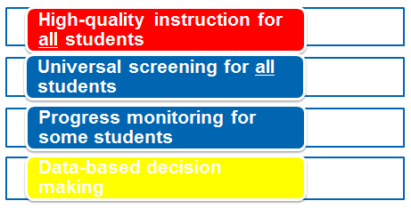
CEM Part 2 Guiding Questions
What is universal instruction in MTSS?
What does high-quality math instruction at the universal level look like?
What are instructional considerations for English learners in universal math?
What are considerations for math instruction in CCSS?
What is the role of screening and progress monitoring at the universal level?
How should data-based decisions be made?
Notes:
We have discussed the first question in this CEM part. Now, we will discuss high-quality instruction at the universal level and will answer the next three questions. This discussion will be followed by the use of assessments at the universal level and then data-based decision making at the universal level. You can see how each of these Part 2 guiding questions align to one of the MTSS universal features.

Slide 14
What Does High-Quality Math Instruction at the Universal Level Look Like?
Notes:
Universal math instruction should include evidence-based practices using a standards-aligned curriculum (Buffum, Matto, & Weber, 2012). Your school or district may use a comprehensive published math universal program or it may have conceptualized its own core universal math curriculum. According to Buffum et al. (2012), you should consider comprehensive programs as resources. However, you may need to modify the existing comprehensive program based on your students’ needs or augment aspects of it for additional high-quality math instructional practices. Also, focus on implementing standards-based instruction using the relevant district standards. Therefore, we will first discuss some of the evidence-based features, or instructional practices, of high-quality math instruction before turning to discussion about the current national math standards.
For more information: http://www.rti4success.org/video/how-do-i-know-if-rti-tools-and-interventions-i-am-using-are-evidence-based
http://iris.peabody.vanderbilt.edu/module/math/cresource/resources/page-10-references-additional-resources-and-information/#content

Slide 15
Activity: Video Jigsaw Listening
Interactive Activity
Watch as Dr. Allison Gandhi addresses the following question:
How do I know if tools and interventions are evidence based?
http://www.rti4success.org/video/how-do-i-know-if-rti-tools-and-interventions-i-am-using-are-evidence-based
National Center on Response to Intervention, n.d.a
Notes:
As mentioned on the previous slide, at all MTSS levels, instructional practices should be evidence based. So let’s explore this notion further. This term is important across all the MTSS levels: universal, supplemental, and intensive. It is often applied to intervention curriculum, assessments, and teaching practices. When an instructional feature or comprehensive instructional program or intervention is said to be evidence based, this means that there were likely a few experiments in which some students received the program or instructional feature and some students did not. If there were learning gains in the treatment group that were statistically significantly greater than in the control group, sometimes referred to as differential effects, then there is some indication that the instructional feature was helpful for student learning. When additional studies, called replications, find similar positive effects, there is better indication that the instructional feature facilitates student learning. Now let’s watch a video featuring Dr. Allison Gandhi, principal researcher at the American Institutes for Research, who explains the notion of evidence based in more detail.
You may conduct this video activity through Jigsaw Listening. Jigsaw Listening is an activity that students/participants can then use in their teaching contexts.
For Jigsaw Listening:
Students pair up and take out paper for taking notes.
One person in each pair (half of the class) should watch the video in order to answer, “What is evidence-based practice?” The other partner should watch the video in order to answer the question, “What are considerations for selecting evidence-based tools and interventions?”
At the end of the video, partners share their responses with each other.
Debrief the content as a class. Ask: What is evidence-based practice and what should be considered in selecting evidence-based tools?
You may also debrief the activity as a class. Ask: How did this activity support students? (Students may respond that they were able to engage with a partner and discuss each of their answers with a partner before discussing as a whole class. Therefore, their partner could provide support and modelling if needed.)
Consider different populations and student groups while exploring the evidence of a program or instructional feature. Therefore, if you have a certain student demographic in your classroom, evidence for the instructional feature or program is strengthened for that student group if the research reports how the program functions for the relevant student subpopulation. When judging an evidence base, consider the different groups and how they may respond rather than just considering the general efficacy of an intervention.
Ask participants what subgroups they might explore further.

Slide 16
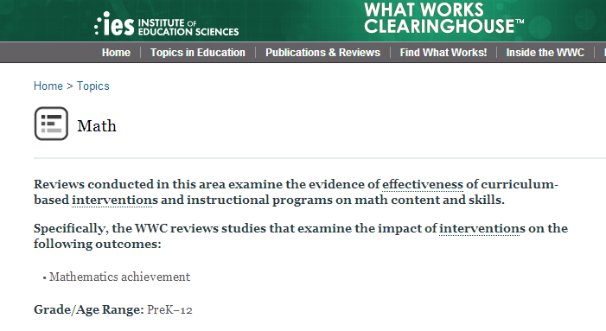
What Works Clearinghouse
What Works Clearinghouse, 2008
Notes:
There is a list of evidence-based universal (as well as secondary and intensive) math programs and interventions on the What Works Clearinghouse (WWC) website. The WWC is part of the U.S. Department of Education’s Institute of Education Sciences (IES), which was established under the Education Sciences Reform Act of 2002.
This link details WWC review procedures: http://ies.ed.gov/ncee/wwc/pdf/reference_resources/wwc_procedures_v2_1_standards_handbook.pdf
Some universal program WWC research reports are summarized here: http://iris.peabody.vanderbilt.edu/ebp_summaries/

Slide 17
WWC Effectiveness Rating Categories
Rating | Evidence for Positive Effect? | Evidence for Negative Effect?
Positive effects | Strong evidence | No evidence
Potentially positive effects | Evidence | No evidence
No discernable effects | No evidence | No evidence
Mixed effects | Evidence | Evidence
Potentially negative effects | No evidence | Evidence
Negative effects | No evidence | Strong evidence
What Works Clearinghouse, 2008
Notes:
These are the six WWC ratings:
Positive effects. Strong evidence of a positive effect with no overriding contrary evidence.
Potentially positive effects. Evidence of a positive effect with no overriding contrary evidence.
No discernible effects. No affirmative evidence of positive or negative effects.
Mixed effects. Evidence of inconsistent effects.
Potentially negative effects. Evidence of a negative effect with no overriding contrary evidence.
Negative effects. Strong evidence of a negative effect with no overriding contrary evidence.
Understanding each rating will help you as you use the WWC website to identify universal math programs. Keep in mind that evidence should show function of the program with relevant student subgroups.
This link details WWC review procedures: http://ies.ed.gov/ncee/wwc/pdf/reference_resources/wwc_procedures_v2_1_standards_handbook.pdf
Some universal program WWC research reports are summarized here: http://iris.peabody.vanderbilt.edu/ebp_summaries/

Slide 18
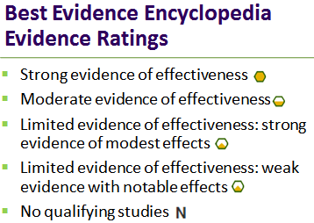
Best Evidence Encyclopedia
Center for Data-Driven Reform in Education, n.d.; National Center on Response to Intervention, n.d.b
Notes:
The Best Evidence Encyclopedia provides similar reports for evidence. Each program reviewed is rated for its level of evidence, and a symbol next to each program’s name shows its rating. The categories of evidence of effectiveness are strong, moderate, limited (strong evidence of modest effects and weak evidence with notable effects), and no qualifying studies. Ratings are based on both the quantity and the quality of studies reviewed and consider the number of studies, the type of studies (preference for randomized or randomized quasi-experimental), sample size, and effect size.
For more information: http://www.bestevidence.org/math/mhs/top.htm

Slide 19
Activity: Pairs to Squares Exploration
Handout 5
Interactive Activity
Center for Data-Driven Reform in Education, n.d.
What Works Clearinghouse, 2008
Notes:
Now let’s investigate some of the universal math programs using information from WWC or the Best Evidence Encyclopedia.
Conduct this activity using activity Handout 5. The activity, called Pairs to Squares, takes about 15 minutes to complete. Participants can keep track of this activity in their notebooks in order to draw on this when they begin teaching.
For Pairs to Squares:
Have participants work in the same pairs as the prior activity.
Each pair should pick two universal programs and explore the information on the WWC or Best Evidence Encyclopedia website.
After an appropriate duration of time, have partners combine with another pair (groups of four; “square the pairs”) and share their findings.
If pair in the small groups investigated different programs, they can give a brief summary of the program. If they investigated the same universal program, they can each report their findings and discuss how their analyses were similar and different.
Debrief the activity with participants; noting how working in pairs, then small groups, helps provide peer scaffolding and support. They can keep these grouping structures in mind in universal math.

Slide 20
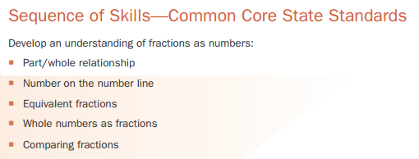
High-Quality Math Instruction Includes:
A mix of teacher-directed and student-centered instruction with explicit attention to math concepts by teachers and students.
A rigorous cognitive level with a range of curricular components that build on each other in a coherent sequence.
New math concepts introduced to students using a variety of different methods.
Students prompted to explain thinking, practice solving problems, and reason conceptually, abstractly, and visually.
Assessment that informs instruction.
National Center on Intensive Intervention, 2014
Notes:
Explicit instruction often entails initial instruction and modelling by the teacher, guided practice with the teacher, independent student practice and application, and reteaching to address misunderstandings. Although not math specific, many practices outlined by Paschler et al. (2007; IES Practice Guide) can be applied to math. These findings include space learning over time; use a sequence of content that builds understanding in meaningful ways (see figure on slide for example of a sequence with fractions); integrate examples with practice; combine visual and verbal descriptions; integrate abstract and conceptual representations; assess students to inform and facilitate learning; and teach students how to judge their own learning and strengthen their metacognitive skills, those skills that help them to think about their learning.
Have participants discuss these and other features.
For more information: The IRIS Center for Training Enhancements. (2010). High-quality mathematics instruction: What teachers should know. Retrieved from http://iris.peabody.vanderbilt.edu/module/math/
Center for Data-Driven Reform in Education. (n.d.). Mathematics/middle and high school. Best evidence encyclopedia. Retrieved from http://www.bestevidence.org/math/mhs/top.htm

Slide 21
Teachers Using High-Quality Math Instruction May:
Relate content to prior experiences and build background knowledge when necessary.
Explicitly instruct important concepts and how existing and requisite math skills can be used to solve problems.
Model and demonstrate concepts and support students as they practice.
Support students as they practice and prompt students to think aloud with respect to their math reasoning.
Attend to students’ math error patterns.
Foster conceptual math understanding through the use of heuristic strategies.
IRIS Center for Training Enhancements, 2010; National Center on Intensive Intervention, 2014
Notes:
Support students’ math learning through modelling concepts and prompt them to expressively think aloud while they acquire and work with a new skill.
Buffum et al. (2012) presented the notion of concentrated instruction as a “systematic approach of identifying essential knowledge and skill that all students must master” (p. 45). They suggested asking questions like, “Where are we and where do we need to go?” Echevarria, Vogt, & Short (2013) recommended conducting a task analysis to determine the elements that require additional background enhancements. To conduct a task analysis, determine the degree of background knowledge a student must possess in order to accrue the new content knowledge and then conduct background-building activities accordingly. For example, an instructor may show a brief multimedia video clip related to a math concept before modelling the target concept for the class.
For explicit instruction, demonstrate each step related to a specific set of math problems and allow students to practice on a new set of problems using the same procedures (Baker, Gersten, & Lee, 2002; Gersten et al., 2009). Show students heuristic strategies that promote metacognitive math learning. Heuristic strategies are those that help students think about their math learning (e.g., underline key words, check work). These strategies are not math specific, but they help students attend to methods for solving math problems (Gersten et al., 2009), and these heuristic techniques are particularly supportive of students with learning disabilities.
Have participants think-pair-share ways they have seen their teachers implement these practices or have implemented these practices themselves.
For Think-Pair-Share:
1. Pose the question.
2. Provide students a few minutes to reflect on their answers.
3. Students find a partner and share together.
4. Debrief answers as a whole class.

Slide 22
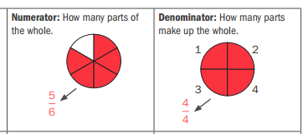
Teachers Using High-Quality Math Instruction May:
Develop math language:
Promote word-level and text-level skills students will need to engage with and comprehend the math content.
Figure from: National Center on Intensive Intervention, 2014
Notes:
Develop students’ math language. Academic English is the language of the classroom, of academic disciplines (e.g., science, history, and math) in texts and literature. It is often used in extended discourse related to reasoning (Schleppegrell, 2004, 2007). Unique linguistic patterns in math can be found in vocabulary, discourse, and with grammatical patterns. For example, to contend with math, one must relate math concepts to each other and work with more technical and sometimes abstract math vocabulary (see Bauman & Graves, 2010, for a discussion regarding academic vocabulary). Therefore, promoting skills connected to the language structures in math is helpful for student math learning. At the end of this CEM section, we will discuss ways to focus on math vocabulary. However, supporting students contend with the language of math also includes the discourse and text levels as well.
Have participants think-pair-share how these practices can help promote student math learning.
Figure drawn from curriculum on http://www.intensiveintervention.org/resources/sample-lessons-activities/mathematics.

Slide 23
Teachers Using High-Quality Math Instruction May:
Promote visual representations:
Draw on visual and graphic representations for more abstract concepts.
Use manipulatives and multimedia.
McGraner et al., 2011; National Math Advisory Panel Report, 2008
Notes:
Paivio (1990) brought forth the dual coding theory. The dual coding theory stipulates that learners draw on visual and verbal information when comprehending new information. Therefore, helping to strengthen the visual code for math concepts may help promote, facilitate, and support students’ understanding, especially with more abstract concepts.
Read slide. Have participants think-pair-share ways they have seen their teachers implement these practices or have implemented the practices themselves.

Slide 24
Teachers Using High-Quality Math Instruction May:
Enable engaged learning, including peer-mediated learning.
Notes:
At the universal level, there should be opportunities for student interactions and discussion and interaction between teacher and students using all modalities of language: reading, speaking, writing, and listening (Fuchs, Fuchs, Mathes, & Simmons, 1997; Moschkovich, 1999). Grouping configurations can be strategically applied to support math lesson objectives.
Look at the three square pictures. These pictures depict the grouping configurations: teacher-to-whole-class and independent practice. What do you notice about the level of engagement with the students in the square pictures? Do you think instruction is reaching all of them? (Allow participants to share.) You can see in these pictures that some students are engaged, like the female in the pink shirt and the male in the plaid shirt, but not all students. The female in the purple shirt in the back looks very bored, or perhaps she is confused.
Now look at the circular pictures. What do you notice about the level of engagement? (Allow participants to share.) These grouping configurations increase student discussion and engagement with the math content. In paired work, half the class will be speaking at once.
Teacher-to-whole-class and independent practice have an important place in the lesson but should be used along with paired work and small group configurations as well. The instructional goals of the lesson should be used to determine the grouping patterns for each class, and in turn the groupings should be supported by lesson goals and objectives.
Strategic grouping configurations can also support a gradual release of learning (e.g., teacher models, teacher models with students, students do it together, students do it alone), through which students’ responsibility is increased as they acquire the concept (see Fisher & Frey, 2013, for discussion regarding gradual release). For example, a teacher may initially model a new math concept to the class (i.e., teacher-to-whole-class), then have students practice with a partner and confirm their answers in small groups. At the end of the lesson, when students have already engaged with the concept with their peers and acquired it through the teacher model, they may participate in an individual activity.
If there is time, conduct the noise experiment. Ask one participant to be the Noise Monitor. Pose a question to the class and call on one student. Have the Noise Monitor note the noise level. Then pose a second question and ask participants to share in pairs. Have the Noise Monitor note the noise level. Have participants discuss their feelings with respect to the noise level. Ask: Is a noisy classroom always a sign of an unmanaged class? What are additional considerations regarding peer learning? Students may respond that they should monitor the groups/pairs, that students should be held accountable for learning in form, that students may become more adept at peer learning activities as the year advances (with additional practice), that noisy activities should not be conducted when the next-door neighbor is administering an important test, etc.
For more information, see: http://iris.peabody.vanderbilt.edu/module/rti-math/cresource/how-can-teachers-effectively-implement-rti-for-mathematics/rti_math_11/rti_math_11_link_lessonplan/#content

Slide 25
Use Groupings Aligned to Instructional Goals
Determine and combine grouping configurations based on instructional goals.
Cooperative, small groups
Paired instruction
Independent practice
Peer tutoring/learning models
Whole class
IRIS Center for Training Enhancements, 2010
Notes:
Paired instruction often includes students working in dyads. Cooperative small groups often entail small groups of students. Each student is usually held accountable for his or her learning and performance in the small group (Slavin, 2011). Ask participants to discuss ways they may hold students accountable for learning in small groups.
Peer tutoring and learning models show promise in the research as a way to support student learning and increase learning motivation while students practice a concept (Fuchs, Fuchs, Yazdian, & Powell, 2002; Roscoe & Chi, 2007; Saenz, Fuchs, & Fuchs, 2005). Peer tutoring should not be used as a means to teach entirely new concepts (Fuchs et al., 2002). With peer tutoring and learning, students teach each other. In reciprocal peer learning, the roles of the tutor and tutee switch. Cross-age peer tutoring and learning models include dyads of different ages (Topping, 2005). The tutor or learning leader is often the older student.
Determine student groups using a variety of ways; do not always group based on math proficiency level or language proficiency level. Students may choose groupings, or teachers might choose. Perhaps students are grouped based on interests. Consider pairing/grouping as a means of scaffolding, using heterogeneous groups in terms of math proficiency level. At other points in instruction, students may be paired in more homogenous groups and the activity differentiated to meet each group’s needs. Also consider language background and social elements while determining groupings. Link your reasons for grouping and peer learning back to the needs of the lesson goals and objectives.
For more information: http://iris.peabody.vanderbilt.edu/module/rti-math/cresource/how-can-teachers-effectively-implement-rti-for-mathematics/rti_math_11/rti_math_11_link_lessonplan/#content

Slide 26
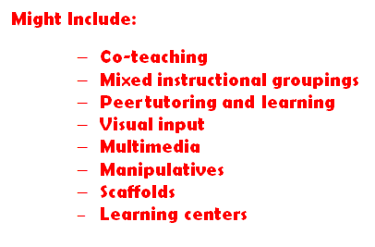
Teachers Using High-Quality Math Instruction May:
Implement accommodations to ensure that all students have access to the universal math program.
Notes:
We know that classrooms today are diverse, with students who have many different backgrounds, interests, and language backgrounds. González, Moll, & Amanti (2013) discussed the notion of funds of knowledge—all children bring important attributes with them to their learning situations, and those attributes, or funds, can be drawn on to help promote additional content acquisition.
Instruction at the universal level should strive to meet the diverse needs of all students, including students with learning disabilities. At the universal level, this may include differentiation of instruction, or tailoring instruction to meet individual student needs (Tomlinson, 2000; Tomlinson & McTigue, 2006). Attention should be given to differentiation practices that are linguistically and culturally responsive, accommodations, and modifications. In universal instruction, differentiation may involve mixed instructional groupings, team teaching, peer tutoring or learning, learning centers, and accommodations to ensure that all students have access to the instructional program (Williams et al., 2014). Consider the learning goals and universal math lesson objectives and then consider how you can help each student in class access those goals and learning objectives. How can you unlock the target math content for each child? For some students, you may need to scaffold their learning with some supports or present material in a different way. Other students will benefit from lessened support, removal of the scaffolds, or additional instructional enhancements. For example, you may observe that one student is a very visual learner. Therefore, during individual practice time, you could show that visual learner a digital image that depicts the target math concept. You may notice that another student has grasped the target concept before the others; you may provide that student with an extension activity or pair that student with another student who would benefit from some additional support.
Differentiated instruction is NOT the same as the supplemental or intensive instruction that characterize the other MTSS levels. It is also NOT conducting three different kinds of lessons in one class, and math instruction should focus on the grade-level math concepts outlined by the standards. Scaffolding is also found within differentiation. The term scaffolding is used to talk about instructional supports that help support students as they learn. We often talk about implementing certain kinds of scaffolds in learning, but strategically removing scaffolds when students are ready, informed partially through assessment, is just as important as applying the scaffold.
If there is time, have participants reflect on times they have encountered differentiation, scaffolding, and removal of scaffolding in their lives.
Also, have participants share ways they may differentiate math instruction at the universal level. If they are currently teaching, they may talk together about the different differentiation practices they have seen. If they are not yet teaching, they may talk about different ways they have seen their teachers differentiate instruction.
For more information: http://iris.peabody.vanderbilt.edu/wp-content/uploads/2013/06/div.pdf#content

Slide 27
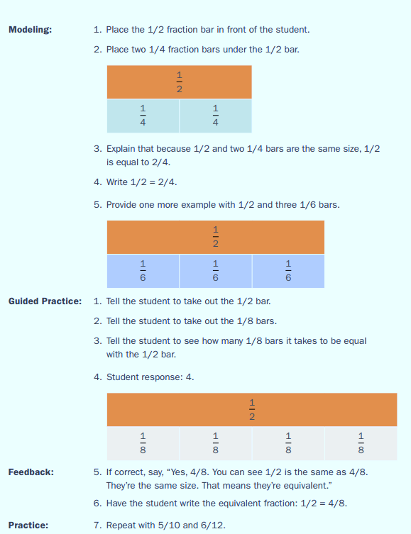
Support Learning for Students With Disabilities
Use precise language to teach key concepts.
Model, repeat, and demonstrate steps in a process.
Provide concrete learning opportunities, including the use of manipulatives.
http://www.intensiveintervention.org/resources/sample-lessons-activities/mathematics
National Center on Intensive Intervention, 2014
Notes:
This slide depicts steps in an example of supportive instruction from the National Center on Intensive Intervention.
Read slide.
According to VanDerHeyden and Allsopp (2014), students with math learning disabilities can have “difficulties with visual-spatial processing and associating mathematical language with the abstract notations used to represent mathematics (i.e., numbers and symbols)” (p. 22). Therefore, concrete graphical representations in universal instruction can provide support with more abstract math concepts. Consider also the needs of students with reading disabilities (see Jordan, 2007) as they engage with the language of math. These students may need support with the language elements that arise in their math materials. Research shows promising effects in helping students with disabilities attend metacognitively to their math learning (think about their learning and acquisition), and heuristic strategies, or those strategies that help students think about their learning process, can help promote students’ metacognitive mathematical thinking (Fuchs, Fuchs, & Prentice, 2004).
For more information: National Center on Intensive Intervention. (2014). Fractions as numbers. Washington, DC: U.S. Department of Education, Office of Special Education Programs, National Center on Intensive Intervention.

Slide 28
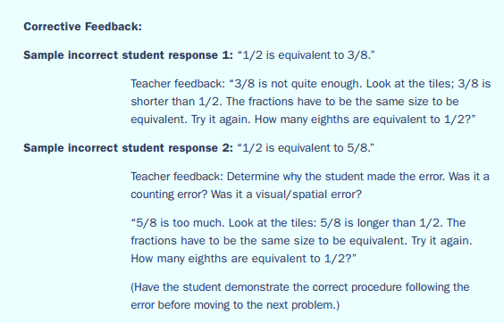
Support Learning for Students With Disabilities
Provide repeated opportunities to correctly practice skills.
Deliver feedback and direct error correction.
Encourage the student to repeat the correct process when an error is made.
http://www.intensiveintervention.org/resources/sample-lessons-activities/mathematics
National Center on Intensive Intervention, 2014
Notes:
Providing students opportunities to practice with the new math skill is also an important component in supporting students with math learning disabilities. Provide opportunities for students to practice and apply the new math skills. While they practice provide performance feedback that includes explicit correction of errors as they work; encourage student to repeat the correct process. Incorporate peer-mediated into practice opportunities for students as well (Baker, Gersten, & Lee, 2002). Peer assisted learning show promise in the research as a way to support student learning and increase learning motivation while students practice a concept (Fuchs et al., 2002; Roscoe & Chi, 2007; Saenz et al., 2005). Peer tutoring should not be used as a means to teach entirely new concepts (Fuchs et al., 2002). Refer back to slide 25 for the various peer assisted learning models.
The National Center on Intensive Intervention has developed a collection of companion materials and activities intended to assist special education teachers, interventionists, and others working with students with intensive mathematics needs.
See more at: http://www.intensiveintervention.org/resources/sample-lessons-activities/mathematics

Slide 29
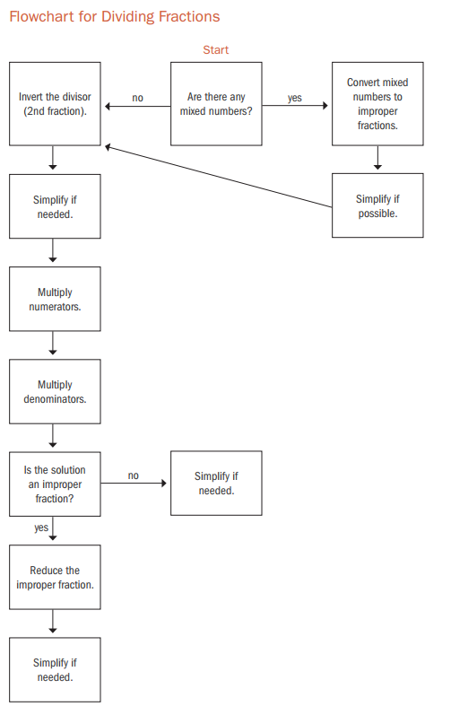
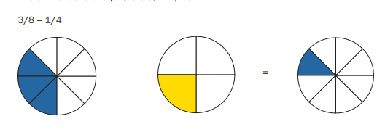
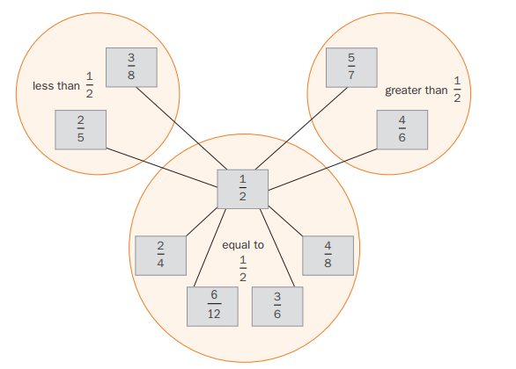
Draw On Graphic Supports and Graphic Organizers
Present information in a variety of visual formats.
http://www.intensiveintervention.org/resources/sample-lessons-activities/mathematics
National Center on Intensive Intervention, 2014
Notes:
Also, while presenting information for students with math learning disabilities, consider additional formats and include visual cues. For example, the process to complete a new math concept may be represented through a flowchart or with visual cues. Graphic organizers, such as Venn diagrams, T-charts, word webs, and thinking maps, can help students identify concepts and make relationships among them, and teacher-prepared outlines equip students with a form for notetaking while reading dense text material. These are most helpful to students if major concepts are already filled in and students provide details. Consider providing partially filled in outlines and then fading this scaffold out when students are ready to independently take notes. These visual representations also help support students acquiring English. These visual ways to present information help students make use of the visual representation route, as discussed in Paivio’s (1990) dual coding theory, while English learners contend with the language.

Slide 30
Address the Needs of English Language Learners
Watch and listen as Dr. Alfredo Artiles talks about considerations for instruction in MTSS for English language learners (ELLs).
http://www.rti4success.org/video/what-should-educators-take-consideration-when-instructing-english-language-learners
Center on Response to Intervention, n.d.f
Esparza Brown & Sanford, 2011
Notes:
So now, let’s talk more specifically about considerations for English language learners (ELLs) at the universal level. Before a student moves from the universal level to the supplemental level, it should be determined that the student received linguistically and culturally appropriate instruction within the universal curriculum (Sanford, Brown, & Turner, 2012).
English learners compose roughly 10% of school-aged children today (Batalova, Fix, & Murray, 2007), representing more than 400 languages (Esparza Brown & Sanford, 2011). The largest demographic group comes from homes where Spanish is the home language. While engaging with this part of the CEM, keep in mind that ELL students in the U.S. are a heterogeneous group and that second languages, according to Bialystok and Hakuta (1994), “develop under an extremely heterogeneous set of conditions, far more diverse than the conditions under which children learn their native language” (p. 2). English learners’ language proficiency profiles may be different; some students may come to their schooling experience in English with strong first-language proficiency while others may not have fully developed their first language before acquiring English (Brown & Doolittle, 2011). Therefore, instructional guidelines in this CEM section should be taken as general considerations and with acknowledgement that each of your ELL students will have individual learning needs.
Let’s watch a video in which Dr. Artiles, professor at Arizona State University, talks about ways to be culturally responsive to the needs of ELLs in an MTSS framework. Keep the following question in mind as you watch the video: What should educators take into consideration when instructing ELLs, particularly in an MTSS framework?
Debrief answers as a class.
Broadly speaking, although good, high-quality instruction is generally helpful for English learners, research also indicates that additional instructional supports are beneficial for English learners’ content learning (August & Shanahan, 2006; Gersten et al., 2007; Baker et al., 2014). Some promising practices that help support their learning across disciplines in the universal level are multimodal in nature. These multimodal practices draw on multiple modes of input, including visual and nonlinguistic support. Multimedia that integrates animated visualizations, oral language, and, if with captions, written connected text, is well suited to supporting English learners content learning. Other promising practices indicated by research also help strengthen students’ text-level skills such as promotion of vocabulary development and students’ academic language development (see August & Shanahan, 2006). These are vital areas to promote because past research has documented the fact that English learners may lag behind their non-English-learner peers in terms of oral language proficiency (see August & Shanahan, 2006).
Sanford, Brown, and Turner (2012) presented the PLUSS model of instruction, which integrates many of these aspects. They presented the PLUSS model related to reading instruction, but many of these aspects will apply if you add math next to reading:
P: Preteach critical vocabulary
L: Language modeling and opportunities for using academic language
U: Use visuals and graphic organizers
S: Systematic and explicit instruction in reading (and math) components and strategies
S: Strategic use of native language
For more information: http://www.rti4success.org/sites/default/files/rtiforells.pdf

Slide 31
Use Valuable Resources
Draw on students’ background experiences and home languages as learning resources.
1 ½
Moshkovich, n.d.; National Center on Response to
Intervention, n.d.b; Understanding Language, 2010
Notes:
Because English learners have experience with other countries and/or languages, they will bring unique backgrounds with them to their learning situations, and these funds of knowledge can be drawn upon to promote content instruction in English (Baker et al., 2014; Echevarria, 2013), including math. According to Esparza Brown and Sanford (2011), “the time spent in asking specific questions about a student’s background will yield benefits in planning assessment and instruction. The formal and home literacy experiences of ELLs will also provide insights about their instructional needs” (p. 7).
Keep in mind that a student may come from prior learning structures and situations that are far different from those found here in the United States, and with math, students may have received instruction on math concepts in different ways. For example, they may have been discouraged from showing work. Therefore, students from other countries may benefit from guidance and support with schooling structures that are new to them, and they may feel empowered if asked to draw on their prior background experiences. You can work with students to understand their backgrounds and find out ways to make them feel comfortable, empowered, and supported in their new learning environment.
If there is time, have participants speak in small groups about times they traveled to a new country, watched another country’s TV show, or participated in a new sport. Have the groups discuss cultural elements that were new to them and how they felt navigating new cultural contexts. Have groups discuss ways they can help support students new to the schooling structures here in the United States. Also, have groups discuss ways they can find more information about a child’s background and prior schooling experiences and support students with their new learning environments and in building new background.
For more information, reference CEEDAR’s culturally responsive education innovation configuration at: http://ceedar.education.ufl.edu/wp-content/uploads/2014/08/culturally-responsive.pdf
Other resources for more information include:
http://www.rti4success.org/sites/default/files/rtiforells.pdf
http://ell.stanford.edu/sites/default/files/math_learnmore_files/2.Principles%20for%20Math%20Instruction%208-14-13.pdf
http://ell.stanford.edu/sites/default/files/math_learnmore_files/4.Language%20of%20Math%20Task%20Templates%2010-4-13.pdf

Slide 32
Provide Nonlinguistic Input
Utilize graphics, graphs, realia, manipulatives, multimedia, gestures, and actions.
Moshkovich, n.d.; Center on Response to Intervention, n.d.b; Understanding Language, 2010
Notes:
The use of nonlinguistic support in addition to the oral input can help promote students’ visualization of their math learning. This may help students remember and comprehend math concepts through their visual routes (remember Paivio’s dual coding theory). These techniques are particularly supportive for English learners because English learners are learning grade-level math content in the language they are acquiring (Moschkovich, 2012), so gestures, realia, and multimedia (like captioned videos and digital texts) provide an additional level of support (see Dalton, Proctor, Uccelli, Mo, & Snow, 2011). Manipulatives, such as counting chips, microscopes, and globes; real-life objects, such as coins, bills, and models of animate and inanimate objects; and other visual aids can reduce the language load of an activity and provide concrete examples to students whose English skills and background experiences may be lacking. Visuals, such as overheads, models, graphs, charts, timelines, and maps, all help students who have a hard time processing large amounts of auditory information.
For more information, see:
http://ell.stanford.edu/sites/default/files/math_learnmore_files/2.Principles%20for%20Math%20Instruction%208-14-13.pdf
http://ell.stanford.edu/sites/default/files/math_learnmore_files/4.Language%20of%20Math%20Task%20Templates%2010-4-13.pdf
http://www.rti4success.org/resource/implementing-effective-literacy-practices-instructing-english-language-learners-within

Slide 33
Utilize All Language Modalities
Provide varied opportunities for practice and reinforcement of math concepts in speaking, listening, reading, and writing.
Moshkovich, n.d.; Center on Response to Intervention, n.d.b; Understanding Language, 2010
Notes:
Promote the use of academic language structures found in math through student engagement with the different modalities of language: reading, writing, speaking, and listening (Baker et al., 2014). Each language modality is characterized by different linguistic structures and requires slightly different skill sets. For example, speaking is more expressive in nature than listening, grammatical patterning varies between writing and speaking; and so on (McNamara, Crossley, & McCarthy, 2010). Practice and application activities in all four language modalities in math class provide students opportunities to engage with math in the specific language modalities.
For more information, see:
http://ell.stanford.edu/sites/default/files/math_learnmore_files/2.Principles%20for%20Math%20Instruction%208-14-13.pdf
http://ell.stanford.edu/sites/default/files/math_learnmore_files/4.Language%20of%20Math%20Task%20Templates%2010-4-13.pdf
http://www.rti4success.org/resource/implementing-effective-literacy-practices-instructing-english-language-learners-within

Slide 34
Promote Academic Math Conversations
Provide authentic ways for students to engage in meaningful math conversations.
Help students actively use their academic math language.
Moshkovich, n.d.; Center on Response to Intervention, n.d.b; Understanding Language, 2010
Notes:
Encourage all students to engage with class math discussions. As students are in the formative stages of acquiring English, Moschkovich (n.d.) cited that instructors should focus on their math reasoning and knowledge and their utilization of math practices, instead of extensive focus on English learners’ accuracy with language use or language mistakes they may make.
For more information, see:
http://ell.stanford.edu/sites/default/files/math_learnmore_files/2.Principles%20for%20Math%20Instruction%208-14-13.pdf
http://ell.stanford.edu/sites/default/files/math_learnmore_files/4.Language%20of%20Math%20Task%20Templates%2010-4-13.pdf
http://www.rti4success.org/resource/implementing-effective-literacy-practices-instructing-english-language-learners-within

Slide 35
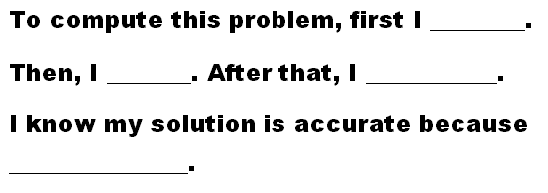
Support Academic Math Conversations
Model academic math language for students.
Provide sentence frames and other scaffolds to help support academic math talk.
Allow for additional wait time in discussion.
Speak clearly and slowly.
Moshkovich, n.d.; Center on Response to Intervention, n.d.b; Understanding Language, 2010
Notes:
Model academic language for students and apply language scaffolds to help prompt students’ expressive use of academic math language. Allow for some additional time as your ELL students are participating in academic math conversations (Echevarria, Vogt, & Short, 2013), especially for students in the formative stages of English acquisition. Without some additional wait time, the class conversation may have moved on before that child could participate.
As a class, brainstorm other ways to support academic math conversations.
For more information, see:
http://ell.stanford.edu/sites/default/files/math_learnmore_files/2.Principles%20for%20Math%20Instruction%208-14-13.pdf
http://ell.stanford.edu/sites/default/files/math_learnmore_files/4.Language%20of%20Math%20Task%20Templates%2010-4-13.pdf
http://www.rti4success.org/resource/implementing-effective-literacy-practices-instructing-english-language-learners-within

Slide 36
Engage Students in Peer Learning
As students actively take part in learning, they practice expressive use of math language.
Moshkovich, n.d.; Center on Response to Intervention, n.d.b; Understanding Language, 2010
Notes:
English learners benefit from engaged learning time so that they can routinely and actively practice with English. Moreover, when active, engaged learning takes place in a certain subject (in this case, math), students expressively practice the language structures that are often found in that subject’s language register. Therefore, peer learning and active student engagement has been shown to be supportive for ELLs (Baker et al., 2014; Gersten et al., 2007) because it provides authentic opportunities for students to actively engage with English—the language they are acquiring—and when this occurs in math, it is also in the register of the math subject area.
Recall the teacher-to-whole-class grouping configuration that we just discussed in this CEM section. In that configuration, only one student can talk at a time. So what would happen if that grouping was exclusively or pervasively used in universal math? (Allow participants to share. Some answers may be that there would be limited opportunities for students to engage with their “language instrument.”) With teacher-to-whole-class configurations, only one student can speak at a time, and with independent practice, none of the students are speaking or engaging with their oral language instruments. Teacher-to-whole-class has a place in high-quality universal math instruction but in concert with the other grouping configurations (that are informed by instructional goals).
At the same time, keep in mind that some learning structures of other countries may be different. A child coming from a teacher-to-whole-class lecture-style learning situation may benefit from some adaptations to support them as they begin to engage with peer learning activities.
Have students share how they might help support students as they acclimate to interactive learning.
For an example of math interactive activities: http://www.cal.org/create/pdfs/siop-math-tip-final.pdf
For more information, see:
http://ell.stanford.edu/sites/default/files/math_learnmore_files/2.Principles%20for%20Math%20Instruction%208-14-13.pdf
http://ell.stanford.edu/sites/default/files/math_learnmore_files/4.Language%20of%20Math%20Task%20Templates%2010-4-13.pdf
http://www.rti4success.org/resource/implementing-effective-literacy-practices-instructing-english-language-learners-within

Slide 37
Enhance Students’ Math Vocabulary
Evidence-based vocabulary instruction should:
Be daily and explicit.
Consist of definitions and contextual examples.
Include repeated exposure to target words over several days.
Engage students in active, deep processing activities with target words in reading, writing, listening, and speaking.
Include regular review of words that are difficult for students to acquire.
Center on Response to Intervention, n.d.b
Notes:
Now let’s turn to vocabulary instruction’s place in universal math instruction. Universal math instruction should consist of some vocabulary instruction for all students as a way to help support their promotion of word-level elements in their math materials. Vocabulary is a key determinant in models of reading comprehension, but it is also an important component in content knowledge acquisition and academic success, and acquiring the vocabulary of a content domain is associated with success in that content (in this case, math; see Bravo & Cervetti, 2008; Schleppegrell, 2007). English is a vocabulary-rich language with a vast and ranging lexicon (i.e., universe of words; Nation, 2001). Some research suggests that children will acquire 50,000 words by the time they leave secondary school (Graves, 2006). So English vocabulary acquisition is a tall order for many school-aged children. Fostering vocabulary development across content areas can prove to be very beneficial for all students; in many cases, it will be extremely beneficial for students such as English learners and students with learning disabilities because, at times, the vocabulary level poses some challenge for these learners (see August & Shanahan, 2006).
Recent research suggests that vocabulary instruction that is daily and explicit and includes repeated exposure that promotes deep processing of target words can be effective for all students. These studies show that exposure can come in a variety of forms, including use of visuals, such as illustrations and graphic organizers; use of videos; paired activities between ELLs and English proficient students; group discussions; and writing activities. The goal of these vocabulary instructional components is for students to develop an understanding of word meanings to the point where they can use these and related words in their communication and as a basis for their content area learning.
With respect to the math language register, a level of depth, or quality, of word knowledge is needed for some conceptual words in order for students to grasp the math concepts (Marzano, 2004; Schleppegrell, 2007). For some conceptual words vital to math, it may not be enough for a student to have a general sense, or flavor, for the word, they may need more complete word knowledge (Marzano, 2004)—one has to understand fully what a hypotenuse is if one is going to apply the Pythagorean Theorem. Consider Marzano’s (2004) point when choosing words for rich vocabulary instruction in math; we will talk about choosing words shortly. Because the math register is technical in nature, a characteristic of math language regards multiple-meaning words; students may encounter new technical, or domain-specific, word meanings for word forms they already know (e.g., table, operation, expression, solution). These words may pose a challenge for language learners and students with reading disabilities. Therefore, draw their attention to the new meaning for the known word form and the way it appears in the content area (in this case, math; see Bravo & Cervetti, 2005).
Let’s talk about what makes up math vocabulary. Domain-specific words are those words that are mainly found in the content areas. For math, domain-specific words are measurement, diameter, cubic, etc. These words are more technical in nature, conceptually key to a content area, and in many cases lower frequency (compared to words that cross-cut subject areas). Although these words are useful for students, current research (Baker et al., 2014; Gersten et al., 2007; Nagy & Hiebert, 2011) and the CCSS (2013) authors also recommend focusing on words that cut across content areas. These are called general academic words—like identify, determine, scarcely. They have high dispersion across the content areas, meaning that they are found across the disciplines. Words of grammatical cohesion, or connectives, also fall under this category—for example, however, therefore. These connectives join ideas and signal shifts in text, and in math understanding, these words may help students better comprehend conceptual and relational elements of math problems, math word problems and text \book explanations (see Nation, 2001; Uccelli, Rosenthall, & Barr, 2012).
Concerning English learners, note that in some cases, they may present with different vocabulary needs from their non-English-learner peers. For example, English learners may need additional assistance with words that native speakers already know and are not part of the academic curriculum. For example, ELLs may not know words such as bank, take, sink, or can, yet textbook publishers will assume that students know these words and not include them as vocabulary targets. Teachers should provide students with a brief instruction during lessons that emphasizes the meanings of common phrases and expressions, not just single words. They can also draw attention to potentially confusing words and phrases during instruction. In other cases, some ELLs may more easily acquire words that may be more arduous for their non-ELL peers. For example, words that are shared across two languages and words that are higher frequency in the ELL’s first language may present with a lessened learning challenge for the ELL student compared to a child who does not have experience with that other language. (Remember that the ELL student population is heterogeneous and the transfer effect across languages may not be as evident with ELLs who have less developed first languages.)
Formatively assessing students’ vocabulary knowledge can help shed light on the kinds of words they may need additional instructional support on. Let’s now turn to some elements of strategic vocabulary instruction with respect to math.
For more information, see:
http://ell.stanford.edu/sites/default/files/math_learnmore_files/2.Principles%20for%20Math%20Instruction%208-14-13.pdf
http://ell.stanford.edu/sites/default/files/math_learnmore_files/4.Language%20of%20Math%20Task%20Templates%2010-4-13.pdf
http://www.rti4success.org/resource/implementing-effective-literacy-practices-instructing-english-language-learners-within

Slide 38
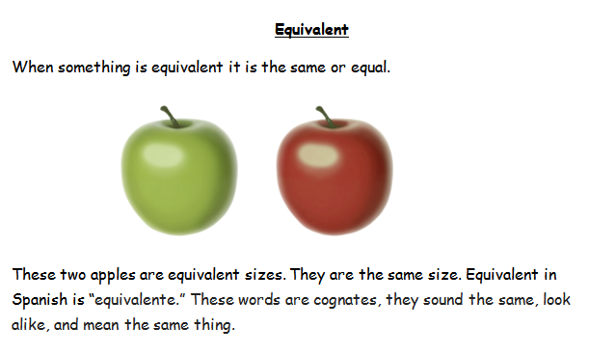
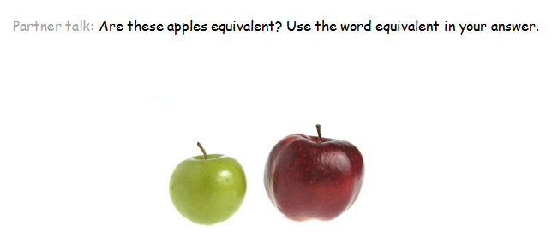
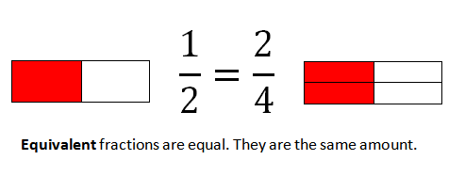
Robustly Instruct Judiciously Chosen, Useful Words
Present a few key domain-specific and general academic words and phrases in child-friendly language and apply the word to its use in math.
Notes:
Choose words and phrases for rich vocabulary instruction very carefully. A prudent selection of words for rich instruction is critical because rich vocabulary instruction, instruction that prompts students’ deep processing of word meanings (see Beck & McKeown, 2002; Coyne, McCoach, & Kapp, 2007), although effective, is also time intensive. Accordingly, only a handful of words should be taught at a time. Some authorities recommend teaching about eight to 10 words per week; others suggest two to three words per day.
Some words may pose a greater acquisition challenge (Nation, 2001) such as words that are more abstract and less able to be mentally imaged; these conceptually difficult words may benefit from the additional instructional support of rich instruction (see August, Artzi, & Barr, 2012; Bravo & Cervetti, 2005; Nagy & Heibert, 2011). Therefore, think about selecting words that students would be less likely to acquire through their own means or the words that need intensive instructional target. At the same time, remember that it may be better to richly instruct math conceptual words that students need depth of knowledge for in order to accrue math content (Marzano, 2004).
To determine the utility of a word, you may choose general academic words that are frequent in texts, domain-specific words that are conceptually important to the math content, and other general academic words that students will need to know to better understand the domain-specific word. In order to measure something, for example, students have to evaluate the length. Therefore, teaching some high-utility general academic words like evaluate, as well as some important domain-specific vocabulary like measurement and length, can help students develop deeper conceptual understandings of the math measurement content (Baker, et al., 2014; see Marzano & Marzano, 1988, for discussion of mega-cluster approach to word selection). Perhaps, however, you determine that the majority of your students already know the word measurement. Then spend time robustly instructing another high-utility word that would benefit from the additional instruction, and perhaps provide students a glossary entry with the word measurement to have as additional support.
Have participants look at the vocabulary picture cards and discuss elements that are present on the cards and how they may enhance the instruction.
For more information, see:
http://www.corestandards.org/assets/Appendix_A.pdf
http://www.rti4success.org/resource/implementing-effective-literacy-practices-instructing-english-language-learners-within

Slide 39
Apply Embedded Instruction With Richer Approaches
Use grade-appropriate math materials to find high-frequency words/phrases or words/phrases conceptually important to the subject of math. Richly instruct a few high-utility words. Provide embedded explanations (or marginal glosses) for a few words that are more concrete and easily defined through parenthetical means.
Rich Instruction
1. determine
2. common
3. denominator
Convert ,or change, each fraction into a new fraction.
Lesson from National Center on Intensive Intervention, 2014
Notes:
In addition to intensive rich vocabulary instruction, other words can also be targeted through brief parenthetical explanations or through meanings and/or translations provided at the bottom or margin of a page (sometimes called glosses). This less robust approach is what Coyne et al. (2007) called embedded instruction (see also Graves et al, 2014). Words that may be well served through embedded instructional means may be those that are more concrete, more easily mentally imaged, and more easily defined (see August et al., 2012).
Let’s look at how rich vocabulary instruction may work in tandem with less-robust embedded vocabulary instruction within the context of a math lesson. In this lesson on fractions, the words determine, denominator, and common are crucial for students to understand to complete the math activity. Determine and common are also words that are higher-frequency in school text (see Zeno, Ivenz, Millard, & Duvvuri, 1995) and, therefore, knowing those words will be useful for students beyond math. The domain-specific word, denominator, is certainly not nearly as frequent as the general academic words, but it is a conceptually integral word for one to work with fractions. Here convert is a good candidate for embedded instruction because it is more easily defined and slightly more concrete. It is also a cognate with Spanish, convertir; it sounds and looks similar and means the same thing across both languages.

Slide 40
Help Students Become Adept Independent Word Learners
Promote student use of word learning strategies when encountering unknown words.
Notes:
In tandem with rich instruction and embedded support for high-utility vocabulary, you can promote strategies that help students become better independent word learners. This will be a key skill for them because the majority of the vocabulary they will acquire will be through more independent means (see Graves, August, & Mancilla-Martinez, 2013). Although word learning strategies are often discussed in the context of reading instruction, these techniques may also be useful for students as they engage with math texts. Consider the grade-level universal math content and materials to help inform you about the language structures that may be targeted for this instruction. For example, if nominalization appears frequently in the materials, you may consider activities that help reinforce that skill.
The word learning strategies highlighted in prior research and supported in the CCSS include structural analysis, or analysis of word parts, sometimes also referred to as morphology instruction (Bauman et al., 2002; Deacon et al., 2010; Goodwin & Ahn, 2010; Kieffer & Lesaux, 2007); contextual analysis (Bauman et al., 2002), or drawing students’ attention to the context clues in the text; and promotion of students’ use of word reference materials (Graves, 2006). These three vocabulary strategies are beneficial for all students—ELLs and non-ELLs. As previously mentioned, ELLs often come to their learning situations with knowledge and a level of proficiency in another language, an important learning fund. Therefore, promoting students’ awareness of cognates, or words that are shared across both languages, can be particularly supportive for English learners (Carlo et al., 2004; Dressler & Kamil, 2006).
Although these are four distinct word learning strategies, they also work together as one attends to a text and language through metacognitive means (Baker et al., 2014). For example, the context of the surrounding text can help a reader determine word parts from a word and whether that word is a cognate. The learner will need the context of surrounding text to determine which dictionary meaning entry they should ultimately choose. Graves (2006) recommends devising an approach to word learning strategies.
For more information, see:
http://www.rti4success.org/resource/implementing-effective-literacy-practices-instructing-english-language-learners-within

Slide 41
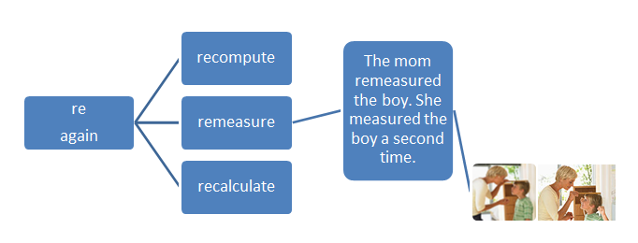
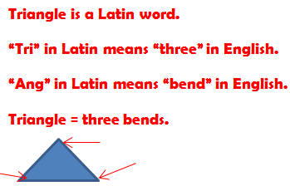
Word Learning Strategy: Structural Analysis
Focus on key word parts (prefixes, suffixes, and roots) that appear frequently in math materials.
Notes:
Structural analysis is the analysis of word parts such as roots, prefixes, and suffixes. A prefix is a group of letters that goes in front of a word. In addition to teaching students the meanings of these word parts, students can also practice with word and sentence deconstruction and reconstitution activities such as building affixed words (Graves, 2006). Drawing on an ELLs’ funds of knowledge with their language background, you may also directly translate word parts across languages (e.g., ly in English is mente in Spanish) and point to the word parts that are the same across both languages (re in English is re in Spanish; Graves et al., 2013).

Slide 42
Word Learning Strategy: Contextual Analysis
Draw attention to context clues as they arise in math materials and texts. Have students actively find illustrations for the clue. Name the clue. Some common clues are:
Context Clue | Example
Definition | A diameter is a part of a line that goes through the center of the circle with endpoints on the circle.
Example | The Earth is a sphere.
Pivot | John has four apples, but Sandy only has two.
Notes:
Draw students’ attention to context clues as they arise in math materials and texts. Name the kind of clue (e.g., a pivot, definition). For frequent context clues, you may have students actively find illustrations for the clue or make note of the clue (Bauman et al, 2002; Graves, 2006; Graves et al, 2013).

Slide 43
Word Reference Material Skills
Reinforce students’ use of headwords and ways to determine the correct word sense in a multiple-meaning dictionary entry. | Facilitate students’ use of hyperlinked words and marginal glosses with digital texts.
Emphasize rereading text after a word meaning is determined.
Notes:
Help students attend to the unique text features of their dictionaries, bilingual dictionaries, or digital dictionaries. With technology today, many digital pages have hyperlinked meanings of translations for key vocabulary; books may have those same scaffolds in the margins—an element called marginal glosses (Blachowicz & Fisher, 2002). Research indicates that students benefit from support in how to make use of these scaffolds and that includes understanding when to look up a word and go back to read the page or word problem a second time with the new known word meaning (Nation, 2001).

Slide 44
Word Learning Strategy: Cognate Awareness Analysis
Draw students’ attention to words that are similar across both languages.
Contrast across both languages.
Find these words in math materials.
English Word | Spanish Word | Differences
calculate | calcular | te → ar
problem | problema | a added to Spanish word
fraction | fracción | tion→ cion
Notes:
Cognates are words that sound and look similar across two languages and have similar meanings; research studies have generally found positive effects regarding instruction that fosters this kind of awareness for English learners (see Carlo et al., 2004). You may point out cognates that are encountered in the math content and record the word; students may individually search for cognates in their math materials. Applying contrastive analysis, or analysis related to the word differences across both languages, can help promote students’ cognate awareness (Graves, August, & Mancilla-Martinez, 2013). Also, help support students understanding related to false cognates, or those words that look alike across two languages, but do not mean the same thing.

Slide 45
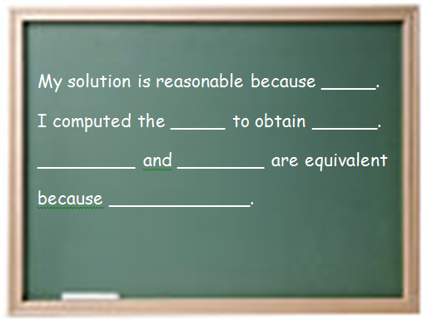
Enhance Environment With Math Language and Concepts
Post academic math language around the classroom. Use visuals, graphic support, and color coding to promote visualization.
Notes:
The picture on the right portrays a classroom without environmental enhancements or print. What do you think of this classroom? How would you like to be a student learning there? If a student, any student, looks around, there are no cues to help reinforce the math language or concepts encountered in the lessons—they just look up to see a drab yellow wall.
You can enhance the classroom’s physical classroom environment with the language of math and math concepts. Math vocabulary walls that include domain-specific and general academic words and phrases important to math can help provide visual reinforcement concerning the important vocabulary for students. To help increase visualization, you may group the words under the unit they were initially introduced with and color code the words by unit. You could also provide bulletin boards that describe word learning strategies. Perhaps there is a context clue wall (or word part wall) that students can add to as they come across examples of the clues in their math texts (Blachowicz & Fisher, 2000, 2002). Adding pictures to the word wall also helps increase visualization. Other bulletin boards may include important sentence frames to help students participate in math conversations or engage in peer learning or may graphically show certain math concepts. You can also explicitly show students the environmental print in your math classroom and draw on those assets in your instruction as reinforcers and scaffolds (Harmon, Wood, Hedrick, Vintinner, & Willeford , 2009). Perhaps students can sit in front of a word or concept wall while completing their independent practice.
At the same time, keep the walls and bulletin boards organized and clean looking. If they are too busy, students may become overstimulated or confused while attempting to engage with the environmental print.
Have participants look at each bulletin board example and think-pair-share about ways to improve each one. Some examples for improvement may be adding illustrations to the context clue wall and sentence frame that help depict the linguistic concept. An improvement for the word wall would be to color code the words by unit, make sure that the bulletin boards are organized, and so on.

Slide 46
Activity: Explore the Instructional Quality
Handout 5
Interactive Activity
Center for Data-Driven Reform in Education, n.d.; What Works Clearinghouse, 2008
Notes:
Now let’s take some time to explore one of the universal math programs from the WWC for some of these math instructional features that we discussed in these last two CEM sections.
On the same worksheet as the last activity, Handout 5, explore one universal math program for some of the instructional practices we discussed for all students as well as those elements of differentiation.
Have participants work in either the same small group as the last activity or in their pair from the last activity. They should do Part 3.

Slide 47
What Are Considerations for Universal Math Instruction in CCSS?
Common Core State Standards Initiative, n.d.a,b
Notes:
While discussing math at the universal level, it is important to note that the instruction should be informed by and aligned to the national standards. The CCSS-M were briefly discussed in CEM Part 1. However, this section will dive deeper into instructional considerations with respect to the CCSS-M. In doing so, we will explore the various elements of the CCSS-M.

Slide 48
CCSS-M Focus
Math Practices (How?)
Math Content
(What?)
Common Core State Standards Initiative, n.d.a,b
Notes:
The CCSS-M places an equal weight on the math content and the math practices.
According to the CCSS-M (n.d.a):
“The Common Core State Standards for Math actually include two types of standards: the content standards and the standards for mathematical practices. The content standards define the specific skills that are to be mastered at each grade level. For example, multiplication, division, and fractions are all content standards for 3rd grade. The standards for mathematical practices, however, outline how students go about doing the math. They are skills, based on the NCTM process standards, which students should utilize on a daily basis, regardless of the content being taught.”

Slide 49
CCSS-M Focus
Math Practices (How?)
Math Content
(What?)
Notes:
First, we will explore the math practices highlighted in the CCSS-M.

Slide 50
Activity: CCSS-M Math Practices 20-Word Jigsaw
Interactive Activity
Common Core State Standards Initiative, n.d.b
Notes:
These eight practices are a framework for how students should engage with math. They are overarching and apply across the K-12 curriculum.
According to the CCSS-M (n.d.b):
“The Standards for Mathematical Practice describe varieties of expertise that mathematics educators at all levels should seek to develop in their students. These practices rest on important “processes and proficiencies” with longstanding importance in mathematics education. The first of these are the NCTM process standards of problem solving, reasoning and proof, communication, representation, and connections. The second are the strands of mathematical proficiency specified in the National Research Council’s report Adding It Up: adaptive reasoning, strategic competence, conceptual understanding (comprehension of mathematical concepts, operations and relations), procedural fluency (skill in carrying out procedures flexibly, accurately, efficiently and appropriately), and productive disposition (habitual inclination to see mathematics as sensible, useful, and worthwhile, coupled with a belief in diligence and one’s own efficacy).”
Have students jigsaw these eight math practices. There are two options for a jigsaw activity provided: 1. the 20-Word Jigsaw and 2. the Graffiti Wall Jigsaw.
For the 20-Word Jigsaw (Option 1):
1.Ask each participant to take out a sheet of paper.
2 Split participants into eight groups.
3. Assign each group a math practice.
4. Give them time to explore the math practice on the CCSS-M site. Each group should then come up with a story that is less than 20 words that adequately captures the essence of that math practice. Tell them to each write their 20-word story because they will be teaching that practice to other students who have not explored it.
5. Have participants regroup into a second group that includes one student from each original group. If students are appropriately grouped then the eight group members should each have a unique math practice.
6. Each participant teaches their new group about the math practice and shares the original group’s 20-word story.
7. Debrief group answers with a “Whip Around the Room” (go around the room by group and have each group share out their 20-word stories). Discuss the final 20-word stories as a class.
8. Debrief the interactive activity. Ask students how this might help support student learning. Students might say that there was peer support in the jigsaw groups, but that all students were held accountable because they had to teach the content to their second groups. Students might say that the 20-word story helped them attend to the most important pieces in their explanation.
For the Graffiti Wall Jigsaw (Option 2):
1.Give each group a piece of chart paper.
2. Split participants into eight groups.
3. Assign each group a math practice.
4. Give them time to explore the math practice on the CCSS-M site. Each group should then talk about a piece of graffiti (a picture) that adequately captures their math practices. They can draw their graffiti on chart paper. The other group members conceptualize a caption for their graffiti.
5. Have participants regroup into a second group that includes one student from each original group. If students are appropriately grouped then the eight group members should each have a unique math practice.
6. With your call, each group rotates to each of the graffiti posters. The participant who was in the first group that made the poster explain the math practice and how their graffiti captures the essence of the practice.
7. At the end, debrief the content with the class.
8. Debrief the activity. Ask participants how this might help support student learning. Participants might share that there was peer support in the jigsaw groups, but that all students were held accountable because they had to teach the content to their second group and there were specified jobs in the first group. Participants might say that the graffiti wall helped them visualize their learning with the image.
This is the explanation of the CCSS-M math practices drawn from: http://www.corestandards.org/Math/Practice/

Slide 51
CCSS-M Focus
Math Practices (How?)
Math Content (What?)
Common Core State Standards Initiative, 2014a, n.d.
Notes:
Now we will turn to the math content highlighted in the CCSS-M. Keep in mind, however, that math practices are still relevant while discussing the math content of the CCSS-M. We will talk about that more in this CEM section.

Slide 52
Math Content Domains Across Grades
Grades | Skills
K-2 | Concepts, skills, and problem solving related to addition and subtraction.
3-5 | Concepts, skills, and problem solving related to multiplication and division of whole numbers and fractions.
6 | Ratios and proportional relationships and early algebraic expressions and equations.
7 | Ratios and proportional relationships and arithmetic of rational numbers.
8 | Linear algebra and linear functions.
Common Core State Standards Initiative, n.d.a
Notes:
First let’s look at the math content domains. This chart shows the CCSS-M math content domains by grade.
VanDerHeyden and Allsopp (2014) noted, “During the elementary grades, the CCSS emphasize content related to counting and cardinality, operations and algebraic thinking, number and operations in base ten, number and operations–fractions, measurement and data, and geometry. Proficiency in these domains provides students the foundation for success with middle school and high school mathematics. In middle school, geometry is a continued domain of emphasis, and students’ understandings of the K-5 domains are utilized to develop proficiency in ratio and proportional relationships, the number system, expressions and equations, functions, and statistics and probability. By the time students reach high school, they have engaged in learning related to all 11 domains” (p. 13).
According to the CCSS-M (Common Core State Standards Initiative, n.d.a):
“There is a greater focus on fewer topics. The Common Core calls for greater focus in mathematics. Rather than racing to cover many topics in a mile-wide, inch-deep curriculum, the standards ask math teachers to significantly narrow and deepen the way time and energy are spent in the classroom… Mathematics is a coherent body of knowledge made up of interconnected concepts. Therefore, the standards are designed around coherent progressions from grade to grade. Learning is carefully connected across grades so that students can build new understanding onto foundations built in previous years. For example, in 4th grade, students must “apply and extend previous understandings of multiplication to multiply a fraction by a whole number.” This extends to 5th grade, when students are expected to build on that skill to “apply and extend previous understandings of multiplication to multiply a fraction or whole number by a fraction… Each standard is not a new event, but an extension of previous learning. Coherence is also built into the standards in how they reinforce a major topic in a grade by utilizing supporting, complementary topics. For example, instead of presenting the topic of data displays as an end in itself, the topic is used to support grade-level word problems in which students apply mathematical skills to solve problems.”
For more information, see:
http://www.corestandards.org/other-resources/key-shifts-in-mathematics/

Slide 53
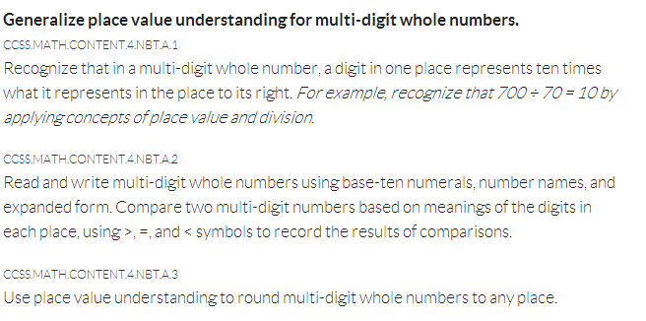
Big Idea and Essential Understandings
Big Idea
Essential Understandings
Common Core State Standards Initiative, n.d.a
Notes:
The CCSS-M standards are organized around domains and clusters. Domains are overarching concepts like number and place value. Within each standard cluster, there are overarching standards and then sub-standards. The National Council for Teachers of Math (NCTM; 1991) calls these big ideas and essential understandings. Big ideas are sometimes also called enduring understandings. These big ideas have worth that is broader than the lesson, and they state the importance for the math concept and skill. Big ideas can consist of sub-units or standards, and these are what NCTM refers to as “essential understandings.” Essential understandings are more specific, and build toward the big idea. Taken together, big ideas and essential understandings often frame a unit or lesson at the universal level (NCTM, 1991).
For more information: http://www.corestandards.org/Math/Content/introduction/how-to-read-the-grade-level-standards/

Slide 54
Activity: AHA! Listening
Interactive Activity
Watch and listen as Dr. Lynn Fuchs talks about considerations with respect to math instruction.
Grades | Skills
K-2 | Concepts, skills, and problem solving related to addition and subtraction.
3-5 | Concepts, skills, and problem solving related to multiplication and division of whole numbers and fractions.
6 | Ratios and proportional relationships and early algebraic expressions and equations.
7 | Ratios and proportional relationships and arithmetic of rational numbers.
8 | Linear algebra and linear functions.
http://www.rti4success.org/video/there-lot-information-about-rti-reading-how-it-different-math
Center on Response to Intervention, n.d.c
Notes:
Consider the math domains we just discussed as you view Dr. Fuchs’ video. In this video, Dr. Fuchs, professor at Vanderbilt, discusses certain considerations for math instruction within MTSS. Think about the similarities and differences across math and reading.
Conduct this activity through AHA! Listening.
For AHA! Video Listening:
Participants listen to the video while noting a few new considerations or things that struck them as they watched the video.
Allow pairs or groups of students to share their ideas.
3. Debrief as a class.

Slide 55
Progression of Content Domains in CCSS-M
Common Core State Standards Initiative, n.d.a
Notes:
Now that we have discussed the content domains, also consider that in the CCSS-M, content domains are situated within the eight math practices we discussed in the prior section. This is a vital shift in the CCSS-M: The eight math practices, represented here by the surrounding orange circle, carry across all the grades.

Slide 56
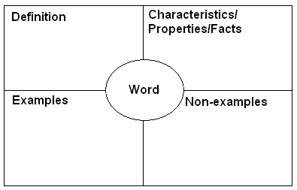
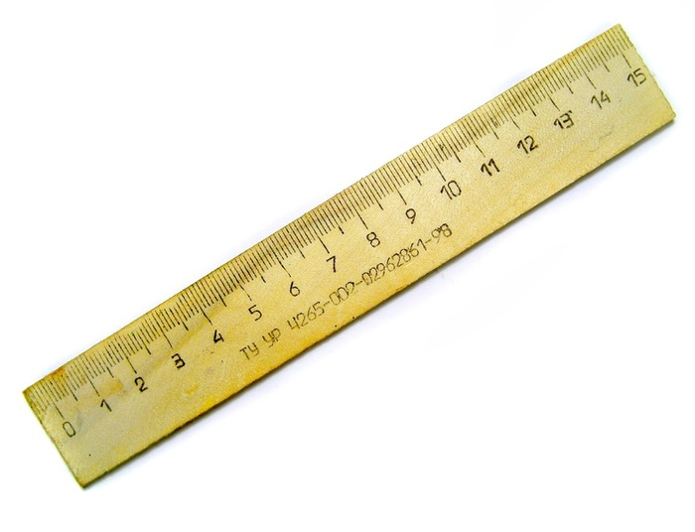
CCSS-M Focus on Rigor
Procedural Fluency
Conceptual Understanding
Math Proficiency
Application
15.5”
Common Core State Standards Initiative, n.d.b
Notes:
Another important shift to note with respect to the CCSS-M is the emphasis on rigor.
According to the CCSS-M (n.d.b):
“Rigor refers to deep, authentic command of mathematical concepts, not making math harder or introducing topics at earlier grades. To help students meet the standards, educators will need to pursue, with equal intensity, three aspects of rigor in the major work of each grade: conceptual understanding, procedural skills and fluency, and application. Conceptual understanding: The standards call for conceptual understanding of key concepts, such as place value and ratios. Students must be able to access concepts from a number of perspectives in order to see math as more than a set of mnemonics or discrete procedures. Procedural skills and fluency: The standards call for speed and accuracy in calculation. Students must practice core functions, such as single-digit multiplication, in order to have access to more complex concepts and procedures. Fluency must be addressed in the classroom or through supporting materials, as some students might require more practice than others. Application: The standards call for students to use math in situations that require mathematical knowledge. Correctly applying mathematical knowledge depends on students having a solid conceptual understanding and procedural fluency.”
So, conceptual understanding includes understanding math concepts, operations, symbols, and diagrams. These understandings help a student connect new math knowledge to previous knowledge. Look at this slide. In order to measure something, the boy needs to know what a ruler is. Procedural fluency entails carrying out math procedures and knowing how to flexibly apply the procedures in the most efficient way. So to measure, the boy must know how to line up the ruler and where to mark. He also needs to understand the units of measurement. Application refers to the use of math when math knowledge is needed. Here the boy and his teacher work together to measure the wood; they are authentically applying the math concept.
When conceptual understanding, procedural fluency, and application work together, math proficiency increases. For example, the boy will gain a depth of math proficiency with respect to measurement and will be able to apply that understanding flexibly and efficiently across a variety of contexts.
Give participants a minute to discuss the graphic on this slide. Ask participants to think of another math concept and talk together about the conceptual understanding, procedural fluency, and application needed to gain proficiency with that concept.

Slide 57
How CCSS-M Aligns With MTSS
National Center on Intensive Intervention, 2014b
Notes:
Now with respect to MTSS, note that the progression of supports provided at each MTSS level can and should be aligned with the grade-level CCSS-M standard, or the standards that inform the universal math program. As you move along the MTSS continuum, the supports increase, but the standard is retained.
In this CEM part we are focused on the universal level, which is sometimes called core, Tier I, or primary). However, you can take the CCSS-M grade-level standard and apply it through the different MTSS levels. The learning supports increase, but the CCSS-M standard does not change (like moving to a below-grade standard). MTSS is focused on supports that unlock each grade-level standard for all students, so all students access and acquire the grade-level content.

Slide 58
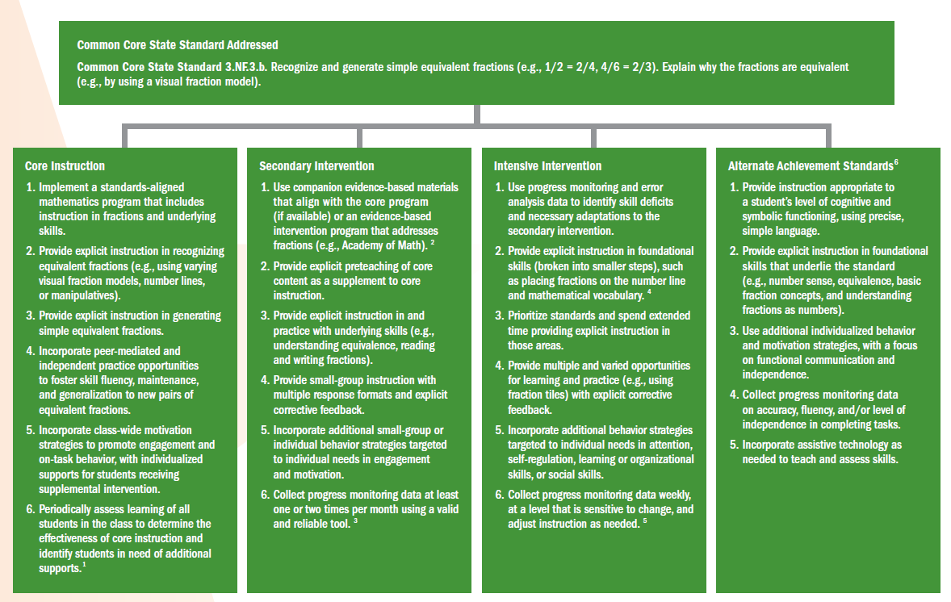
How CCSS-M Aligns With MTSS
National Center on Intensive Intervention, 2014b
Notes:
Here is the same chart of progressions that is indexed to another CCSS-M standard. Again, note that the same grade-level content standard carries through all the MTSS levels.

Slide 59
Activity: Explore in Relation to CCSS-M
Handout 5
Interactive Activity
Center for Data-Driven Reform in Education, n.d.; What Works Clearinghouse, 2008
Notes:
On the same worksheet as the last activity, Handout 5, explore the same universal math program (from the prior activity). However, this time determine the ways in which that universal math program aligns with the CCSS-M. Consult the CCSS-M when needed. Consider both math practices and content domains. Consider the CCSS-M focus on rigor. What elements does the universal program meet? Are there any that it does not seem to meet? How would you address those aspects in your universal math instruction?
Have students work in either the same small groups as the last activity or in their pair from the last activity. They should complete the last part of that activity page.

Slide 60
CEM Part 2 Guiding Questions
What is universal instruction in MTSS?
What does high-quality math instruction at the universal level look like?
What are considerations for math instruction in the CCSS?
What are instructional considerations for English learners in universal math?
What is the role of screening and progress monitoring at the universal level?
How should data-based decisions be made?
Notes:
We have now answered the first four questions for Part 2 of the CEM. Now, we will discuss the use of assessments at the universal level. After that, we will look at data-based decision making.

Slide 61
What Is the Role of Screening and Progress Monitoring at the Universal Level?
Notes:
Now that we have discussed some key curricular considerations, we will discuss how universal screening is implemented at the universal level. Screening can answer these questions:
Is our core curriculum and instruction effective?
Which students need additional assessment and instruction?

Slide 62
Examples of Common Screening Processes
Center on Response to Intervention, n.d.c
Notes:
The screening process is not unique to education. In fact, standardized screening processes, such as blood pressure screenings and vision screenings, are common in many other fields. In all cases, the purpose is to identify indicators that predict if more testing or further intervention is needed; these screeners are designed to be efficient and cost effective. How many of you have participated in blood pressure screenings? These measures do not actually indicate if you have heart problems. Instead, the results of these cost-efficient and brief assessments indicate when more information is needed. Additional assessments (that are most likely more expensive and invasive) are needed to confirm the presence of a problem. All of us have had eye exams, probably beginning in school. This very cheap screening process provided school nurses with sufficient data to refer a child for further assessment. Without this type of standardized eye screening in schools, many children may not have received appropriate vision supports until much later in their schooling. The major goal of all of the screening processes is to identify and address potential problems early in order to prevent bigger problems in the future.
Depending on time available, you may want to provide the following more in-depth explanations of other types of screening.
For more information, see:
http://www.rti4success.org/essential-components-rti/universal-screening

Slide 63
Screening
PURPOSE: Identify students who are at risk for poor learning outcomes.
FOCUS: ALL students.
TOOLS: Brief assessments that are valid and reliable and demonstrate diagnostic accuracy for predicting learning or behavioral problems.
TIMEFRAME: Administered more than one time per year (e.g., fall, winter, spring)
Center on Response to Intervention, n.d.c
Notes:
Implement screening to identify students at risk for poor learning outcomes; identity students who need additional assessment (i.e., progress monitoring) and instruction (i.e., secondary or intensive); and provide data on the effectiveness of the core instruction and curriculum. The focus for screening is on all students, not just students we believe are at risk. Students may slip through the cracks unless there is a systematic process for screening in place. Screening is not a diagnostic test; it is a brief, reliable, and valid assessment to identify which students may need additional assessments. The tools should demonstrate diagnostic accuracy for predicting learning in math. In other words, they should accurately identify who could be at risk.
Screening data are used to evaluate program effectiveness, establish local norms and cut scores, and provide data to the next year’s teacher. The assessment is typically administered three times a year (e.g., fall, winter, spring), and should incorporate alternative forms and multiple benchmarks. To obtain accurate data across the years, implement screening at the same point each year.

Slide 64
Universal Screening
Interactive Activity
Video 1: Principal Perspectives
http://www.youtube.com/watch?v=HaHWoN-LVFc National Center on Response to Intervention, 2012c
Notes:
Now you will hear from several principals about why they believe screening is important and how they implement screening in their schools.
Conduct this activity through AHA! Listening.
For AHA! Listening:
Students listen to the video while noting a few new considerations as they watch—things that struck them while watching the video.
Allow pairs or groups of students to share their ideas.
3. Debrief as a class.

Slide 65
Screening Process
Two-stage screening process:
Stage 1: Universal screening for all students.
Stage 2: More in-depth testing or progress monitoring for students who score at or below the cut score.
Should be an educationally valid outcome.
Center on Response to Intervention, 2010
Notes:
As mentioned in the video, regular screening is necessary throughout the year for ALL students. Through screening at the middle or end of the year, you may catch students who were doing well at the beginning of the year but are struggling as the demands increase. Struggling students are identified by implementing a two-stage screening process. The first stage, universal screening, is a brief assessment for all students conducted at the beginning of the school year; however, many schools and districts use it two or three times throughout the school year. For students who score at or below the cut score on the universal screener, a second stage of screening is then conducted to more accurately predict which students are truly at risk for poor learning outcomes. This second stage involves additional, more in-depth testing or short-term progress monitoring to confirm a student’s at-risk status (Compton et al., 2010).
Some terms that pertain to screening are:
Cut Score—Score on a screening test that divides students who are considered potentially at risk from those who are considered not at risk.
Target or Benchmark—Predetermined level of performance on a screening test that is considered representative of proficiency or mastery of a certain set of skills.
Criterion Scores—Scores on a screening test that separate students into performance levels (e.g., established, emerging, deficient).
For more information, see:
http://www.rti4success.org/essential-components-rti/universal-screening

Slide 66
Common Mathematics Screeners
Domain | Measures | Grades
Early numeracy | Oral Counting Next Number Number Identification Quantity Discrimination Missing Number | K-1
Computation | M-CBM Math Computation Number Facts | 1-8
Concepts and applications | Math Concepts and Applications Concepts Concepts/Applications | 2-8
Center on Response to Intervention, 2010
Notes:
These are some examples of math screeners. You may have different screeners to assess different outcome measures. No one screener can screen for all areas, so different screeners may be necessary for different outcome areas. While selecting screening tools, you should choose reliable tools that demonstrate diagnostic accuracy for predicting which students will develop learning or behavioral difficulties.
Consider both reliability and validity when choosing screeners. Reliability asks if the assessment produces similar scores across conditions and situations? Reliability is not a particular problem if the tool has good psychometric properties. Validity asks: Does the test measure what you want to assess? Think of validity as the degree of evidence behind the function of a measure for a specific student; it is variable across different contexts. Therefore, validity may be a problem if assessment results could be influenced by students’ language, cultural, and experiential backgrounds.
Choose age-appropriate outcome measures that capture student ability. It is important that the screener you choose has strong classification accuracy, meaning the screening tool is able to accurately classify students into at-risk and not at-risk categories. For example, in reading, in order to have good classification accuracy, screeners must target reading or reading-related skills that are pertinent to the grade and time the screen is administered (Jenkins, Hudson, & Johnson, 2007, p. 585). Gersten et al. (2005) found the following three brief, timed assessments were reliable predictors of first graders at risk for mathematics difficulty: (1) quantity discrimination, (2) missing number identification, and (3) number identification fluency. In Grades 4 through 8, use screening data in combination with state testing results (Baker, Gersten, Flojo, et al., 2002; Gersten et al., 2011).
For more information see:
http://www.nysrti.org/docs/ScreeningforMathematicsDifficultiesinK-3Students.pdf
http://www.rti4success.org/essential-components-rti/universal-screening
http://www.rti4success.org/sites/default/files/RTI%20Screening%20Brief3-Predicting%20Students.pdf
Note: Similar names for measures within a domain reflect the names of different products (by different manufacturers), and Math-Curriculum Based Measurement (M-CBM) by AIMSweb has been discontinued and is no long available for purchase

Slide 67
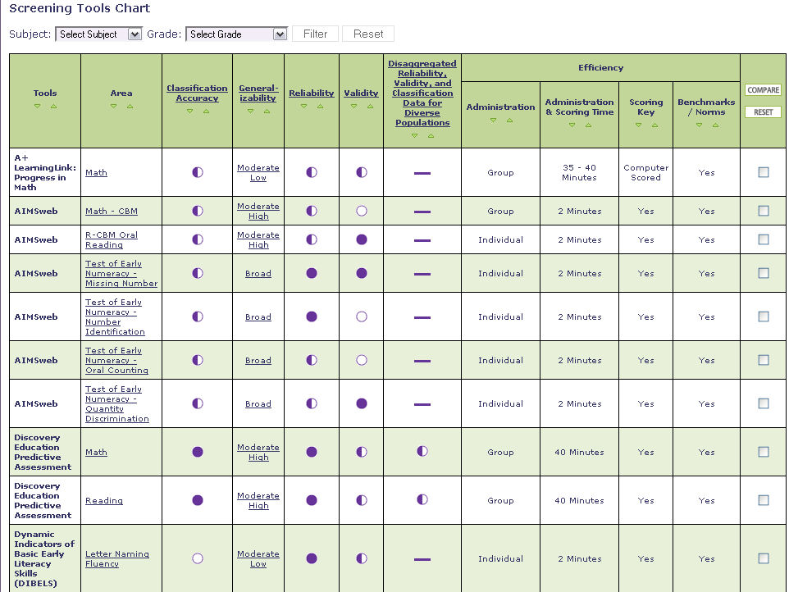
Center on RTI Screening Tools Chart
National Center on Intensive Intervention, 2014
Notes:
The National Center on Intensive Intervention (NCII) has developed a screening tools chart that can be accessed through the Center on Response to Intervention website at http://www.rti4success.org/screeningtools. The tools chart does not recommend tools but provides users with a consumer report on available tools, similar to what you may find when searching for consumer goods such as a car. We will look at the process for using the tools chart, recommended in the user’s guide. We will also look in depth at the columns, which include both indictors of valid tools and efficiency factors to consider.
When possible, demonstrate the most updated version of the tools chart on the website (http://www.rti4success.org/screeningTools) instead of using the following screenshots. If possible, project the most recent version of the tools chart on the website so participants can see the actual site and how it works.
For more information, see:
http://www.rti4success.org/resources/tools-charts/screening-tools-chart

Slide 68
Tips for Using the Tools Chart
Gather a team.
Determine your needs.
Determine your priorities.
Familiarize yourself with the content and language of the chart.
Review the data.
Ask for more information.
National Center on Intensive Intervention, 2014
Notes:
Read slide.

Slide 69
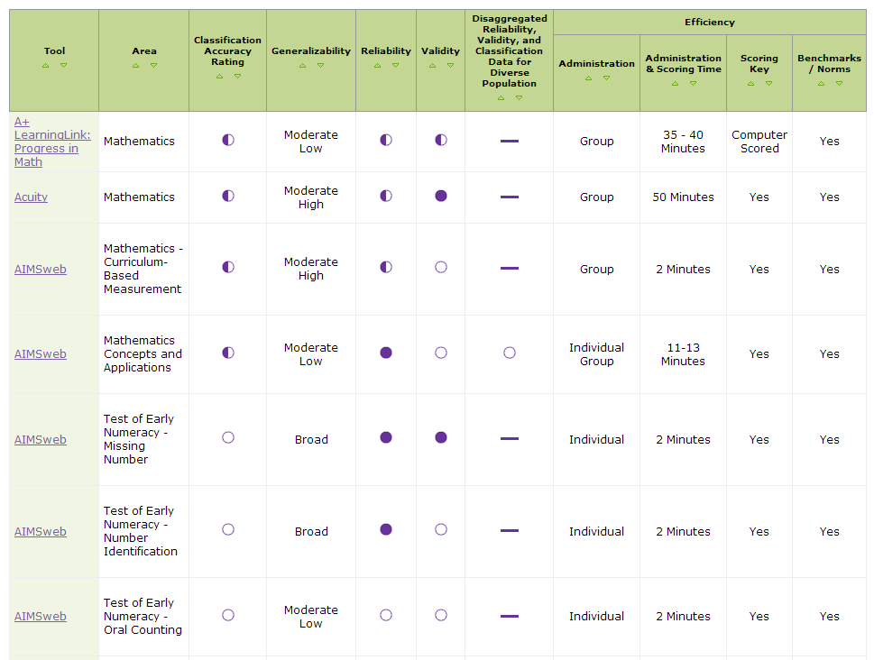
NCRTI Screening Tools Chart
National Center on Intensive Intervention, 2014
Notes:
Screening involves brief assessments that are valid, reliable, and evidence based. They are conducted with all students or targeted groups of students to identify students who are at risk of academic failure and, therefore, likely to need additional or alternative forms of instruction to supplement the conventional general education approach. The tools chart includes a large amount of information designed to assist you in selecting a tool that is most appropriate for use in your classroom, school, or district. The best tool is not going to be the same for every user and is not determined by any single element on the chart. Users of the chart should review all of the different elements of the chart while making a decision. While looking at screeners in the tools chart, ask yourself:
Who should be involved in selecting a screening tool?
What types of expertise and what perspectives should be involved in selecting a tool?
Is it a tool that can be purchased for a reasonable cost?
Is it a tool that does not take long to administer and score?
Is it a tool that offers ready access to training and technical support for staff?
Is it a tool that meets the highest standards for technical rigor?
Is it a tool whose effectiveness has been studied and demonstrated in my district or state?
Explain the tools chart features:
Across the top of the chart are the standards by which the Technical Review Committee (TRC) reviews each tool. Click on each standard for a detailed description of how the rating was defined. The vendors/developers of the tools have provided implementation information, which includes the cost of the tool, what is needed to implement it, the support provided, how the tool is intended to be used, and with whom it should be used. To access this information, click on the name of the tool in the Area column. The ratings in the chart can be clicked to view the specific data submitted for Classification Accuracy, Generalizability, Reliability, Validity, and Disaggregated Data for Diverse Populations. Every column of the chart can be sorted by clicking the arrows at the top of the column.
The tools in the chart can be filtered by subject and grade using the filter tool at the top of the chart. To see all tools again, hit Reset. Tools can be compared by clicking the boxes on the far right of the chart. Pick as many tools as you wish to compare and hit the Compare button. To see all tools again, hit Reset.
For more information, see the NCRTI website, http://www.rti4success.org/tools_charts/supplementalcontent/screening/universalscreeningusersguide.pdf
and
http://www.rti4success.org/resources/tools-charts/screening-tools-chart
The screening tools chart can be accessed at http://www.rti4success.org/screeningtools.

Slide 70
Content and Language of the Chart
Ratings of technical rigor:
The efficiency of the tool.
Implementation requirements for the tool.
Detailed data submitted by the vendor.
National Center on Intensive Intervention, 2014
Notes:
When possible, demonstrate the most updated version of the tools chart on the website (http://www.rti4success.org/screeningTools) instead of using the following screenshots.
There are four main areas on which tools are evaluated: ratings of technical rigor; efficiency; implementation requirements (e.g., cost, training needs); and the data submitted by the vendor (e.g., reliability data, validity data). The ratings of technical rigor are represented with rating bubbles, similar to the symbols used in Consumer Reports. A full bubble indicates convincing evidence, and an empty bubble indicates unconvincing evidence.
The first area that is presented is the ratings of technical rigor. For each of these standards, the TRC reviewed data submitted by developers of the tools and gave a rating of convincing, partially convincing, unconvincing, or no evidence. If using the tools chart online, you can click on the name of the standard in the column heads of the chart to view a definition of the standard and a rubric describing the specific criteria used by the TRC to rate tools on that standard.
Refer participants to the tools chart and glossary of terms in the back of the training manual. Briefly review the definitions of the different technical criteria.
Classification Accuracy. The classification accuracy indicates the extent to which a screening tool is able to accurately classify students into “at risk for poor learning outcomes” and “not at risk for poor learning outcomes” categories.
Generalizability. Generalizability is the extent to which results generated from one population can be applied to another population. A tool is considered more generalizable if studies have been conducted on larger, more representative samples.
Reliability. Reliability is the consistency with which a tool classifies students from one administration to the next. A tool is considered reliable if it produces the same results when administering the test under different conditions, at different times, or using different forms of the test.
Validity. Validity is the extent to which a tool accurately measures the underlying construct that it is intended to measure.
Disaggregated Data. Data are disaggregated when they are calculated and reported separately for specific sub-populations (e.g., race, economic status, academic performance, etc.).
The last four columns of the chart offer information about the efficiency of each screening tool:
Administration format: Is the tool designed to be administered to an individual or to a group or both?
Administration and scoring time: How long does it take to administer and score the tool?
Scoring key: Is a scoring key provided? If not, is it scored by a computer?
Norms/Benchmarks: Are benchmarks and/or norms available for reference?

Slide 71
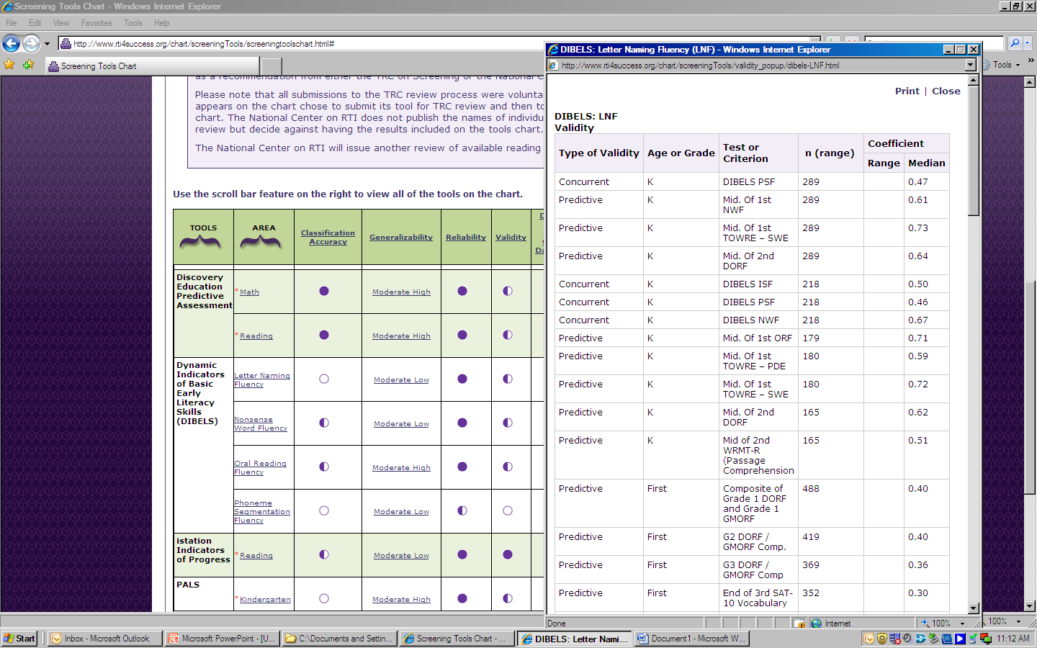
Content and Language of the Chart
National Center on Intensive Intervention, 2014
Notes:
When possible, demonstrate the most updated version of the tools chart on the website (http://www.rti4success.org/screeningTools) instead of using the following screenshots.
The tools chart offers an Implementation Table for each tool, which can be accessed by clicking on the name of the tool. The implementation table includes the following information:
Cost of the tool
Training required to implement the tool
Level of staff expertise required to administer the tool
Where to go for training and technical support
How scores are reported
All of this information is provided by the vendor.
The tools chart also includes detail about the actual data that were submitted to the TRC for review. These data can be viewed by clicking on any of the rating bubbles in the cells in the chart. When possible, look for tools that conducted classification studies with outcome measures and samples similar to your population and outcome of interest. By clicking on the rating bubble, you will obtain more information about which tools are most appropriate for which populations of students.
You may find that the tools chart does not provide you with all the information you need. For example, what if a tool in which you are interested does not have disaggregated data for a particular subgroup that is important to you? NCRTI recommends you ask the vendor or developer. Developers who have chosen to submit their tools for review and publish them on the chart are interested in meeting the needs of their customers. As such, they are interested in doing more research to provide the data that you need. Similarly, if a tool that you currently use or are interested in learning about is not on the chart, call the developer of that tool. Let them know about the TRC review process and the tools chart, and ask them to consider submitting the tool for review.

Slide 72
Disaggregated Data in the Screening Tools Chart
National Center on Intensive Intervention, 2014
Notes:
One of the tools chart’s columns focuses on disaggregated data, indicating whether the data have been analyzed separately for certain student groups like ELLs. That step adds to the evidence regarding the function of that assessment for use with that relevant subgroup. When I click on the column heading, this pop-up explains the criteria for each rating regarding its use of disaggregated data. As you can see, these rating are determined by the number of types of disaggregated data available and the quality of these data. The types of disaggregated data include reliability, validity, and classification accuracy.
The disaggregated data column is useful for determining whether the assessment has been tested with various subgroups such as English learners. When you click on a bubble in this column, you can look at how the data were disaggregated and if there were any meaningful differences between subgroups. As you can see from this screenshot, several products have horizontal lines in that column, meaning that there is no information regarding disaggregated data. This is because the vendors who submitted the information about the assessment did not provide information regarding disaggregated data. All the information in the screening tools chart is based on what the vendors send to NCRTI. As more people request information that is not currently available, vendors will be encouraged to submit more information in the future.
For more information, see the NCRTI website: http://www.rti4success.org/tools_charts/supplementalcontent/screening/universalscreeningusersguide.pdf
And http://www.rti4success.org/resources/tools-charts/screening-tools-chart

Slide 73
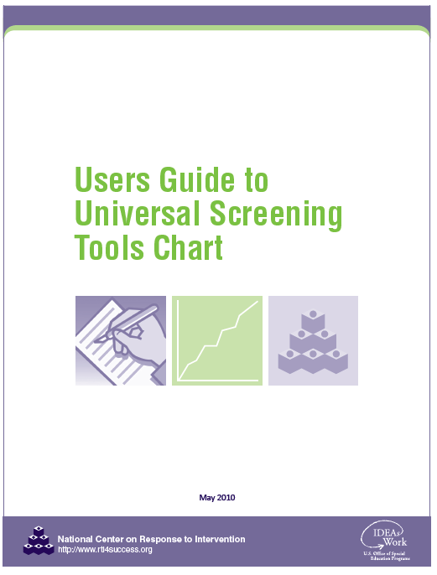
Ask for More Information
National Center on Intensive Intervention, 2014
Notes:
The tools chart provides publisher contact information in the pop-ups found in the second column. For more information about how to use the tools chart, there is a user guide.
http://www.rti4success.org/tools_charts/supplementalcontent/screening/universalscreeningusersguide.pdf.

Slide 74
Activity: Reviewing the Tools Chart
Handout 6
Interactive Activity
Review Screening Tools Chart
What screening tools in math have high classification accuracy, reliability, and validity?
What evidence exists for their reliability and validity?
Which tools are most efficient?
Notes:
Allow 10-15 minutes for teams or tables to look more closely at the screening tools chart, either online if computers are available or using printed copies. The participants will use Handout 6. The time for this team activity will depend of the needs of the group. If time allows, consider having two or three teams share their tool and the evidence they found that supports its validity and reliability.

Slide 75
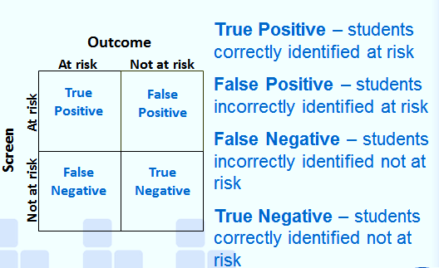
Identifying Students as At Risk
Success in MTSS depends on accurate identification of students who are at risk for poor learning outcomes.
Clinical Decision Making Model
National Center on Intensive Intervention, 2010
Notes:
With screeners, success depends on accurate identification of the students identified as at risk. This is essential for preventing costly identification errors. Perfect screening would result in 100% accurate identification of true positives (i.e., those who need additional support) and true negatives (i.e., those who do not need additional support), but there is no perfect screening tool.
A cut score is a score on a screening test that divides students who are considered potentially at risk from those who are considered not at risk. Cut scores may also be referred to as cut-points or targets, depending on the tool. They are determination points.
Now let’s look at the picture on this slide that depicts the clinical decision making model before talking more about the cut score.
Screening tools in education are rarely 100% accurate because there are so many variables that can affect performance. Screening tools vary in their sensitivity and specificity. Sensitivity is the extent to which a screening measure accurately identifies students at risk for the outcome of interest. Specificity is the extent to which a screening measure accurately identifies students not at risk for the outcome of interest.
Ideally, the screener would only indicate that a student is at risk if he or she is at risk. When students are correctly identified at risk, it is called a true positive. Point to the chart to show the boxes where students are screened as “at risk” and the outcome is “at risk.”
In addition, the hope is that the screener will indicate that a student is not at risk if she is not at risk. When students are correctly identified as not at risk, it is called a true negative. Point to the chart to show the boxes where students are screened as “not at risk” and the outcome is “not at risk.”
Unfortunately, screeners are not perfect. The screening tool may indicate that a student is at risk when, in fact, he is not. A case in which the screener indicates that a student is at risk and the actual outcome shows that the student was not at risk is called a false positive (or a false alarm). Point to the chart to show the boxes where students are screened as “at risk” and the outcome is “not at risk.”
Alternatively, the screening tool may show that the student was not at risk when, in fact, he was. This is called a false negative because the screener indicated that he was not at risk when the outcome shows that he was at risk. Point to the chart to show the boxes where students are screened as “not at risk” and the outcome is “at risk.”
Additional screenings (e.g., winter) and follow-up assessment (e.g., progress monitoring or other skill assessment) are used to verify the accuracy of these results.
For more information: http://www.rti4success.org/essential-components-rti/universal-screening
And http://www.rti4success.org/resourcetype/rti-implementer-series-modules

Slide 76
Determining Cut Score
Screeners use cut scores to divide students who are considered potentially at risk from those who are considered not at risk.
There are multiple ways to determine the criterion for a cut score. One example is percentile ranks:
Percentile | Determination
Below 10 percentile | deficient
10th-25th percentile | emerging
Above 25th percentile | established
National Center on Intensive Intervention, 2010
Notes:
It is important to remember that cut scores used to identify students as at risk may not be the same ones you use to identify students for supplemental support. Your choice of cut score will affect classification accuracy (i.e., sensitivity and specificity). Cut scores are often set to over-identify students as at risk to mitigate false negatives. Think about the blood pressure check. You would rather be falsely over-identified through that screener as at risk for heart disease. When your doctor will follow up with subsequent tests, it will become clear that you are, in fact, not at risk. However, if the heart screener, the blood pressure check, had criteria set at too rigorous of a level and, therefore, under-identified people, then some of those with heart disease would be missed with the screener. That is why it is important to enact a two-staged procedure with screening—the second stage of screening will help shed better light on those students who are truly at risk versus the students who were over-identified.
The two-staged approach may also help mitigate confounding factors that may have negatively influenced that student’s performance on the screener that specific day. Perhaps a student was sick on the day of the screener and performed under the cut score due to those affective factor reasons. The second stage will shed light on whether that student is really at risk or simply had a bad day. It is the same with your blood pressure check. Perhaps you ran that day right before your doctor’s appointment. That may have influenced the results and indicated you were at risk for heart disease when you were not. Therefor, the additional testing your doctor may order as a result of the initial screener will help determine whether you are really at risk for heart disease. Accordingly, to improve classification accuracy, your screening process may include a two-stage screening process:
Stage 1: Universal screening
Stage 2: More in-depth testing or progress monitoring for students who score at or below the cut score
As the second stage of the screening process, progress monitoring may be used to avoid inappropriately identifying students who do not need interventions despite being identified as at risk through the screener.
Concerning English learners, Brown and Doolittle (2008) suggest that it can be helpful to compare an English learner to his or her true peers as a way to examine the instructional program provided to a group of similar students. An ELL’s true peers are other students who share similar characteristics, including similar language proficiencies and cultural and experiential backgrounds. The purpose of this comparison is to identify whether a lack of progress may be specific to the one student or if there may be a problem with the instructional program given to a group of students.
For more information:
http://www.rti4success.org/essential-components-rti/universal-screening

Slide 77
National Center on Intensive Intervention, 2010
Notes:
This type of data representation is what is often associated with the triangle. In fact if you turn this upside down (click for animation), you will see where the triangle graphic originates.

Slide 78
National Center on Intensive Intervention, 2010
Notes:
Students who score below the cut score, perhaps those students in the yellow and red, should now have their progress monitored. This enables you to understand their performance at a deeper level. It also helps to ensure classification accuracy because screeners often over-identify students at risk to mitigate false negatives. Progress monitoring will help you determine those students who were falsely identified as at risk by the screener.

Slide 79
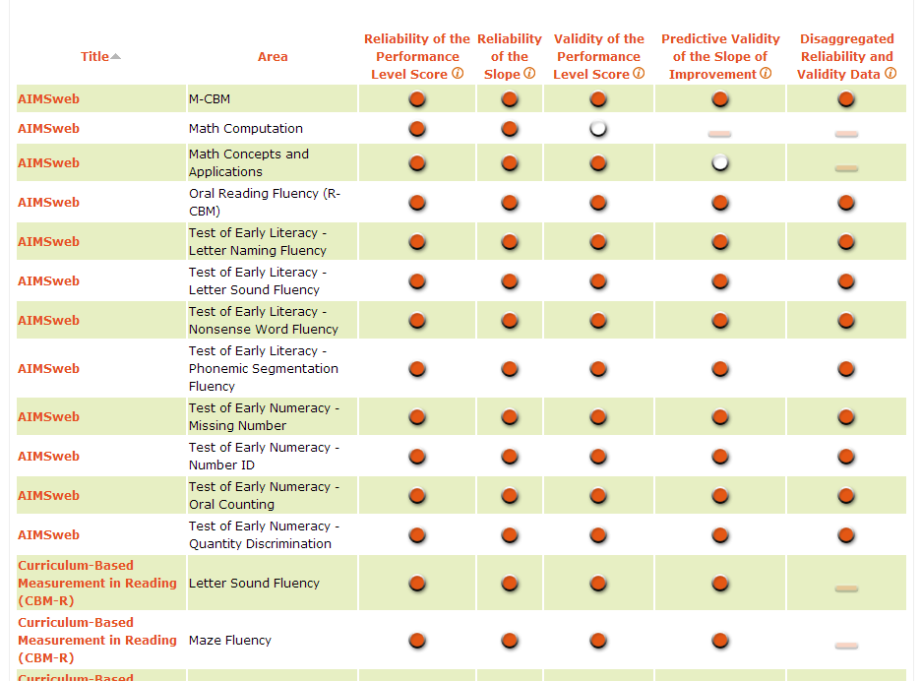
Progress Monitoring in Universal Instruction
Students identified through the universal screening are monitored to assess their risk status.
National Center on Intensive Intervention, 2014a
Notes:
For those students who are indicated to be at risk (i.e., scored below the cut score), you will want to enact a second stage of screening. This may be in the form of progress monitoring for a brief period. Note that progress monitoring is also used to track student growth once they start receiving supplemental or intensive instruction, but here, progress monitoring can be used as the second stage of screening. Progress monitoring as a way to track student progress in the other MTSS levels will be explained in more detail in CEM Part 3, but let’s touch on it here in the context of a second screening stage.
As with screening, the Center has developed a progress-monitoring tools chart that can be accessed through the Center on Response to Intervention’s website at http://www.rti4success.org/progressmonitoringtools.
You will likely not want to share all of the information below but rather use it as a reference if participants have questions about this slide. The PM tools chart began through the National Center on Student Progress Monitoring and has continued through the Center on Response to Intervention. Given the extensive research being conducted in the area of progress monitoring, the progress-monitoring tools chart has significantly more indicators (i.e., columns) and tools than the screening tools chart. This is discussed further in the Progress-Monitoring CEM.

Slide 80
Progress Monitoring
PURPOSE: Monitor students’ response to universal, supplemental, or intensive instruction to estimate rates of improvement, identify students who are not demonstrating adequate progress, and compare the efficacy of different forms of instruction.
FOCUS: Students identified through screening as at risk for poor learning outcomes.
TOOLS: Brief assessments that are valid, reliable, and evidence based.
TIMEFRAME: Students are assessed at regular intervals (e.g., weekly, biweekly, monthly).
Center on Response to Intervention, n.d.d
Notes:
The timeframe for progress-monitoring assessment is dependent on the tools being used and the typical rate of growth for a student. Progress monitoring can be used any time throughout the school year. With progress monitoring, students are assessed at regular intervals (e.g., weekly, biweekly, monthly) to produce accurate and meaningful results that teachers can use to quantify short- and long-term student gains toward end-of-year goals. CEM Part 3 will discuss progress monitoring in supplemental instruction in more detail. However, progress monitoring can also be used as a second screening stage for students who score below the cut score, or determination point. That will help to shed light on whether they are making sufficient progress in universal math instruction.

Slide 81
What Is Progress Monitoring?
Uses data to quantify student achievement.
Allows practitioners to:
Estimate rates of improvement.
Identify students who are not demonstrating adequate progress.
Compare the efficacy of different forms of instruction in order to design more effective, individualized instruction.
Center on Response to Intervention, n.d.d
Notes:
Progress-monitoring data can be used to estimate student improvement, compare the efficacy of different interventions, and identify students who are and are not responding to instruction. Progress monitoring is an example of a standardized formative assessment. Although teachers can use the data to make decisions about what is or is not working, they are not considered to be diagnostic assessments. Progress-monitoring tools can either be mastery measures or general outcomes measures. When used as a progress-monitoring tool, they address very different questions: 1) Has the student learned the skill? and 2) Can the student generalize and maintain the learned skills, respectively? No progress-monitoring tool is perfect. Participants must take into account their needs and priorities as well as the technical adequacy of the tool when selecting progress-monitoring tools.

Slide 82
Progress-Monitoring Tools Should Be:
Brief assessments.
Repeated measures that capture student learning over time.
Measures of grade-, age-, or instructionally appropriate outcomes.
Reliable, presenting evidence to make valid inferences.
Center on Response to Intervention, n.d.d
Notes:
Progress-monitoring tools are brief assessments that are reliable and evidence based and use repeated measures that capture student ability. The measures should show evidence that allows you to draw conclusions about their validity with respect to students. They should be measures of age-appropriate outcomes. No one progress-monitoring tool can monitor all outcome areas. Different tools may be necessary for different areas. Progress monitoring will be highlighted in CEM Part 3.

Slide 83
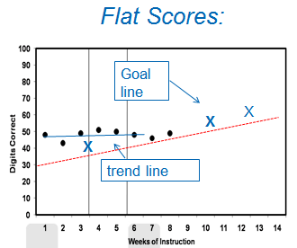
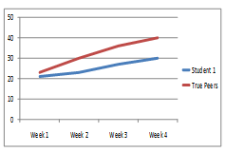
Identify Students Not Making Adequate Progress
X
Brown & Doolittle,2008; Center on Response to Intervention, n.d.d
Notes:
With progress monitoring, you can see improvement by looking at trend lines in comparison to a goal line. In the first example, we see that this trend line is flatter than the goal line. The student is not benefitting from the instruction, and, therefore, the teacher needs to make a change in the instructional program. That kind of trend line is called a flat score.
The second example shows student who is an English learner compared to a truer peer. We see that the student representing the blue line has not made as much progress as his or her true peers. Therefore, we can assume that we need to make adjustments in that student’s instructional program but may not need to make adjustments for the others. What would you do if the student were making the same progress as his or her true peers, but none were on track? In that case, the instructional program should be adjusted for all students in the group. Comparing a student to his or her true peers should never excuse a teacher from adjusting instruction when students are not making sufficient progress.
Remember, you should never lower the goal because a student is an English learner. Below-grade-level performance should not be considered normal or something that will resolve itself when oral language proficiency improves. If the trend line is flatter than the goal line, the instructional program should be changed or adjusted to increase a student’s scores so the scores match or surpass the goal line. When an ELL student is not making progress, the instructional program itself must be examined to determine the match between the curriculum and the student’s current level of English language proficiency (Brown & Doolittle, 2008).
For more information: http://www.rti4success.org/resource/rti-implementer-series-module-2-progress-monitoring

Slide 84
Activity: Pick and Chips
Handout 7
Interactive Activity
Pass a “chip” out to each group member.
One member picks a card and reads it to others at the table.
Each person reacts to the card and can agree or disagree with any of the comments they previously heard. After a member responds, he or she should put his or her chip in the middle.
When all chips are in the middle, have another person pick a new card.
Notes:
Have participants discuss elements of progress monitoring in universal instruction (as a second screening stage) through the activity Pick and Chips.
For Pick and Chips:
Group participants into table groups. Have each group cut out the cards from Handout 7 or have them pre-cut. Do the same procedure with the chips.
Put the cut cards in the middle of the table and pass a chip out to each member.
One member picks a card and reads the question to the table members.
Then, each person responds and puts the chip in the center. Each person can also react to the answers previously heard, but every group member should respond.
After about 10 minutes for activity, debrief answers as a class. Ask participants how this may help support learning. Responses may note that the chips force each participant to engage with the conversation, but that the group provides a scaffold.

Slide 85
CEM Part 2 Guiding Questions
What is universal instruction in MTSS?
What does high-quality math instruction at the universal level look like?
What are considerations for math instruction in the CCSS?
What is the role of screening and progress monitoring at the universal level?
How should data-based decisions be made?
Notes:
Again, more specific methods for progress monitoring will be highlighted in CEM Part 3 when the supplemental level of instruction is discussed. Now let’s turn to the process for data-based decision making and what that looks like at the universal level.

Slide 86
What Is the Process for Data-Based Decision Making?

Slide 87
Purpose of Data Analysis
Identify students who need additional assessment and instruction.
Evaluate effectiveness of universal curriculum and instruction.
Allocate resources.
Evaluate effectiveness of instruction programs for target groups (e.g., English learners, Title I).
Center on Response to Intervention, n.d.d
Notes:
Read slide.
Because MTSS is a framework for providing services, the outcomes you are concerned with could vary and could include components such as academic achievement, behavior, graduation, or post-school outcomes. Sites (e.g., state, district, schools) typically identify the outcomes students are expected to achieve and then screen to see which students are not likely to achieve those outcomes.

Slide 88
Levels of Data Analyses
Data analyses should occur at the:
District Level
School Level
Grade Level
Class Level
Student Level
Center on Response to Intervention, n.d.d
Notes:
Read the slide.
Identify what you are looking for at all levels of analysis (e.g., district, school, grade, class, students) and levels of prevention (e.g., efficacy, struggling students).

Slide 89
Routines and Procedures for Data-Based Decision Making
Teams should establish:
Routines and procedures for conducting data reviews.
Decision-making processes.
Explicit decision rules for assessing student progress.
Center on Response to Intervention, n.d.d
Notes:
Teams should establish routines and procedures for conducting data reviews, establish decision-making processes, and establish explicit decision rules for assessing student progress. This is an important task for district teams to accomplish so that there is some consistency across schools. Collaborative teams may include grade-level teams, subject-specific teams, vertical teams that are across grade levels but “share common learning outcomes developed across consecutive years” (Buffum et al., 2012, p. 34), and teams that are interdisciplinary.

Slide 90
Conducting Data Reviews
Conduct data reviews at logical, predetermined intervals.
Schedule data reviews prior to the beginning of instruction.
Use established meeting structures.
Involve relevant team members.
Center on Response to Intervention, n.d.d
Notes:
It is important to develop routines and procedures for how your team will review data. Establishing these routines and procedures will help build consistency and trust among the school data teams.
Read slide.

Slide 91
Data-Based Decision Making
Articulate routines and procedures in writing.
Implement established routines and procedures with integrity.
Ensure routines and procedures are culturally and linguistically responsive.
Center on Response to Intervention, n.d.d
Notes:
As a team, determine the steps are you going to follow in order to use the screening data to make decisions? Ongoing evaluation of the selected routines and procedures is necessary to ensure they are culturally and linguistically responsive and lead to the desired outcome.

Slide 92
Establishing Routines and Procedures
Consider clarifying in writing:
Center on Response to Intervention, n.d.d
Notes:
In thinking about establishing routines and procedures for data-decision making, consider clarifying the following points in writing prior to implementation. Articulating routines and procedures in writing helps ensure and assess whether established routines and procedures are being implemented with integrity.
These are some things data teams can clarify in writing.
Read slide.
Data fishing can be fun but may lead to problems. It can cause sites to delay the use of data (especially if there are a lot of data), change the focus of the analysis, and miss important trends or issues. Identify what you are interested in knowing prior to your data analysis. If you are not sure what you are looking for, conduct an analysis of the more critical outcomes first (e.g., graduation, reading performance) and then focus on outcomes in other areas. It is important to prioritize. Develop a plan for how you will systematically analyze your data. This can increase the efficiency of your data-analysis activities. It also helps manage the output many data systems offer. Only the most critical data are needed at first. It allows you to know where to delve deeper. Determine how much evidence is needed for the team to identify success or lack of success. Once identified, the team can continue moving through the problem-solving process in order to develop a plan of action.

Slide 93
Examples of Explicit Decision Rules
Also articulate in writing:
Center on Response to Intervention, n.d.d
Notes:
Teams may also consider articulating in writing specific decision rules. They may want to define what happens when certain things occur:
More than 80% of students are above cut score.
Less than 80% have reached the cut score: Do we strengthen the core instruction and curriculum? Do we add an intervention?
Lack of progress is evident: What do you do? Do you make a plan?
Student progress varies by target group (e.g., Title I, special education, low SES)
Decision rules should be established at all levels, including class, grade, and school.

Slide 94
Activity: Write and Right
Handout 8
Interactive Activity
Each group member reacts to the prompt at the top of the page.
Then pass the page to the right.
The second person adds his or her thoughts in the next box and can also react to the current response.
When everyone in the group has added their thoughts to the prompt, take a few minutes to discuss each one as a group, noting overarching themes in the answers. Be ready to share.
Notes:
Have participants discuss considerations of data teams through the activity Write and Right.
For Write and Right:
Use one handout set per group of three.
Pass each piece of paper out to each group member. Each person reacts to the prompt at the top of the page (they will each have different prompts).
Then each member passes the page to the right when you call on the groups to do so.
The member adds his or her thoughts in the next box and can also react to the previous response.
When everyone in the group has added thoughts to the prompt, take a few minutes to discuss each one as a group, noting overarching themes in the answers.
Debrief the overarching themes as a class.
Debrief the whole activity as a class. Ask participants how this activity may support learning. Some answers may mention that it integrates writing, and provides peer modelling and support.

Slide 95
Handout 9
Case Study:
Meet Ethan and Mr. Math
Bear Lake Elementary School
National Center on Response to Intervention
National Center on Student Progress Monitoring
Notes:
In this section, you will meet Ethan, who is struggling with universal math instruction. This case study will illustrate the various topics that we talked about in Part 2 of the CEM. While participants engage with the next set of slides, have them answer the questions on Handout 9 at relevant points.

Slide 96
The Implementation Process
Handout 9
Implement standards-aligned, high-quality math universal instruction.
Conduct universal screening.
Monitor some students’ progress.
Conduct data-based decision making.
Notes:
This is the 4-step implementation process of a universal program as discussed in this CEM section. It includes: implementing standards-aligned high-quality math instruction at the universal level with attention to students diverse needs, including students with math and reading disabilities and English language leaners; conducting universal screening for all students; monitoring the progress of some students who performed below determined targets on the screening measure, and conducting data-based decision making with school teams.
Now let’s look at the case study of Mr. Math and his student Ethan.

Slide 97
The Universal Math Curriculum
Handout 9
During the 50-minute mathematics period, Mr. Math uses a CCSS-M-aligned math curriculum that was adopted by Bear Lake’s principal.
The principal enacted the curriculum after reviewing What Works Clearinghouse data, journal articles, and reports on evaluations from U.S. Department of Education.
Notes:
During the 50-minute mathematics period, Mr. Math uses a CCSS-M-aligned math curriculum that was adopted by Bear Lake’s principal. The principal enacted the curriculum after reviewing WWC data, journal articles, and reports on evaluations from U.S. Department of Education.

Slide 98
While Teaching, Mr. Math Draws on:
Handout 9
Explicit instruction of key concepts.
Modeling.
Heuristic strategies.
Student think-alouds.
Peer learning, with various student groupings informed by instructional goals.
Realia, visuals, and use of multimedia.
Differentiation of instruction, including providing scaffolds and removing them when students are ready.
Targeting a mix of key general academic and domain-specific vocabulary, word learning strategies, and math language structures to help promote understanding of the “math language.”
Notes:
However, Mr. Math also makes sure to draw on certain math instructional practices.
Read slide.

Slide 99
While Teaching, Mr. Math:
Handout 9
Explicitly models concepts, provides students opportunities for practice and application or concept, and provides explicit feedback and error correction for students.
Fosters academic math conversation and provides some language-based scaffolds, like sentence frames.
Uses gestures and nonlinguistic support, like graphics.
Provides additional wait time and tries to speak clearly.
Draws on multimedia videos, computer programs, and manipulatives to help illustrate some key concepts.
Notes:
While teaching, Mr. Math attends to the learning needs of all students at the universal level.

Slide 100
Mr. Math and Screening
Handout 9
Bear Lake screens all students students in September.
Mr. Math implemented a screener for all students.
He chose a few screeners to target key skills in the second grade math content.
Mr. Math consulted the Center on RTI tools chart and determined that the validity, reliability, and efficiency of the screener fit his context and student population.
Notes:
Read slide.
Note that Mr. Math will also screen his students in December and again in April. These are consistent timeframes set forth by the Bear Lake principal.

Slide 101
Ethan and Screening
Handout 9
Ethan performed below a cut score. The box plot below shows Ethan’s score (blue dot) compared to his peers.
Center on Response to Intervention, 2010
Notes:
On the math screener that Mr. Math administered, Ethan performed below the cut score and also performed below his peers.

Slide 102
Mr. Math and Progress Monitoring
Handout 9
Mr. Math monitors the progress of those students, including Ethan, who initially scored below a cut score.
Mr. Math uses brief, valid, and reliable assessments.
Mr. Math uses a few math screeners that each target different math skills.
He consulted the Center on RTI’s tools chart to determine those measures.
Notes:
For the students who scored below the cut score, Mr. Math monitors their progress for about 8 weeks.

Slide 103
Ethan and Progress Monitoring
Handout 9
Ethan demonstrated inadequate growth after the 7-week period over which Mr. Math monitored his growth.
Weeks of instruction
Figure from Center on Response to Intervention, 2010
Notes:
This slide shows the graph from one of the Math screeners Mr. Math gave. For all the screeners, Ethan’s trend line is flat. He is not making progress.

Slide 104
Data-Based Decision Making at Bear Lake
Handout 9
Mr. Math and the other members of the second-grade Bear Lake data team review the data for the students they were monitoring.
They consult district and school data at the same time point in previous years.
They consider both growth and level of performance level.
Notes:
Read slide.
The Bear Lake data team also consulted their previously developed plan for how they will systematically analyze the data. They previously determined in writing the decisions rules and specifications for determining whether students will benefit from some additional supplemental support in math. Therefore, they looked to these written decision rules to help them determine the course of action for Ethan.

Slide 105
Next Steps
Handout 9
Despite the quality of Mr. Math’s universal math instruction, Bear Lake’s data team decided that Ethan may benefit from supplemental support.
Stay tuned for Part 3 (Supplemental Math Interventions).

Slide 106
Activity: Concentric Circles
Handout 9
Interactive Activity
Half the class forms a circle. You are INSIDE CIRCLE. The other half forms a circle around the inside circle. You are OUTSIDE CIRCLE. INSIDE circle: Turn and face OUTSIDE circle.
Find a partner across from you (person in INSIDE circle partners with person in OUTSIDE circle).
Share your answers to Question 1. When I call time, OUTSIDE CIRCLE, move one person to the left. INSIDE CIRCLE, stay where you are!
Once OUTSIDE CIRCLE moves, you will have a new partner.
Share Question 2 with your new partner.
OUTSIDE CIRCLE moves and shares for Question 3.
Notes:
Use the Concentric Circles activity to have participants share each part of their reaction to the case study.
Rotation 1: Do you think the proper universal curriculum was enacted at Bear Lake Elementary? Do you think Mr. Math’s instruction was sufficient at the universal level? What did you like? Do you have suggestions for improvement?
Rotation 2: (after the outside circle rotated one position to a new partner) What did you think of Mr. Math’s assessment procedures at the universal level? Do you think he enacted appropriate procedures with Ethan?
Rotation 3: (after the outside circle rotate one more position to a new partner) Do you think the Bear Lake data team enacted appropriate procedures for data-based decision making? Do you have any ideas for additional considerations? Do you think they made the proper decision regarding Ethan?
For Concentric Circles (also called Inside/Outside Circle):
1. Half the class forms a circle. They are the INSIDE CIRCLE The other half forms a circle around the inside circle. They are the OUTSIDE CIRCLE.
2. INSIDE circle, turn and face OUTSIDE circle.
3. Each participant should have a partner across from them (person in INSIDE circle partners with person in OUTSIDE circle).
4. Have participants share their answers to question 1. Do you think the proper universal curriculum was enacted at Bear Lake Elementary? Do you think Mr. Math’s instruction was sufficient at the universal level? What did you like? Do you have suggestions for improvement?
5. When you call time, OUTSIDE CIRCLE, moves one person to the left. INSIDE CIRCLE, stays where they are!
6. Once outside circle moves, participants will have a new partner.
7. They share question 2 with your new partner. What did you think of Mr. Math’s assessment procedures at the universal level? Do you think he enacted appropriate procedures with Ethan?
8. When you call time, OUTSIDE CIRCLE, moves one person to the left. INSIDE CIRCLE, stays where they are!
9. Once outside circle moves, participants will have a new partner.
10. They share question 3 with your new partner. Do you think the Bear Lake data team enacted appropriate procedures for data-based decision making? Do you have any ideas for additional considerations? Do you think they made the proper decision regarding Ethan?
After the Concentric Circles activity debrief the answers to all three rotation questions as a whole group. Also, discuss how concentric Circles might help support engaged student learning. For example, students are paired with a partner and had the opportunity to work with a few partners through the activity.

Slide 107
Cool Down
Notes:
Take some time at the end of the session to go back to the warm-up activity and revisit the answers to the questions posted on the wall.

Slide 108
Activity: Sticky Note Carousel Revisit
Handout 4
Interactive Activity
Go back to the sticky notes posted on the wall at the start of the module.
Write on at least three more sticky notes using black ink. You can:
Modify an existing answer (and post the sticky on top of the answer you want to change).
Add a new answer.
Notes:
Debrief the answers that people wanted to change and the additional answers.

Slide 109
In Summary
National Center on Response to Intervention
National Center on Student Progress Monitoring

Slide 110
MTSS Features at Universal Level
Universal screening for all students
Progress monitoring for some students
Data-based decision making
High-quality instruction for all students
Notes:
To review, in universal instruction, attention should be on fidelity of implementation, with consideration for cultural and linguistic responsiveness and recognition of student strengths as well as the use of high-quality instruction with evidence-based practices.
The next CEM part will discuss considerations for math instruction and assessment at the supplemental level.

Slide 111
Disclaimer
This content was produced under U.S. Department of Education, Office of Special Education Programs, Award No. H325A120003. Bonnie Jones and David Guardino serve as the project officers. The views expressed herein do not necessarily represent the positions or polices of the U.S. Department of Education. No official endorsement by the U.S. Department of Education of any product, commodity, service, or enterprise mentioned in this website is intended or should be inferred.

