Slide 1


Assessment and Progress
Monitoring for Students with Severe Disabilities
Developed by Diane Browder, Leah Wood, and Caryn Allison for CEEDAR
U.S. Department of Education, H325A120003
Notes:
We are going to spend some time talking about how to use assessments to improve our instruction. What has been your experience with taking tests? (let participants share). Have you ever had a test experience that was positive? What made it positive?

Slide 2
Objectives of this Session
Participants will be able to-
  Plan ways to prepare students for alternate assessments using skills assessments
  Develop data sheets for ongoing progress monitoring
  Make data-based decisions
Notes:
(Read the objectives). What data systems do you currently use?

Slide 3
Purposes of Assessment
To determine who is eligible for services
  E.g., Student qualifies for special education as a student with Autism Spectrum Disorder
To develop an individual education plan
  E.g., Current level of performance in literacy
To determine if students meet expectations for educational outcomes
  E.g., Alternate assessment based on alternate achievement standards
To monitor ongoing progress
  Progress for month in literacy
Notes:
The purposes of assessment are…..(Read/ talk the slide). Now let’s have a show of hands about who here has participated in any of these methods of assessment for your students. How about the first one. Who has been part of an assessment to determine eligibility when a student is first placed in special education? (repeat with others).

Slide 4
IDEA requires…
No single measure can be used to determine eligibility; a variety of instruments must be used
Assessments must be technically sound, valid, and reliable
Assessments must be nondiscriminatory with regard to culture, race, language, or method of communication
Assessments must be conducted by trained assessors
Notes:
Let’s look at what IDEA requires (read/talk slide). Let’s talk about why each of these is important. What can happen if only one assessment is used to decide if a person has an intellectual disability? (might falsely identify). Why is it important for assessment to be technically sound? Let’s consider what would happen if you wanted to weigh yourself but your scale was not reliable. That is, your weight might change every day just because the scale was not calibrated. How would that affect your dieting decisions? Or what if you used an invalid measure, for example you used a ruler to check your weight? Assessment also must be fair. What happens to children when an assessment is used that is not responsive to their culture or their mode of communication? (wrong assumptions; poorly matched services, low expectations). Why must assessor be trained? (so get a fair outcome that is reliable).

Slide 5
Methods of Assessment
To what extent must the assessor follow a standard administration?
  Standardized vs. informal
How will the assessment be administered?
  Direct testing of the student vs. interview caregiver vs. teacher completes checklist vs. portfolio
To whom will the score be compared?
  Norm referenced, criterion-referenced
Who sets the standard?
  Expert panel vs. teacher sets criterion
    QUESTION: Which of the above does our state’s alternate assessment use?
Notes:
Let’s look at some methods of assessment. I’ll ask the question and you tell me what our state’s alternate assessment uses. How many of you have administered the state’s alternate assessment? How many of you are not familiar with it? For those who are familiar, let’s consider the first question….(read each question. If there is any confusion in the group, take a minute to pull up the state’s website on alternate assessment to locate the answer.)

Slide 6
Alternate Assessment of Alternate Achievement Standards
Purpose: school accountability for student achievement of state standards
Who: students with “significant cognitive disabilities” who cannot take general assessment even with accommodations (eligibility for AA-AAS determined by the IEP committee)
Developed by: State education agency
Notes:
We call the type of alternate assessment that students with significant cognitive disabilities take “an alternate assessment based on alternate achievement standards.” Note that I did NOT say “alternative assessment.” It is called an ALTERNATE assessment in IDEA and NCLB. Alternate achievement standards means that the students are not working towards grade level achievement. They ARE working on the same content as other students in their age and grade level, but at some level of alternate achievement. Because the students are not working on grade level achievement, these assessments are not used for student accountability. That is, the student does not have to get a certain score to move to the next grade level. For students with severe disabilities, grade level is based primarily on chronological age. Instead, the purpose is school accountability. The school is accountable for ALL students learning including those with severe disabilities. Federal law says that alternate assessments are for students with “significant cognitive disabilities”. This is not an actual category in IDEA and you cannot require a student to take an alternate assessment based on their disability level. For example, you can’t say all students with severe intellectual disability will take alternate assessments. The IEP teams decides that the cognitive impairment is significant and that the student cannot take the general assessment even with accommodations. This is a serious decision and it means students will not be working towards the grade level achievement needed to receive the typical state diploma. These assessments are developed by the states. Often teachers serve on committees to help develop the assessments or review items. Have any of you been involved in developing, reviewing, or field testing our alternate assessment? If so, I know you signed a confidentiality agreement so cannot share specifics about this process. Why is it important not to disclose the contents of the assessment? (so people will not teach only to the test or have an unfair advantage over others who have not seen the test).

Slide 7
How to Prepare Students for AA-AAS
Teach Common Core State Standards on which they will be assessed
Teach students to participate in testing
  E.g., use skills assessments in ongoing instruction
Be sure every student has a communication system to be able to show what they know
  Need to be able to use symbolic communication to participate in AA-AAS (e.g., select a picture)
  Work with speech therapist to plan for students who need intensive work in communication
Notes:
Although we could spend our entire day on alternate assessments, our focus is on what we do in the classroom on an ongoing basis to prepare students to achieve their goals. Here are some considerations for helping students prepare for alternate assessments. First and foremost, we need to teach the content on which the students will be tested- the Common Core. (If your state has curricular resources on extending the CCSS for students in AA-AAS, refer to them here). We also need to prepare the students to take tests. A lot of alternate assessments use multiple choice responses. Students need to know that there is one right answer and to indicate that in some way (e.g., by pointing). Students who do not yet have a selection response or understand pictures and other symbols, need intensive training to acquire these skills.

Slide 8
Example of a Skills Assessment Item in Math
Notes:
Here is an example of one item for a skills assessment you might create when teaching fractions. You might have 5-10 items like this on your skills assessment. To get this item correct, students must have learned what the symbol ¼ means and how to show it using a shaded area. How might you teach students to match a fraction to a shaded area? (accept ideas; if no one mentions time delay, suggest that strategy). How could you adapt this assessment for students who are visually impaired? (e.g., raised symbols).

Slide 9
Example of a Skill Assessment Item in English Language Arts
Comprehension questions
Response options for Question #1
Poem | “Wh” questions
Read aloud this poem: “A Bird Came Down the Walk.” The Compete Poems of Emily Dickinson. Boston: Little, Brown, 1960. (1893)* | Who came down the walk? (bird) What did he bite? (worm) Where did he hop? (wall) Who did he let pass? (beetle)
Notes:
Similarly, here is an item in English Language Arts. Note that a response board can be used for the student to respond.

Slide 10
When to Use….
SKILLS ASSESSMENT
ONGOING DATA COLLECTION
At the end of a chapter or unit of academic instruction
For daily homework or seatwork
To help students practice for AA-AAS
In general education when other students take tests
To monitor progress towards mastery on IEP objectives
For the highest priority academic or daily living skills with data that will be taken frequently (e.g., daily)
Notes:
In this powerpoint, I am going to be talking about two different types of informal, teacher-made assessments. The first one I just shared is called a skills assessment or what teacher often just call a “test”. Here is a list of times when you might give a test. Giving a test to a student with severe disabilities is fairly new in our field. When we did not teach much academics, we did not need tests of this type. In contrast, we now need a way for students to show mastery of the content just like all students do. The two examples I have shared offer ways to create a simple test for the material you teach. Next I’m going to be talking about using data sheets for progress monitoring. We have been using data sheets with students with severe disabilities for a lot of years, but have not always used them wisely. To use them wisely, we need to reap the benefit of the time it takes to collect data by letting them help us with our instructional decisions.

Slide 11
Examples of Data Sheets for Ongoing Progress Monitoring
Examples include
  Task analytic assessment
  Repeated trials assessment (massed trials)
  Repeated opportunity (spaced trials)
  Frequency
  Duration
Notes:
Let’s look at some examples of data sheets. Here are the different options I’ll describe next.

Slide 12
Task Analysis:
Outlines the steps necessary to complete a task
The number of steps correct is scored
The teacher decides on the number of steps presented in each trial (total task versus forward or backward chaining)
For example, a task analysis data sheet would likely be used to record the steps for a student to complete the steps in a science experiment or put on a coat
Notes:
Most of you probably use task analytic instruction. A task analysis defines the chain of responding to complete a task from beginning to end, for example, the steps to put on a coat or to conduct a science experiment. We can use a task analysis for monitoring student progress by recording the number of steps the student performs without help. You may also want to record the prompts that you use to see if the student is making progress by relying on less prompting. The best time to take this data is either while teaching or immediately after the lesson. If you are teaching a group of students, you might alternate days when you take each student’s data.

Slide 13
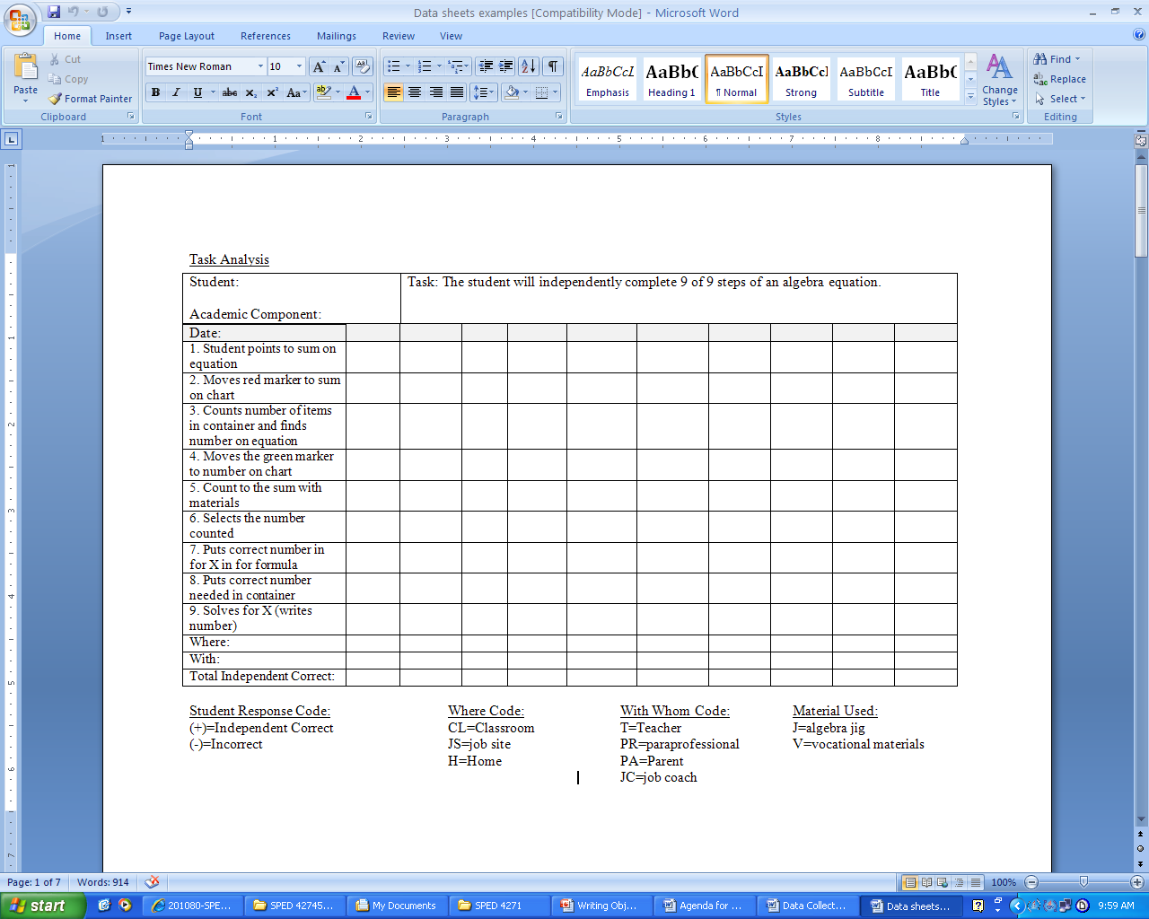
Notes:
This is one example of a data sheet for a task analysis. The task here is for the student to solve an algebraic equation which is a CCSS for middle school students. This teacher has decided to score a + for correct responses or a – for errors. It might be good also to score prompts. What codes might you use for prompts? This teacher is also interested in generalization so will be coding where the skill is performed, with whom, and the materials used.

Slide 14
Repeated Trial:
One of the most common data sheets
The teacher delivers trials in a massed set (e.g., present a sight word, then another word, then another word and so on)
Can be used for academic skills like recognizing math facts, identifying science terms, identifying pictures, reading a schedule
May be useful for some everyday skills
Notes:
A type of data sheet that is useful for a wide range of academic skills is the repeated trial, also called massed trial assessment. This is useful for discrete rather than chained responses. For example, identifying a number is a single, discrete response compared with solving an equation which is a chain of responses. In a repeated trial assessment, you usually put some set of single responses together such as a list of sight words or the numbers under 10 for the student to identify.

Slide 15
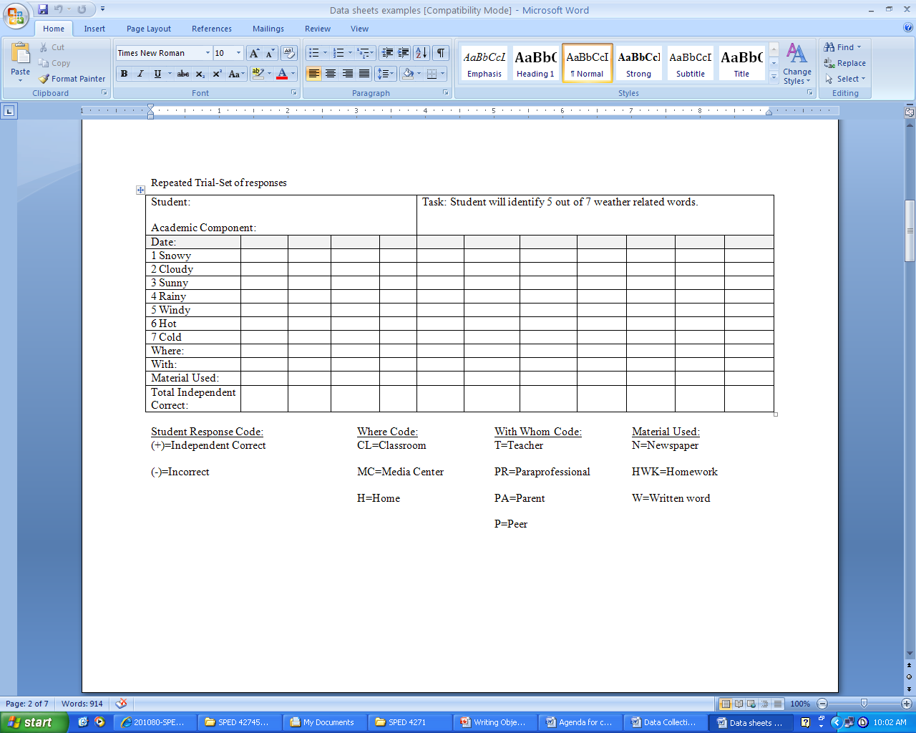
Notes:
Here is an example of a repeated trial assessment. Because these data sheets come from the same teacher, you will see that similar codes are used for scoring. Again, it might be useful also to score the level of prompt. This specific example is one in which the student is learning to read words related to the weather report. The teacher might also assess whether the student can read the words in the context of a report found in the newspaper or on the internet.

Slide 16
Repeated Opportunity:
The skill is taught throughout day when the skill typically occurs (i.e., the trials are spread out or “spaced”)
The student’s responses are charted as they are made (HINT: these data sheets should be on a clipboard and accessible throughout the day)
Examples of skills that a repeated opportunity data sheet may be appropriate for are using following a schedule or telling clock time at start of each lesson
Notes:
Sometimes it does not make sense to present trials to respond in a massed format. Instead, it is better to collect data on the discrete responses as they occur across the school day. The data sheet may look similar to a repeated trials data sheet, but the timing of when data collection occurs differs. The trials are spaced across the day. A helpful hint is to keep the data sheets on a portable clipboard so you can score when the behavior occurs.

Slide 17
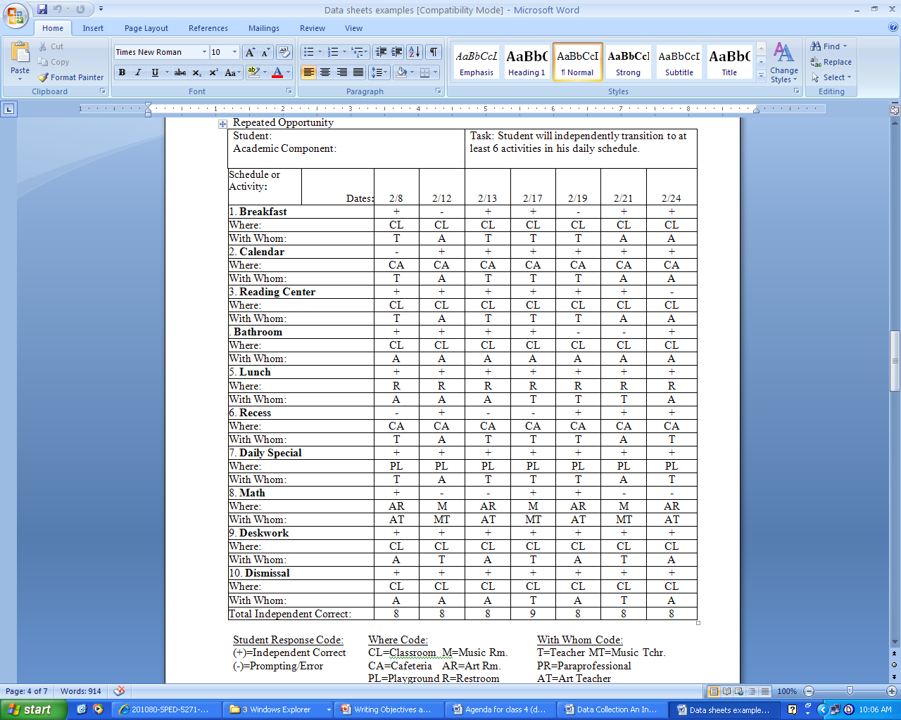
Notes:
Here is an example of a repeated opportunity data sheet. Notice that this one shows data that were collected in February. The teacher recorded whether the student independently transitioned to the next activity, where, and with whom.

Slide 18
Frequency:
Typically used when we want to measure the degree to which there is an increase or decrease in the number of times the student uses a new response or refrains from making an unwanted response
May be measured throughout day (e.g., hand raising instead of calling out) or in one lesson (e.g., activating a communication device to respond)
Notes:
Sometimes a simple frequency count is all that will be needed for the data. Frequency counts work well for keeping track of problem behavior and for a lot of communication skills as well as other behaviors. A data sheet is not really needed for a frequency count. You can collect data on frequency simply by keeping a tally.

Slide 19
Duration:
A skill that is measured in time, specifically, the total amount of time the student engages in task
The purpose of the instruction may be to increase the amount of time (e.g., attending to task) or decrease the amount of time (e.g., length of tantruming behavior). Time can be recorded in seconds or minutes
Examples for when a duration data sheet may be appropriate are when the student is expected to work for 30 consecutive minutes on a vocational task or to indicate the length of time it takes for a student to transition between tasks
Notes:
Sometimes the best way to measure the target behavior is to use time, for example, the duration of the behavior. Duration works well for problem behaviors you want to decrease like tantrums and for behaviors you want to sustain like working on a task. You might use a stopwatch to time the duration of the behavior.

Slide 20
Ongoing Progress Monitoring
Graph the data
Identify the correct decision following decision rules for given examples
Select an appropriate plan for instructional or behavioral change
Notes:
Once you have developed your data sheet for your priority skills and begun to collect data, you need a system for ongoing progress monitoring. Most data-based decision models rely on graphing the data. Then you use some guidelines to review your data and make decisions about changing instruction. While there are many systems for using data-based decisions, I’m going to show you the one developed in research by Diane Browder and colleagues.

Slide 21
Data-Based Decisions
What is a data-based decision?
  Using the data collected to make informed instructional decisions about how to proceed with instruction
Notes:
First, what is a data-based decision? Simply put, it is using your data to make an instructional decision. “Let the data speak.”

Slide 22
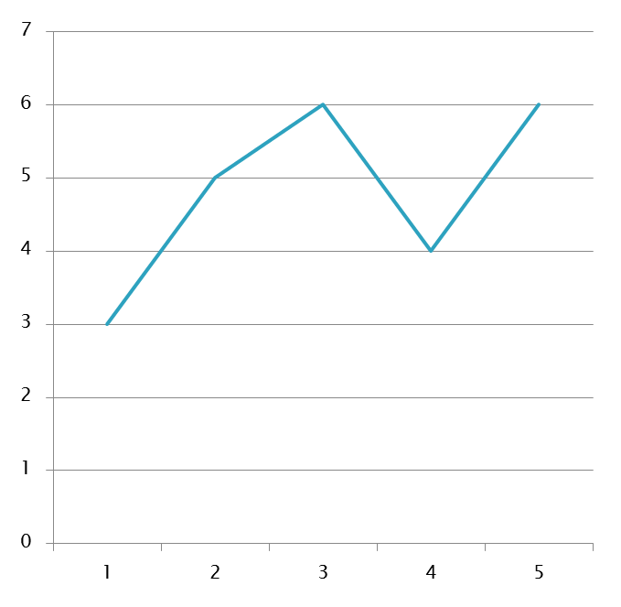
To make data-based decisions, graph data
Why don’t we graph prompted responses?
How many correct on day 4? On day 2?
Count unprompted correct for each session
Put a dot on that number on the graph
Connect dots across sessions
X axis: session
Y axis: number correct
Notes:
Begin by summarizing the data using a simple linear graph. Software programs like Excel can do this for you fairly simply. In this system, you graph independent responses. Why not graph prompted responses? (Wait for answers….because our goal is for the student to be able to do the skill without teacher help).

Slide 23
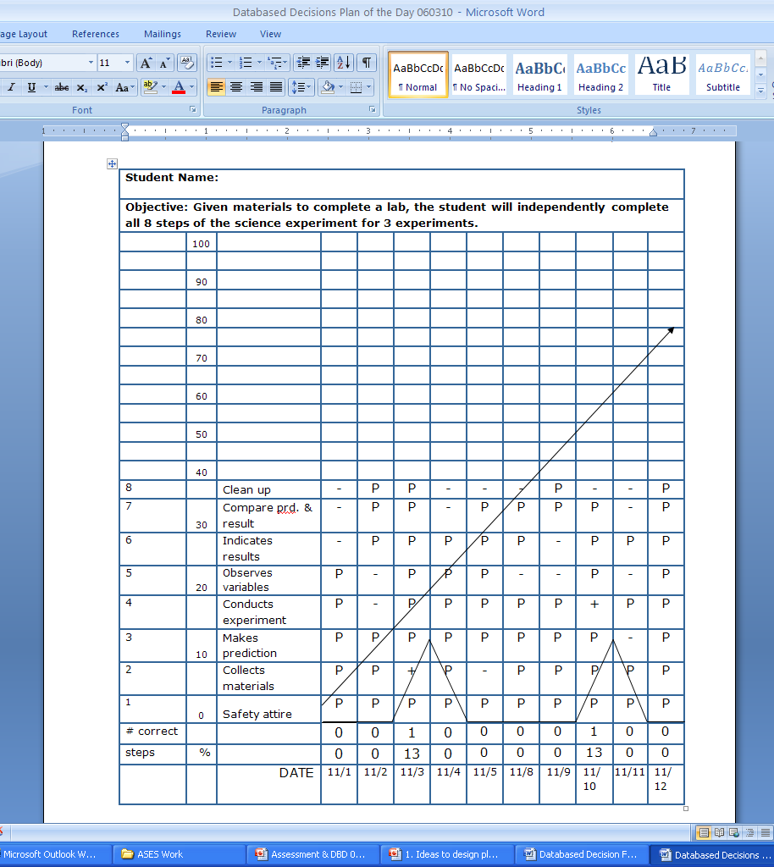
Alternative:
You can superimpose a graph on the data sheet itself.
Advantage: can see prompt levels.
Notes:
Sometimes teachers superimpose their graph on their data sheet like this.

Slide 24
Data-Based Decisions
How much progress is adequate?
  Need to know the criteria of your objective
  Draw an aim line that reflects this criteria
Notes:
Remember at the beginning of this presentation when we discussed who sets the standard for performance. In this case, you do as the teacher. You will decide what you will accept as mastery, which might be 100% for a skill than needs high accuracy. You also need to decide how soon you expect mastery. For example, will you aim for the student reaching mastery by the end of the month? The level of mastery and date forms what we call an Aimstar. For example, my aimstar may be that the student reach 80% of all responses correct by March 1st.

Slide 25
The Aim Line
The aim line, or expected progress during the data collection period, is charted.
Draw aim line from average of first three data points to the number of independent correct listed as mastery in goal statement by the expected completion date (date on IEP) or by the end of the data collection period (2 weeks? 3 weeks? How long instruction lasts)
Notes:
When we begin collecting data we have the student’s starting point of performance. On our graph we also have our aimstar. And aimline shows our expected progress during this data collection period. We create the aim line by using the average of the first three data points as the first data point for our line and the aimstar as the second data point.

Slide 26
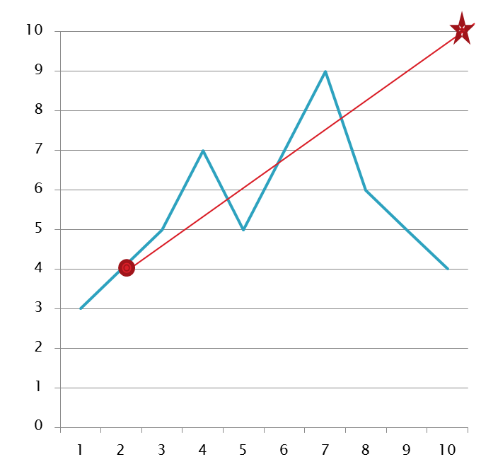
Aim Line with Aim Star
How is progress?
Aim Line
Steps to draw aim line.
1. Set the aimstar
  Aim is 10 correct by end of 10 weeks.
2. Compute 1st 3 data points (baseline)
  Intersection of first three data points is 4.
3. Draw aim line
  Aim line shows rate of progress student needs to make.
Notes:
Here is an example with the steps to draw an aim line. What do you think about this progress? (beginning to regress; not on track).

Slide 27
To determine if progress is adequate
Set aim point
Draw aim line
Draw trend line
Compare aim and trend line
Notes:
Sometimes when there is some bounce in the data like the example I just showed, it can help to draw a trend line and compare this with the aim line.

Slide 28
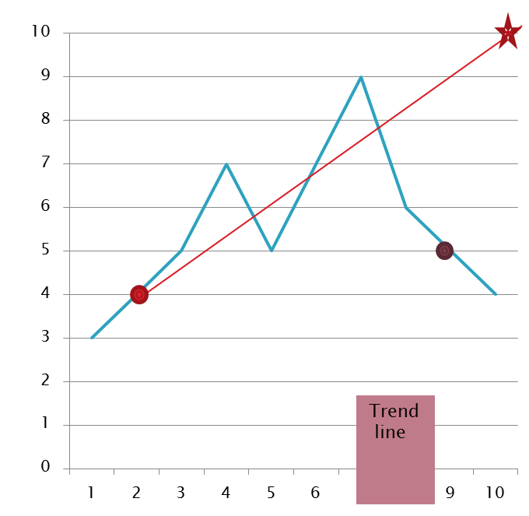
Trend line
Trend will always be up, down, or flat.
What is the trend of these data?
Aim Line
The first point of the trend line is the intersection of the first three data points
The second point of the trend line is the intersection of the last three data points
Connect these points
Notes:
The trend line uses the intersection of the first three data points and the intersection of the last three data points to draw a line. Now with a trend line, we can consider if it is accelerating (going up), decelerating, or flat. How is this data? Yes, there is some acceleration, it’s a little better than where the student started. But the problem is that the trend is well below the aim line isn’t it? So we do need to make some instructional changes.

Slide 29
Data-based Decisions
Trend is either
  Flat
  Accelerating (Going up)
  Decelerating (going down)
Trend line is either
  On or above aim line
  Below aim line
Notes:
When you look at the data, you can see if the trend is flat, going up, or going down and either above or below your aim line.

Slide 30
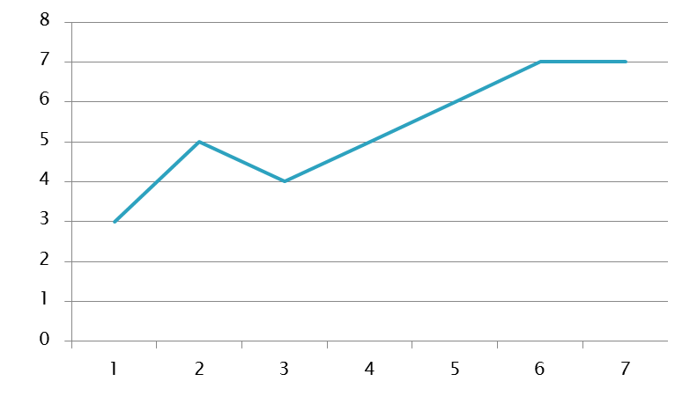
Decision 1: Adequate Progress
Purple: trend; Red: aim
Why not change instruction if adequate?
Trend is accelerating and above aim line
DECISION: Make no changes to instruction
Notes:
Let’s look at some different data patterns and what to do about them. Here’s one of my favorite data patterns. The trend it’s above my aim line. This student has made great progress. I may set another aimstar for next month if I want more than 6/8 correct. For example, we might keep working towards reading the schedule accurately all 8 times. Why would you not change instruction when progress is good? (might confuse student; wastes time better spent on interventions that are not working).

Slide 31
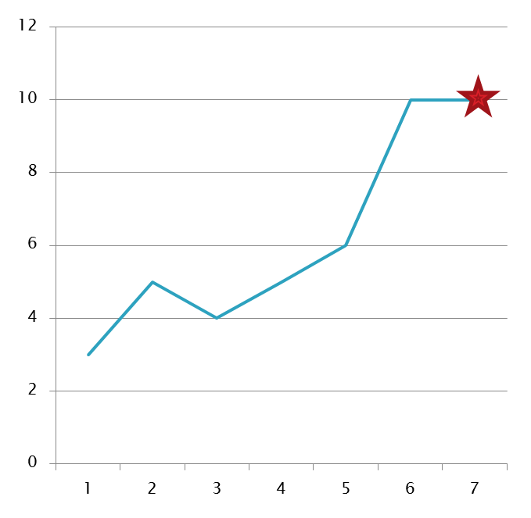
Decision 2: Mastery
Student performance is at criteria
DECISION:
  Work on generalization across materials, settings, people
  AND/OR put on maintenance (each weekly review)
No trend line needed!
Notes:
We don’t even need a trend line for this one because the student has met our mastery criterion which was set as 10/12 correct. It’s time to work on generalization by introducing new teachers, settings, or materials …and to see if the student can maintain the skill without ongoing instruction.

Slide 32
Decision 3: Inadequate Progress
Too slow to reach mastery!!
Trend is accelerating or flat
BUT trend line is below aim line
DECISION 3: Improve instruction to increase independent responding (e.g., fade prompting)
Notes:
Here’s a case where there is some progress, but it’s too slow. Perhaps the end of the school year is coming…or the upcoming alternate assessment. We need to get the student there a bit more quickly. This might include adding some extra teaching trials in daily and working to fade our prompting.

Slide 33
How to Change Instruction
Decision 3: Slow Progress
Use consistent prompt hierarchy
Delay introduction of the prompt
Use a nonspecific prompt
Provide more training trials
Only reinforce independent correct
What are other ideas you might try?
Notes:
Let’s consider a list of options for slow progress. What are other ideas you might try?

Slide 34
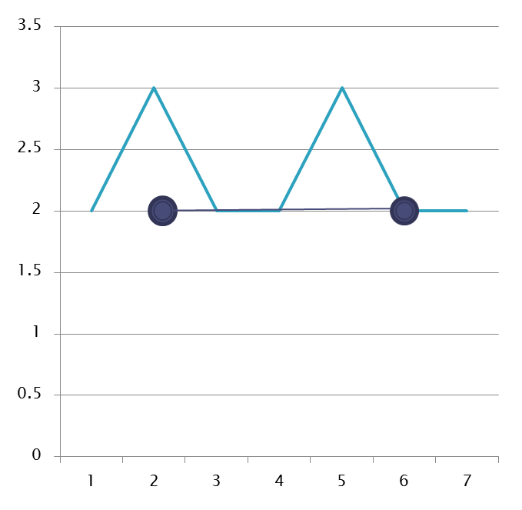
Decision 4: NO Progress
Trend flat
Well below aim line
DECISION 4: Simplify the skill to be learned
  E.g., use chaining; assistive technology
Notes:
This student really has made no progress. There may have been some guessing on the days 3 responses were correct, but most days only 2 are correct. According to my aimline, by this point the student should be getting 4 or more correct if mastery is going to occur by my target date. The skill may be too hard. Perhaps I need to teach a smaller subset of the skill – a smaller list of sight words at a time or part of the chain of behavior.

Slide 35
Decision 4: No Progress
How to Change Instruction
Use chaining-teach a smaller “chunk” of the responses, then add more
Use assistive technology to make student response simpler
Teach a simpler form of the response (e.g., point to options vs. say answer)
What are other ideas you might try?
Notes:
Here are some of the ideas we discussed. What else might you try for no progress?

Slide 36
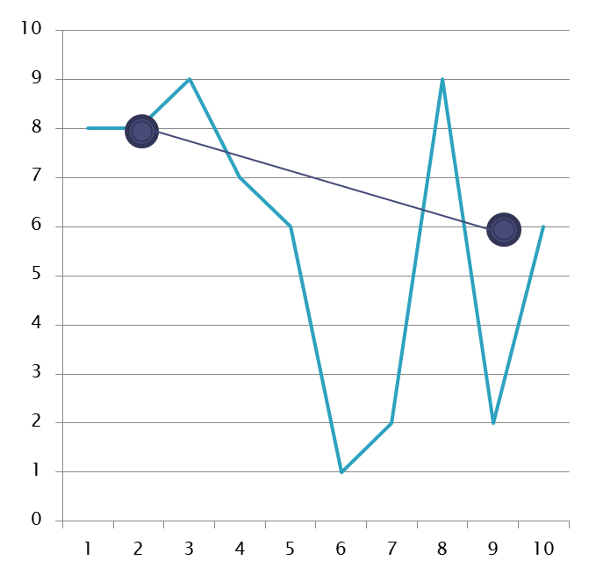
Decision 5: Motivation Problem
Look closely at this last intersection.
Trend is decelerating (going down)
Data are highly variable
DECISION 5: Improve motivation (e.g., vary reinforcers; use new materials)
Notes:
Here’s a student who may have some motivation issues. He did 9 correctly, dropped quickly, then bounced back up. It may be the student is not motivated to do his best from day to day. It may be the task needs to be made more meaningful. Or you might try some novel or high preference materials to improve motivation. Can you think of other reasons why data might look like this?

Slide 37
How to Change Instruction
Decision 5: Motivation Problem
Improve motivation
  Only reinforce their best performance
  Special activity if do skill better than yesterday
  Reinforce independent corrects
  Have student self-monitor performance (e.g., color in bar graph
  Vary reinforcement
  WAIT for best performance
What are other ideas you might try?
Notes:
Here are some ideas for improving motivation. What else might you try?

Slide 38
Do Not Apply Data Based Decisions if . . .
Lack of progress is not related to instruction when:
  Regression across skills
    Discuss medical or behavioral interventions
  Data collection is inconsistent
    Improve data collection
      Criteria not clear enough to instructors
      Increase data collection sessions
    Improve instruction
      Resolve related instructional issues ie attendance
      Increase instructional sessions
      Ensure instruction consistent across instructors
Notes:
In our last example, we gave other reasons why the data may bounce. Here are some reasons that make data-based decisions untenable. Sometimes the student is unstable and all of his or her data are off. Sometimes the data collection or instruction is not consistent. Perhaps there is a new paraprofessional or student teacher implementing the lessons or other classroom challenges have interrupted instruction. In these cases, bounce in the data may not reflect the student’s progress, but other factors.

Slide 39
A few to try
Draw a data sheet, enter the data, graph the aim line and trend line, and come up with a decision about the data.
Juan has been working on identifying vocabulary words during a story-based lesson. His teacher decides if he can identify 3 vocabulary words a lesson for 3 days in a row, Juan will master his goal. His teacher has collected data for 10 days. Juan identified 1 vocabulary word on days 1, 3, 4, and 6. He identified 2 vocabulary words on days 2, 5, and 9. He identified 3 vocabulary words on days 7, 8, and 10.
Notes:
(Have students draw this by hand. Note that the trend is accelerating so there has been progress and some days at 3 correct, but not for 3 in a row. Teacher might decide this progress is adequate and keep working on this skill to get to 3 consecutive days or add new vocabulary. Let participants consider what they would do since there is not clear answer without knowing the real student).

Slide 40
Another example - data sheet, graph, draw aim and trend line, make decision
Betsy is working on her accuracy for her multiplication facts. Her teacher presented her with 10 unknown facts each day (the facts can change each day- the teacher shuffles a series of flashcards that Betsy got incorrect on her pretest and the first 10 were the ones used for data collection). Her teacher expected Betsy to get all 10 facts correct by the time she checks her data in two weeks time. Betsy got 0 facts correct on day 3; 1 fact correct on days 1, 2, 4, and 5; 2 facts correct on days 6, 7, 8 and 9; and 3 facts correct on day 10.
Notes:
(Have students draw this by hand. Here is how it appears. Note that in this example, progress is much too slow. Discuss how to improve the rate of progress.)

Slide 41
Summary
When will you use skills assessment vs. daily data sheets?
What are some options for graphing data?
What is an example of a data pattern that requires an instructional change?
Notes:
In this presentation, we have considered ways to monitor student progress. We began by discussing alternate assessments and how to get students ready to take AA. We have looked at two types of assessment skills assessments and daily data sheets. When will you use each of these? (pause for discussion). What did you think of the graphs I shared? How would you modify them? (Pause for answers). What is an example of a data pattern that requires an instructional change? (wait for answer)

